Slide 1

The National HE STEM Programme
Enabling the HE sector to engage with schools, enhance curricula, support graduates and develop the workforce

Slide 2
The HE STEM
South West Spoke
Widening Participation
Higher Education Curriculum
Workforce Development

Slide 3

Get STEM working: innovation with employer and student engagement
Project Lead: Bournemouth University

Slide 4




Six Sub-Projects
University of Bath
University of Bristol
Bournemouth University
University of Exeter
Plymouth University
University of the West of
England

Slide 5
Meta Project Aims:
Innovative Approaches to Employer Engagement :
Transferability of Practice
Employer Engagement Effective Practice

Slide 6
Technology enabled engagement between employer and student
to improve employability
Year 2 BSc Forensic Science students undertaking the Instrumentation and Analytical Science practical course
Employers from analytical and forensic science sectors

Slide 7
Rationale (i):
Student experience
  -- Presentation skills
  -- Technology familiarisation
Learning opportunity
  -- Professional feedback
Employer contact

Slide 8
Rationale (ii):
To use the two best available conferencing technologies to facilitate communication
10 minute presentation (PowerPoint) + 10 minute feedback
Remaining IAS students required to complete short assessment on recordings of feedback

Slide 9
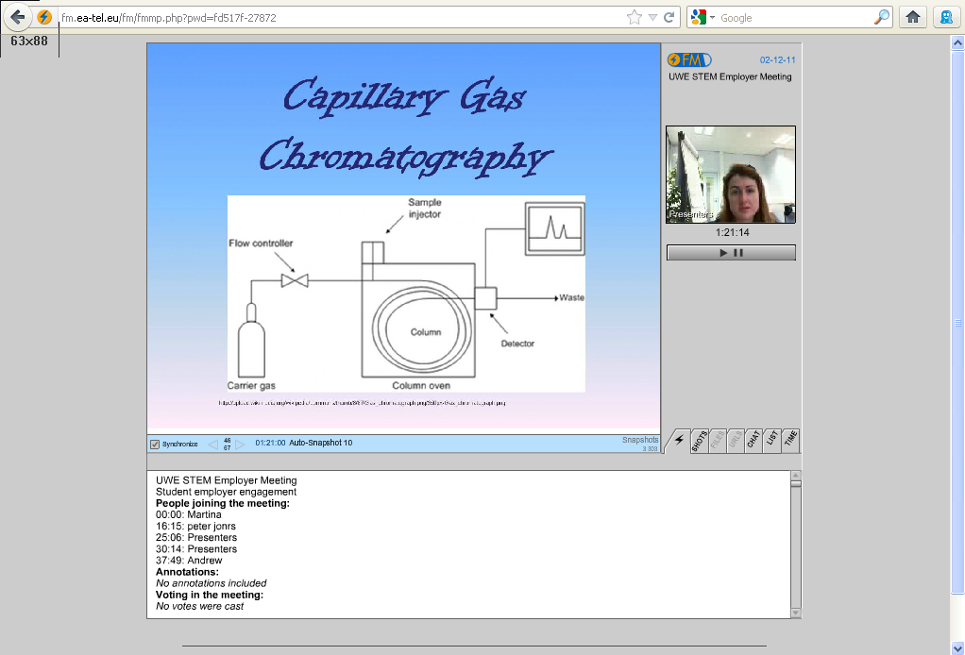
Technology 1: Online Meeting
FlashMeeting online meeting technology

Slide 10
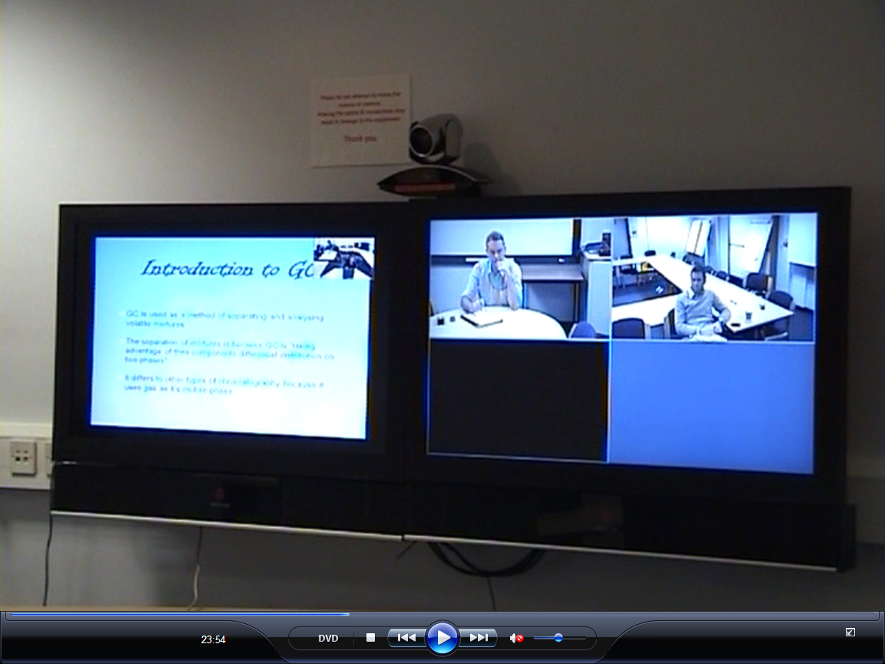
Technology 2:Videoconferencing
Professional Polycom Videoconferencing (VCON) system

Slide 11
Results (i): Presenting Students
Held a positive view of initiative:
Experience – presentation skills
Experience – technology
Experience – communication with experts
Confirmation of quality of their learning by experts
  -- Confidence building
  -- Affirmed relevance of skills for their intended career path

Slide 12
Results (ii): Non-participating students
Held negative view of initiative:
Additional assessment
Outside of comfort zone!
Perceived potential reduction in grades
  In fact, average grade was identical for both practical write-up and presentation-based assessment = 64%

Slide 13
Results (iii): Employer Reaction
An early indication of potential employees? Demonstrate potential strengths in:
-- Communication skills
-- Interest in the subject
-- High academic standard

Slide 14
Employer Reaction (ii)
Awareness and recognition of skills acquired by students
Potential collaboration opportunities with individual students?
Process initiated employer interest in course content and student learning
Potential benefit to ALL students on the BSc Forensic Science course

Slide 15
Thank you

