Slide 1
CRM System
Dr Ross Kay
Weymouth College

Slide 2
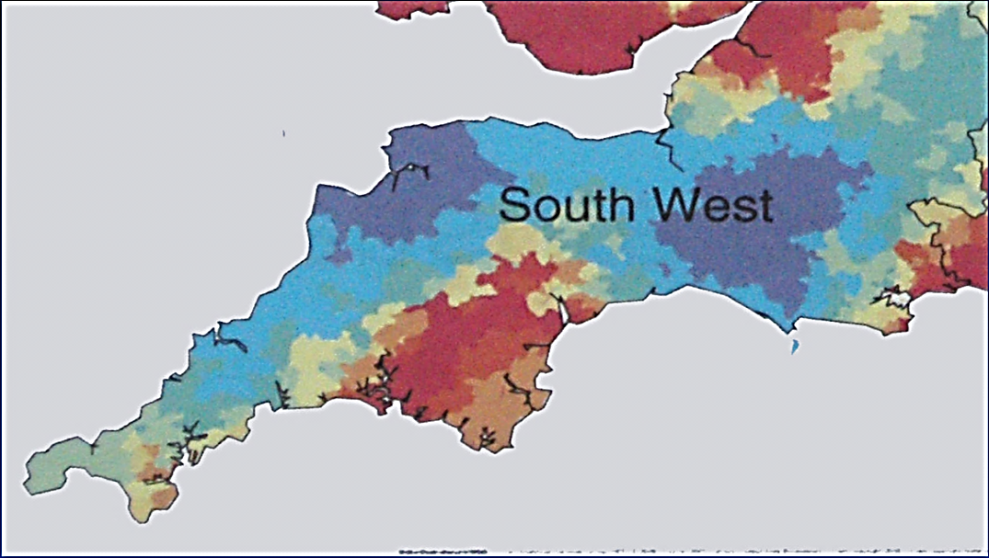
Context and Rationale
Weymouth

Slide 3
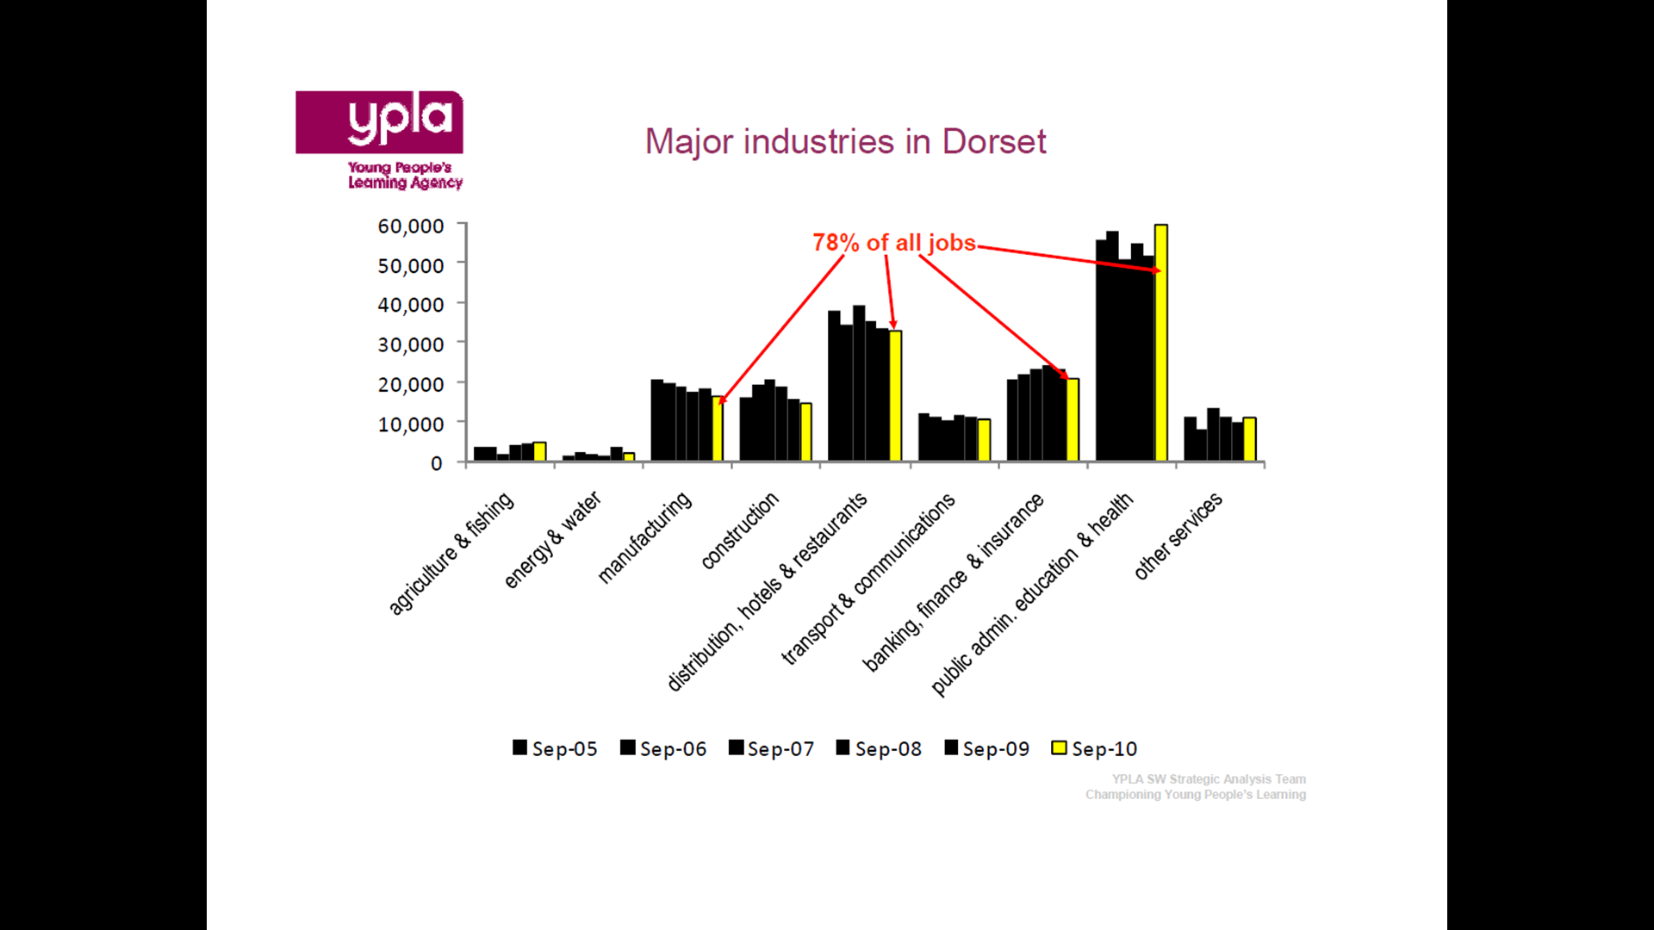
Employment

Slide 4
Opportunity
500 employers engaged annually
Retiring population in ex-MOD organisations and spin-offs
Higher Apprenticeships?
Existing longstanding relationships between the College and HEIs
HE STEM Project!

Slide 5
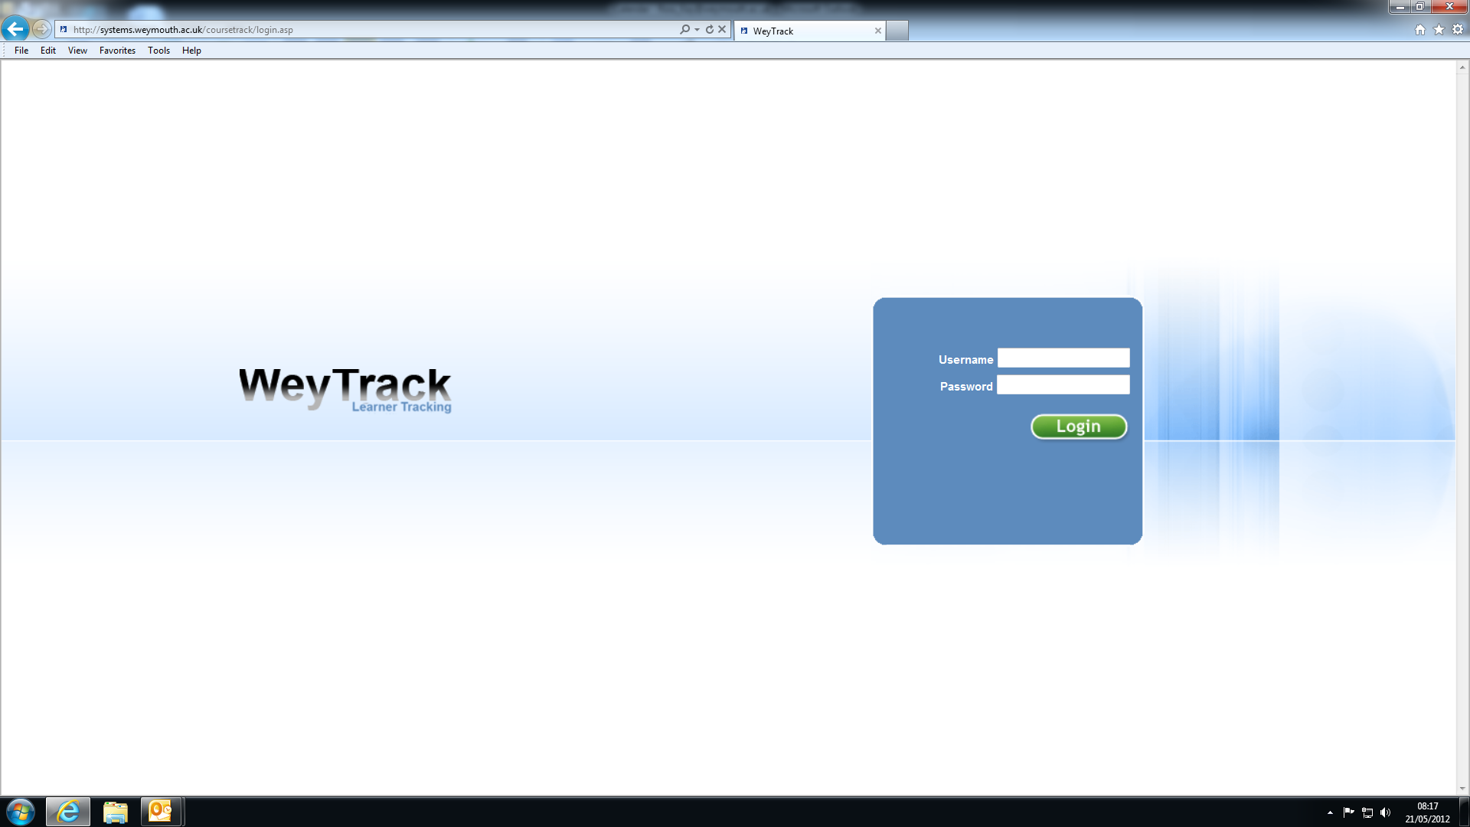

Slide 6
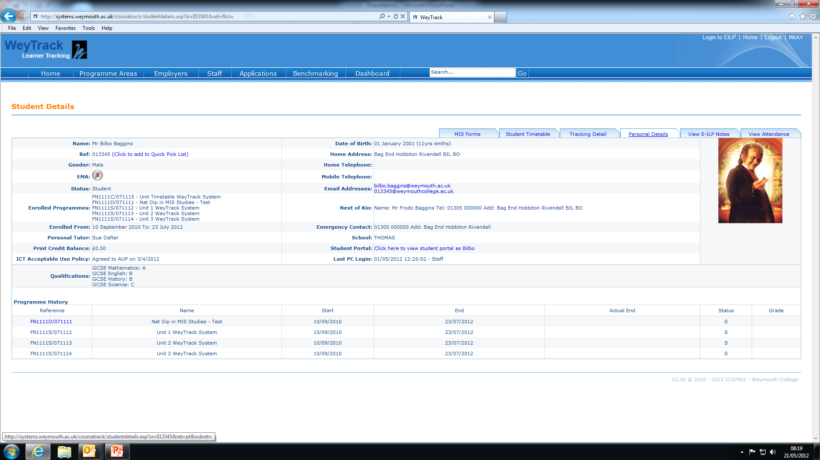

Slide 7
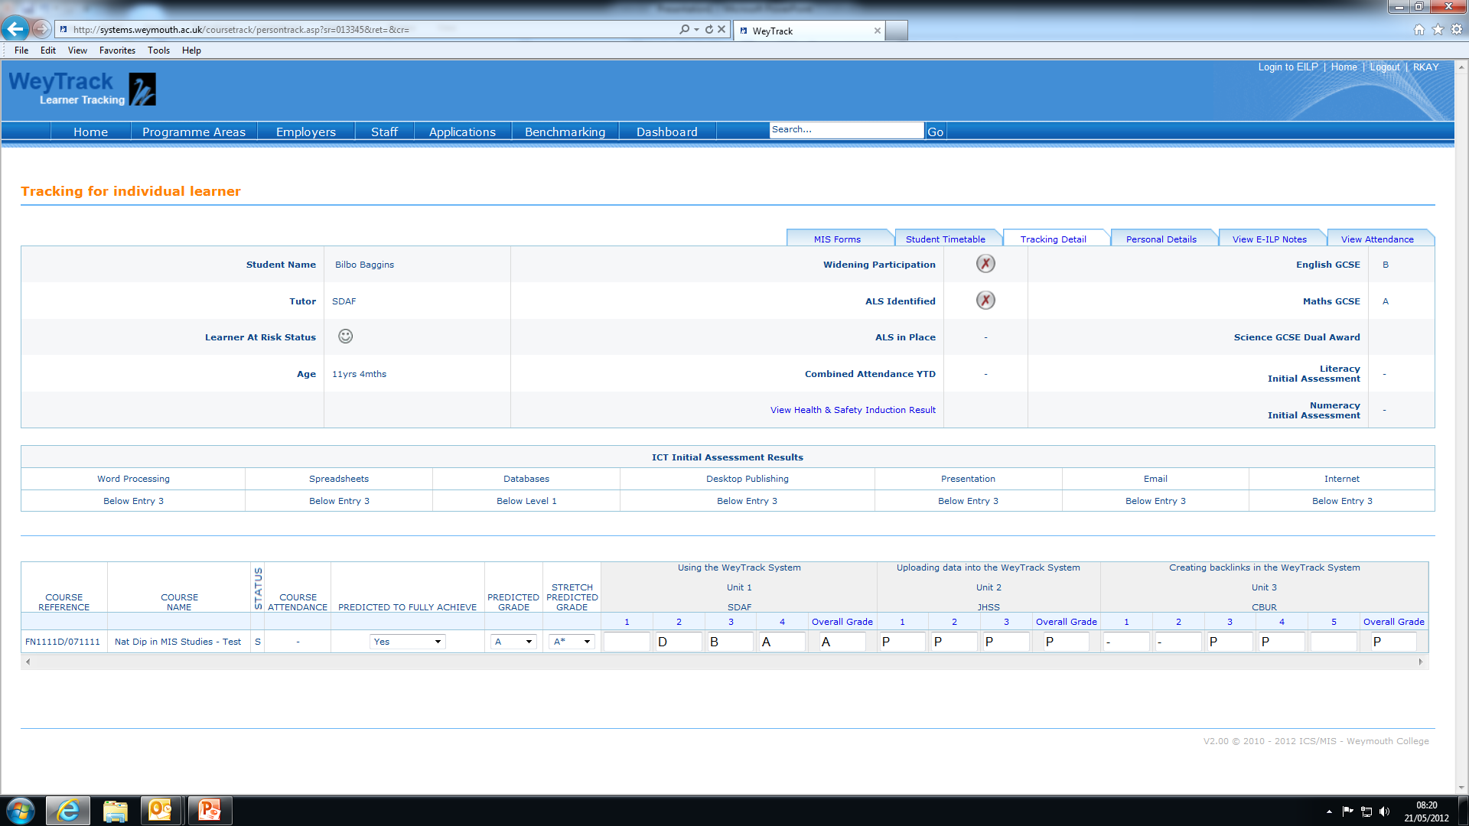

Slide 8
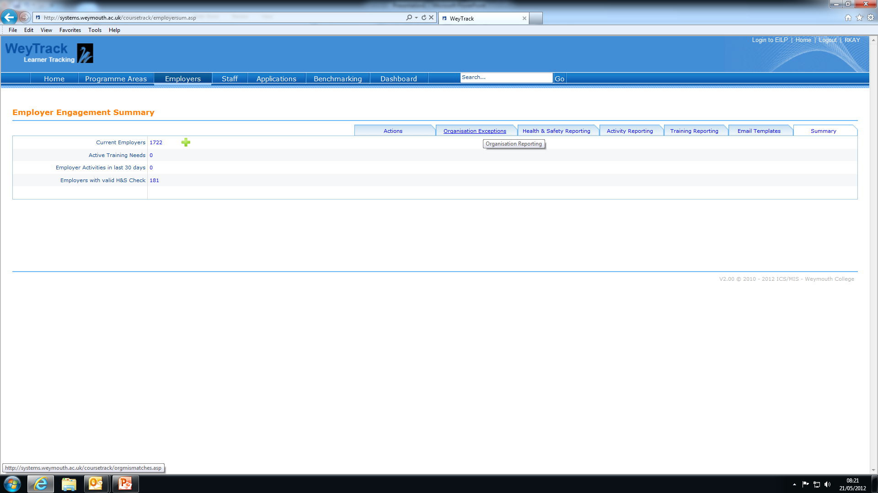

Slide 9
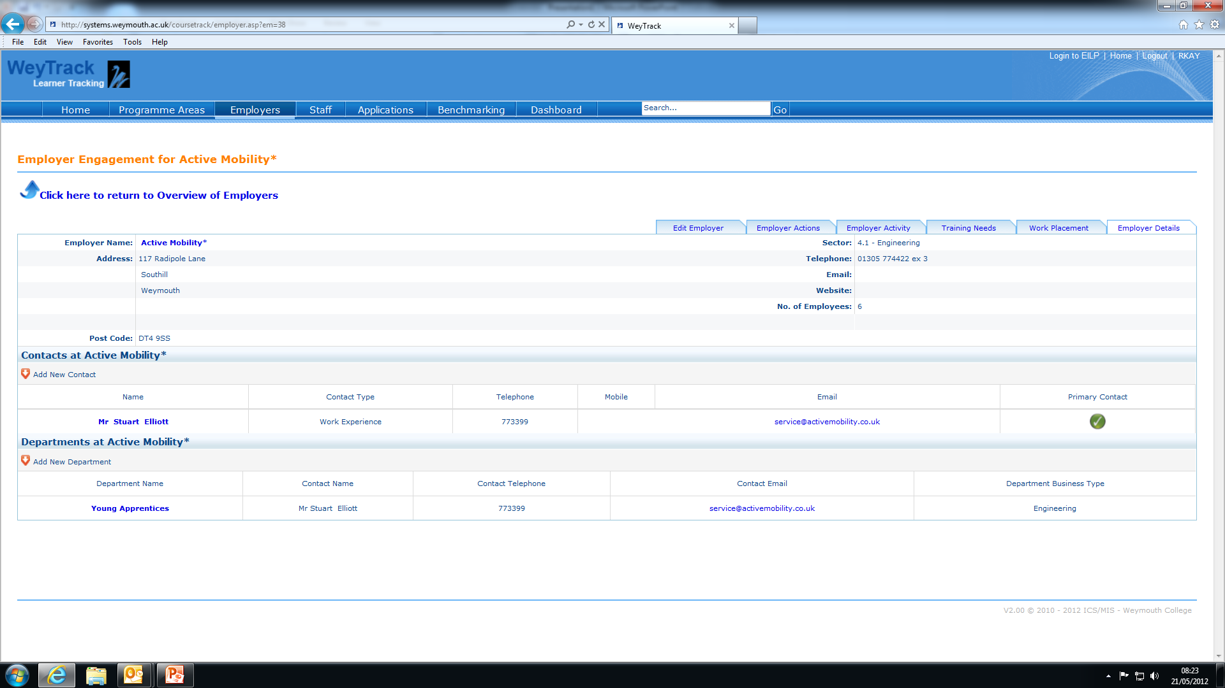

Slide 10
List of Outputs:
A learner and CRM integrated system for the management of interactions with SMEs
Labour Market Intelligence concerning (LMI) the main barriers to engagement with HE in semi-rural locations, geographically isolated from HEIs
New proposals for HE delivery to meet the needs of local Engineering SMEs including content and delivery methodology

Slide 11
Outcomes
The study involved interviews with 30 companies and 13 in depth reviews
A CRM system has been developed
The information gathered has allowed:
  Investment in capital
  Design of curricula
  Recruitment of students

