Slide 1
Physics Outreach Workshop
Caitlin Watson
Head of Public Engagement, Institute of Physics
Outreach & Widening Participation in Practice
2 November 2011
caitlin.watson@iop.org, www.iop.org
Notes:
Notes for first body slide

Slide 2
Outline
IOP activity
  Image of physics and gender awareness
Participants’ Post-its
  What do you think about…?
60 second soap box
  Opportunity to tell everyone about your ‘thing’

Slide 3
Image of Physics
Semiotics research
  What are people’s existing perceptions of physics?
  What deeper symbolism underpins these images?
  What can we take away from this to make physics intriguing and attractive to students?
Notes:
Done in 2007

Slide 4
Symbolism of Physics
A triumph of enlightenment
Reverence
Makes us see the world anew
Order/Chaos
‘Theory of everything’
Pure intelligence
Mystery and mastery
Infinite progress

Slide 5
Physics in Popular Culture
Mad scientist
Cold, calculating, contemptuous
Not athletic / not sexy / not hip
Rogue hero
  Geek chic, outsider, mythbuster
Power with responsibility
Entrepreneurial / free

Slide 6
Branding Physics
Don’t pretend it’s easy – intellectual rigour
Differentiate the world of physics from other study
Offers challenge and intrigue
Creative energy
  Imagination, radical, courageous, future
The everyday and the infinite; big and small
Universe is a strange place
Mind expansion

Slide 7
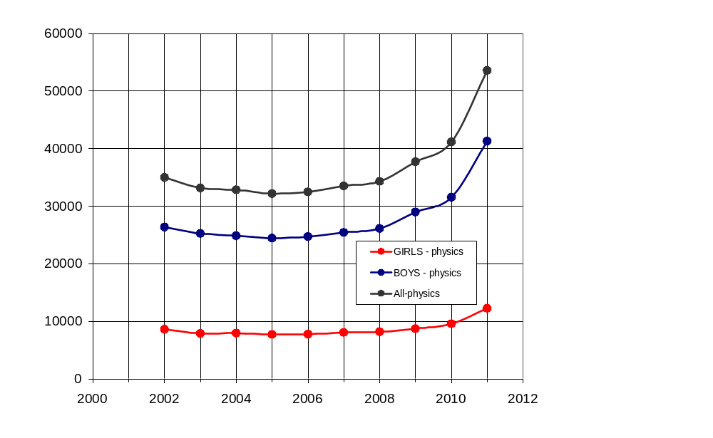
Gender awareness
Post-16: only 22% of girls choose physics
Physics has a highly gendered image
Messages may need to be more nuanced for girls
AS Physics entries 2002-11

Slide 8
Top five items boys and girls would like to learn about in science (English ROSE data)
Boys
Girls
Explosive chemicals
How it feels to be weightless in space
How the atom bomb works
Biological and chemical weapons
Black holes, supernovae and other spectacular objects
Why we dream and what the dreams may mean
Cancer – what we know and how to treat it
How to perform basic first aid
How to exercise to keep fit and strong
STIs and how to protect against them

Slide 9
Managing Groups
Think about whether single sex or mixed groups are most appropriate for the activity
Assign roles to people and change during the activity if possible
Think about whether groups take account of ability or are deliberately mixed ability
Think about group size – does it allow for all to actively engage?

Slide 10
Role model guidelines
Ensure role models have adequate prior info
Allow students to interview them
Encourage role models to personalise experiences and be open to questions related to having a family
Discuss the nature and purpose of scientific research as well as details
Don’t over-simplify
Use accessible language, images, examples and analogies

Slide 11
Girls continue post-16 when…
Activities are managed to ensure active participation by all
Focus is on learning is ideas rather than unconnected facts
Students understand the contribution physics makes to society and their lives
Expectation that anyone can do physics

Slide 12
Engaging with Girls Action Pack
Increasing the participation of girls in physics - an action pack for teachers
  Action research booklet
  Resources sheets
  Learning activity sheets
www.iop.org/education/teacher/support/girls_physics/page_41593.html

Slide 13





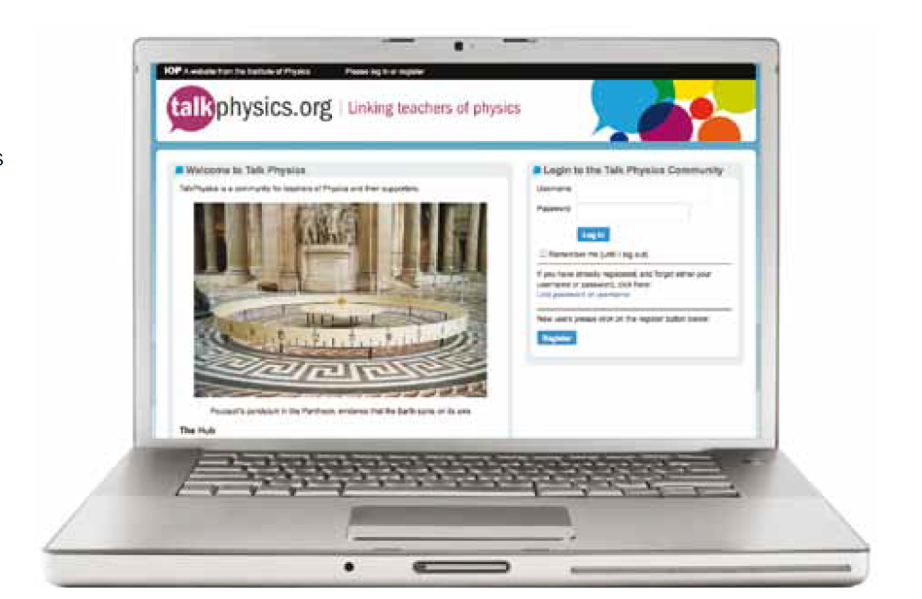
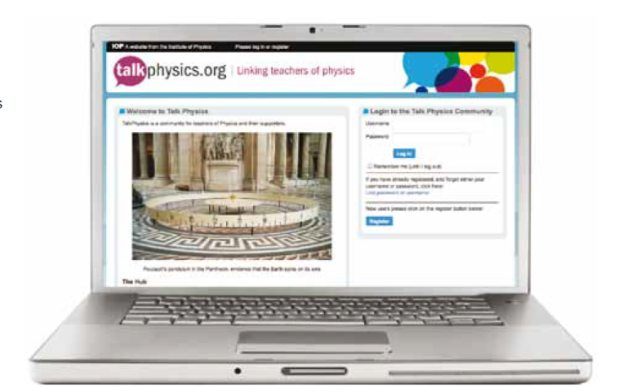
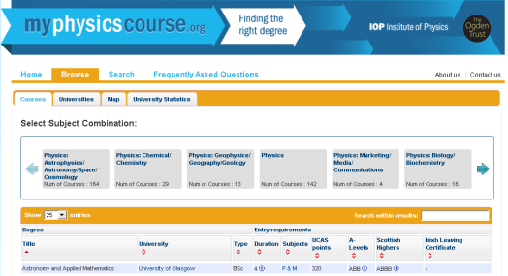
IOP careers materials
physics.org/careers
myphysicscourse.org

Slide 14
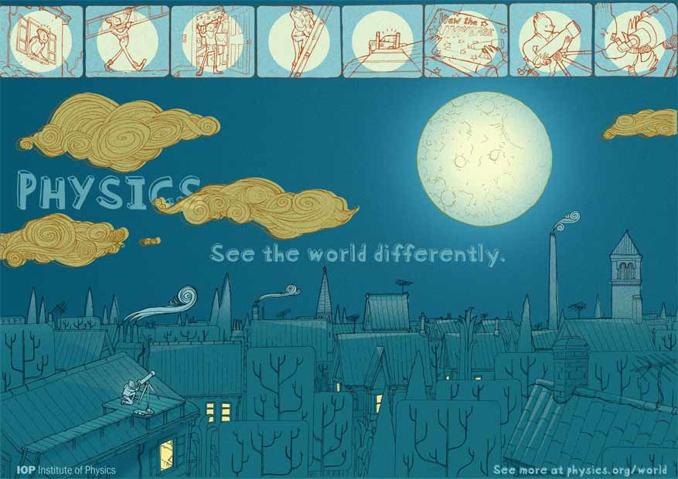

Further resources
Ashfield Music Festival
Physics in the Field
Lab in a Lorry
Posters
SOS Network
www.iop.org/education
www.iop.org/activity/outreach

Slide 15
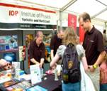
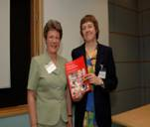

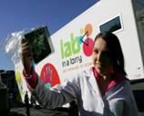

For physics ● For physicists ● For all

Slide 16
Participant Post-its
One idea/thought per Post-it note:
  Good examples you know/want to copy
  Bad examples of things to avoid
  What do you wish you knew?
  What barriers do you face?

Slide 17
Participant Post-its
One idea/thought per Post-it note
  Good examples you know/want to copy
    Extract bits to copy
  Bad examples of things to avoid
    Extract bits to learn from
  What do you wish you knew?
    Extract answers from the group
  What barriers do you face?
    Extract solutions from the group

Slide 18
For physics ● For physicists ● For all

Slide 19
60 second soapbox
What do you want to tell us all about?
  Promote an activity / resource
  Ask for / offer help
  Pose a question
  Make a suggestion

Slide 20
For physics ● For physicists ● For all

