Slide 1
Community-based learning in engineering
Kate Miller, Centre for Public Engagement
University of Bristol

Slide 2
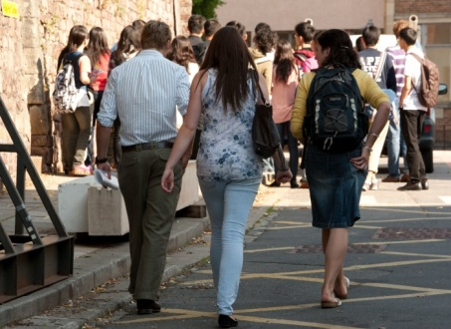
Overview of projects
3rd year research projects and 4th year design projects
Undergraduates interns scoped potential community placements
  Contacting and liaising with community partners
  Co-designing feasible projects
  Recruiting academic supervisors

Slide 3
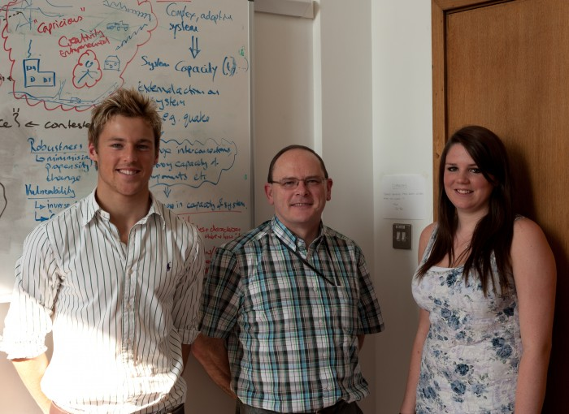
Why use interns?
Technical knowledge of engineering problems
Knowledge of civil engineering undergraduate course
Potential to inspire their peers

Slide 4

Outcomes
11 projects scoped with 8 community partners
9 projects obtained academic supervisors
6 projects (17 students) took part
Projects currently being assessed

Slide 5
Impact on employability
Transferable skills
  Communication
  Project management
Team and partnership working
Consideration of people’s needs

Slide 6
Impact on employability
Solving real-life problems
Provides transition between learning and work
Unique experience

