Slide 1
Introduction to the dissemination “Continuum Model”
Chris Keenan – Bournemouth University
Chris Evans - Marchmont

Slide 2
Dissemination of project work
Wide variety of projects being undertaken in the South West Region
Some have a specific focus (eg curriculum area, enterprise, sustainability)
All have similar dissemination aims: events, brochures, toolkits
Research for BU project indicated employers
Had information fatigue (too many phone contacts from one HE department)
Or, lack of information (could not find their way through the communication channels)
Preferred human contact to brochures, fliers
Lacked an awareness of the benefits that engagement with undergraduate curriculum activities could bring to them, and felt that the HE structures were unwieldy and unsupportive to them
The BU team met with the Marchmont team to discuss how we could maximise dissemination
It was felt that it would be counter-productive and weaken communication if all projects distributed toolkits and other outputs across all employers in the region
The idea of the continuum model began as a place where all project outputs could reside

Slide 3
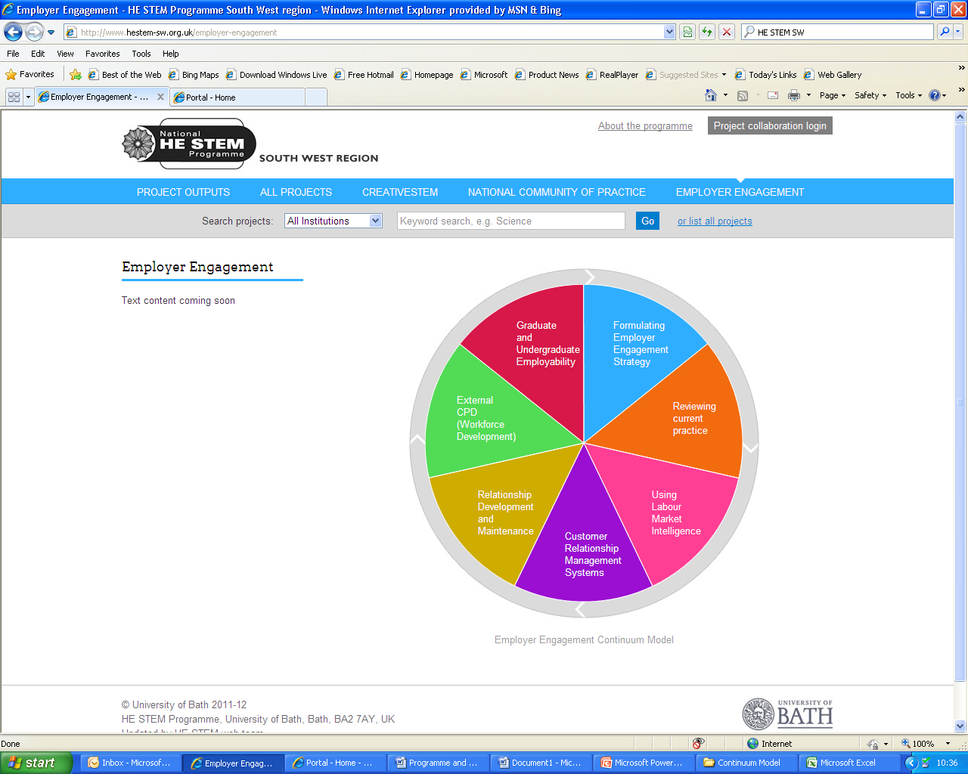
Model

Slide 4
Rationale for continuum model
We conducted a mapping exercise of all SW employer engagement projects
Themes emerged:
Formulating strategy for employer engagement
HEI Self audit of employer engagement
Using Labour Market Intelligence
Customer Relationship Management Systems
Relationship Building
Employee CPD (Workforce Development)
Undergraduate employability

Slide 5
Rationale for continuum model
All project outputs could be disseminated through one point of access – each segment is click through to projects
Some projects may reside in more than one segment
Clickable segments provide context and variety
For example, different approaches, different toolkits, offering ideas for similar problems
You will see that today’s programme follows the structure of the continuum model
HEI can dip in and out of segments – in the same way today we have presentations representing most of the themes

Slide 6
Testing idea of the model
We approached all the project leads to ensure they would be happy to buy into this concept as a one stop access point
We used the model’s titles as discussion areas in our research focus groups at BU
Useful in identifying strengths and also areas that may need development
We also ensured that we would have institutional buy-in to the concept

Slide 7
Over to you
We are confident that the continuum model will provide HEIs with a useful structure which will improve and enhance their interactions with employers
What do you think?
-

