Slide 1
Our Experience of
Graduates
Damien Clancy
Managing Director
Rusal Aughinish Alumina

Slide 2
Table of Contents
Introduction to Aughinish
The Challenge
How we meet the Challenge
Our “take” on the UL Graduate Attributes
What stops a graduate from being hired?
The Ideal

Slide 3
Introduction to Aughinish

Slide 4
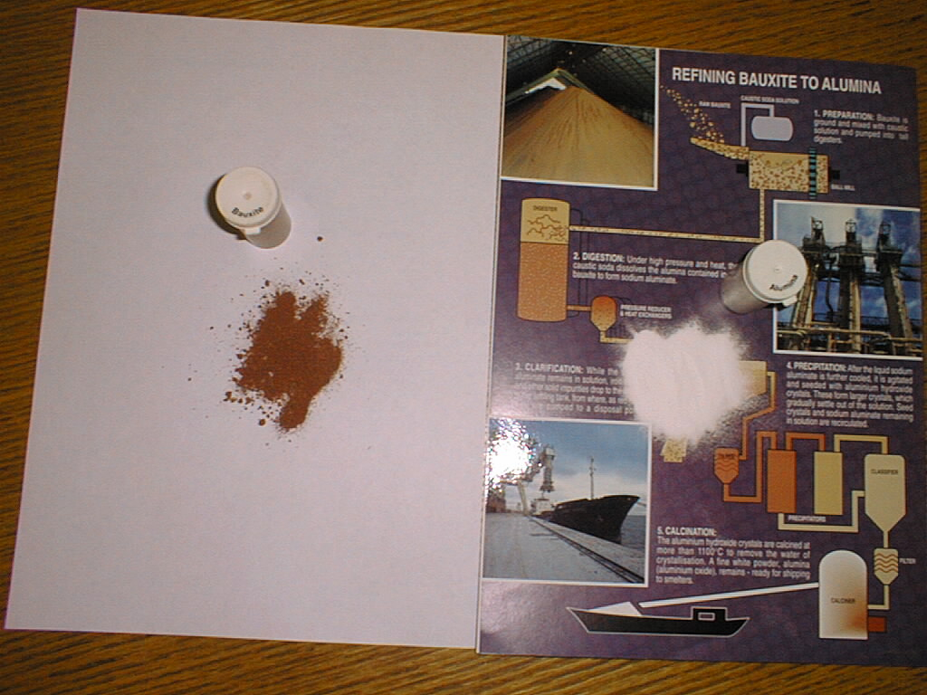
Bauxite to Alumina
Bauxite Rock from West Africa and South America
Alumina
Notes:
A One product company, we refinery bauxite ore to alumina powder.

Slide 5
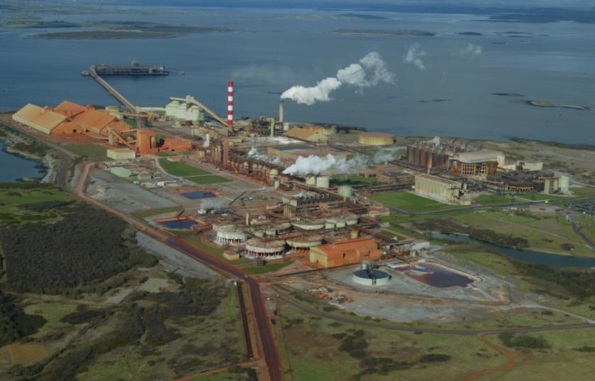
Aerial View

Slide 6
Importance to the Region
€40.0 million in Aughinish salaries alone
€55.0 million in Materials and Services in Ireland
€20.0 million Capital Investment 2011
€ 3.3 million in rates to Limerick County Council

Slide 7
Impact on the Region
450 Aughinish Employees
250 Full-time Service Contractors
50 Ancillary Services:
  Canteen
  Cleaning Services
  Landscaping
Over 700 jobs on-site
  Over half of these have third-level qualifications in a variety of disciplines

Slide 8
The Challenge - Communication

Slide 9
Organisation Design
Values and Principles
  Performance, Accountability, Recognition, Integrity, Trust
Flat organisation
  Self Directed
  50 “self managed teams” (5-8 members)
  Teamwork based
  Reduced supervision
  Accountable autonomy
  Increased engagement
Business Management Systems
Continuous Improvement Focus
Management Team
Facilitators/
Co-ordinators
Work Teams
Work Teams

Slide 10
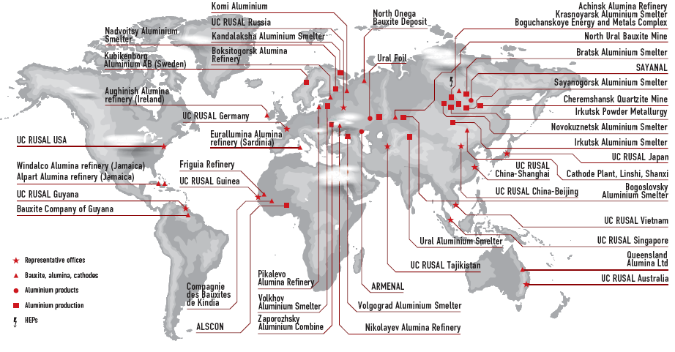
UС RUSAL: Moscow centered

Slide 11
Fifth Owner
 | 1983 | 1985 | 1995 | 1999 | 2007
Anaconda | 25%
Billiton | 35% | 35%
Alcan | 40% | 65% | 100%
Glencore |  |  |  | 100%
United Company RUSAL |  |  |  |  | 100%

Slide 12
Communication assumptions
Culture model
Cultural compatibility
Bridging cultural gap
“They” can be Owners, Government Bodies etc
Basic assumptions
Norms and Values
Artifacts and products

Slide 13
How We Meet the
Challenge

Slide 14
Educational Requirements
Ever increasing number of roles requiring Degree and above
    Mechanical Engineers
    Chemical Engineers
    R&D Engineers
    Electrical and Instrumentation Engineers
    Control Systems Engineers
    Industrial Chemists
    Administration
    Increasingly – operator positions are becoming gateway positions

Slide 15
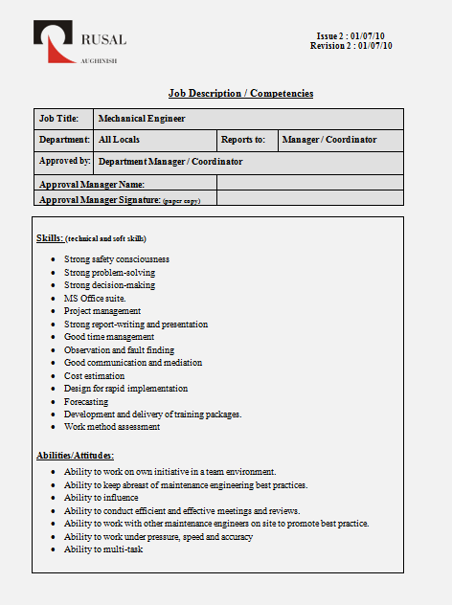
Graduate Key Skills and Abilities
Strong report writing and presentation
Good communication and mediation
Ability to listen
Development and delivery of training packages
Ability to work on own initiative in a team environment
Ability to influence
Ability to conduct efficient and effective meetings and reviews
Ability to work under pressure, speed and accuracy
Ability to multi-task

Slide 16
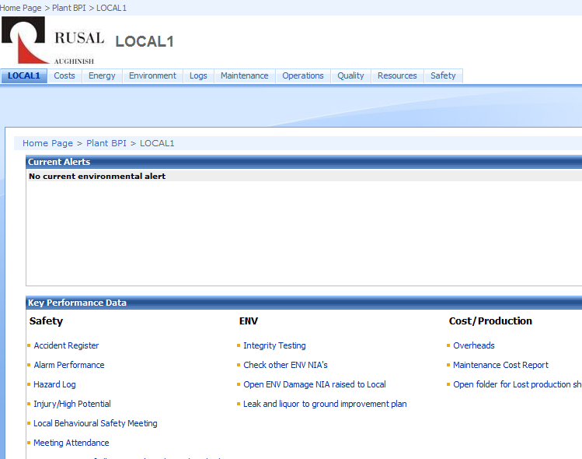
Information Reliant
Day to day working
Requires succinct approach
Accuracy
Good use of text
Grammar
Spelling
  Not text-speak

Slide 17
A Taste Of The Issues
Report writing – no student writes reports….same ones in circulation since I was in College
Difficulty understanding that “not a graduate” does not mean “not an expert”
Need to understand that “Wikipedia” is not always right!
Dependency on twitter/texting language… cul8r
The reality of work
“I don’t like all this paperwork”
“Why do I have to explain what I’m doing”
“Why do I have to go to all these meetings”
“I’m an engineer – I don’t have to be good at grammar”
Notes:
Cui8r = see you later

Slide 18
General Writing Skills
A review of “Requests For Appropriation” of funds (Capital Spend) over the past year has identified the following top 5 list of poor writing skills
  Use of jargon/technical words
  Poor spelling
  Poor grammar
  No key message/poor awareness of target audience
  Not following guidelines

Slide 19
Why clear and concise matters…
It must justify WHY we have to spend money NOW.
It has to make sense to:
  the originator/sponsor
  the people operating the equipment (is it what they want?)
  the manager - that it fits the business priorities
  the financiers/purse string holders - that it stacks up against the many other demands
The approver
  may be in another country
  have a different first language
  have a different academic background

Slide 20
Use of Jargon / Technical Terms
We need Engineers to assume the reader:
  has only a limited knowledge of the project
  does not know the Aughinish plant
  knows little of the process in the plant
  is not an engineer
Problem:
  High usage of technical terms and plant specific terminology without adequate referencing
Examples:
  HFO : Heavy Fuel Oil
  EPA : Environmental Protection Agency

Slide 21
Spelling
Common misspelling/misuse of words, particularly similar-sounding words e.g.
  effects/affects
  It’s (It is) / Its (belongs to..)
  Their)/They’re (they are)/There (that place)
  Been/being
Over-reliance on spell checker
  ‘Their coming too see if its reel’ …will pass spell check

Slide 22
Precision
Instead of…
:
Use…
Soon
As soon as possible
A daily output of 750 per day
Correspondence
Illustration
Communication
Tomorrow/ next week
Before Friday 13th
a daily output of 750.
E-mail,
Graph
Report, telephone call
At all times – think of the Reader

Slide 23
However..
Poor writing and communication skills will limit your career “outside” Aughinish
Poor writing and communication skills may limit your career “inside” Aughinish….
but they are unlikely to get you fired.

Slide 24
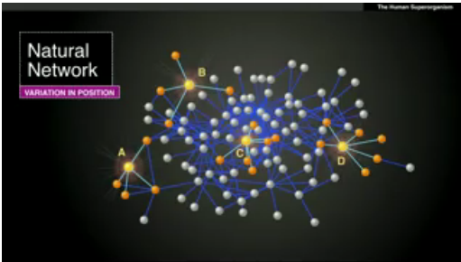
Where do you fit in in the social network in your organisation?
Nicholas Christakis: The hidden influence of social networks. TED May 2010
Notes:
C & D have the same number of people in their social networks….but….C’s connections are connected to everyone else. C knows what’s happening everywhere in his organisation.
D’s connections have few connections within the network/organisation. They are of no value to him within the Organisation.
If you are the person on the periphery (D or beyond) you are not involved in the organisation.
http://www.ted.com/talks/lang/en/nicholas_christakis_the_hidden_influence_of_social_networks.html

Slide 25

Ability to interact and fit-in is crucial
This person will not have a future in the organisation.
It’s down to poor social skills
How can the University assist this individual during his undergraduate studies?

Slide 26
Communicating with others
Because of the Plant size
  E-mail is the preferred tool
  Intranet based logs/forms
  Standardised reports
Far too easy for a graduate to fall into the trap of only using IT-based communication
Danger
  No real personal relationships with others
  No ability to influence on key issues – face-to-face discussion
  Missing out on those who don’t use IT

Slide 27
Our “take” on the UL Graduate Attributes
Responsible
Articulate
Proactive
Creative
Collaborative
Knowledgeable

Slide 28
Responsible
In our organisation – responsibility comes quickly
  No supervisors – we facilitate
Reliance on good engineering standards
  No “police”
  No bureaucracy
  High on accountability
  High on Knowledge Management
Engineers need to be self-driven, honest, personally accountable

Slide 29
Articulate
Decision makers are not their peers - dealing with others is key:
  “Outside” agencies -- Operators
  Managers -- Craftspeople
Information Technology
  Over-dependence on IT-based communication
Inability to tailor the message to suit the audience
Lack of face-to-face people skills
  Insufficent collaboration and meeting practice

Slide 30
Proactive
Graduate programmes no longer include a map to “where you will be in 10 years time”
Organisational horizons are much shorter
To ensure employability graduates must:
  be self-driven
  have a thirst for knowledge
  have a commitment to their employability growth
  understand the benefits of horizontal career moves
  seek learning wherever they can
  recognise that learning is a life-long pursuit

Slide 31
Creative
Confidence in ability to challenge the status quo
Not “afraid to fail” but recognise the “above and below the waterline” issues
Bring and share new ideas
Comfortable with new technologies
  Bring the team with them
Embrace change
  Cushion it for others

Slide 32
Collaborative
Graduating is not the end – it is the start
  “You are the 17th Chemical Engineer that I have dealt with in this section; what are you going tell me that you think I don’t know already?”
  Question posed by a 30-year operating veteran
The views of experienced colleagues/operators/crafts people are key….but
  Ability to listen and make an informed decision is critical
  Not everything people say is of value
  Re-inventing the wheel can be a great past-time of graduates
    This is often a source of entertainment for the veterans
  Who and what to rely on is a key judgement call

Slide 33
Knowledgeable
Critical Thinking & Problem Solving
The role of an engineer is primarily problem-solving
  Able to apply knowledge to a situation
  Able to investigate
    What the data says
    What the people say
  Able to provide a solution
  Confident in selling it

Slide 34
What stops a graduate from being hired?

Slide 35
Immediate “No” at the interview
Answers to technical questions
  “It’s about that size”
  “It was a big blue one”
Attitude
  “Well you wouldn’t really understand this”
  Dismissive of the non-engineer on the interviewing panel
Lack of interaction
  Head down, mono-syllabic answers
  Overly nervous – unable to cope with interview stress
Insuccinct
  Rambling answers to simple questions
Lies
  Usually caught on the simple things

Slide 36
“No” during Co-op/Probation
Not self-starter
Individualistic rather than team
Does not create relationships
Does not create any impression - forgettable
Comes with problems and not solutions
Difficulty coping with range of ages/disciplines
Attendance
Texting
  at lecture – seemingly accepted
  at a work meeting – not excusable
Answering mobile phone during meeting
“Tuning-out”

Slide 37
The Conundrum
Graduate Engineer A
Graduate Engineer B
QCA of over 3.5
Second Primary Degree in related area - technically brilliant
Little collaborative work experience
At work…
Did not interact
Did not ask questions
Preferred office to field
Don’t know if he got “it”?
QCA of just over 2.0
Limited technical knowledge
Extensive collaborative work-experience
At work…
Communicates well
Creates relationships
Explains himself
Happy to get hands dirty
Can explain the why of suggested solutions – and gets money to action

Slide 38
Confidence in Applying Knowledge
Technical skills are a given
Other skills are what differentiates
Being technically exemplar does not mean you will succeed
  Does not mean you will get the job
Co-op exposure is a distinct advantage
  Part-time/summer work in any sphere helps
Graduates do not “know it all” – but many believe they do
Those who succeed are those who accept they must continue to learn

Slide 39
The Ideal

Slide 40
The Ideal
Technical ability
Helpful
Responsive
Builds relationships
Multi-tasker
Versatile – mundane and complex tasks equally diligently
Works on “fitting-in”

Slide 41
The UL Graduate Attributes
Responsible
Articulate
Proactive
Creative
Collaborative
Knowledgeable
Quality writing and communication are key to all
You have identified the potential gaps
You need to ensure that they are filled

Slide 42
Thank you

