Slide 1
Embedding Writing in STEM Disciplines: National HE STEM Conference, University of Birmingham, 3 September 2012
Some top-down and bottom-up strategies for embedding writing development in academic programmes
Lawrence Cleary, University of Limerick
with contributions from: Íde O’Sullivan, University of Limerick; Mary Deane, Oxford Brooks University; Lisa Ganobcsik-Williams, Coventry University; and John Hilsdon, Plymouth University

Slide 2
Top-Down: Graduate Attributes
Mary Deane at Oxford Brookes University (http://www.brookes.ac.uk/services/ocsld/consultants/ocsld/mary_deane.html)
Notes:
Mary’s working with both staff and students to map how graduate attributes are realised in both Oxford Brookes and Exeter. How various research and writing literacies, for instance, are taught, practiced and assessed.
At Coverntry

Slide 3
Top-Down: Graduate Attributes
Lisa Ganobcsik-Williams at Coventry University (http://wwwm.coventry.ac.uk/researchnet/cucv/Pages/Profile.aspx?profileID=436)
Notes:
The creation of the Centre for Academic Writing exemplifies the fact that Coventry takes a ‘Whole-institution’ approach to learner development, seeing writing development as a strategic priority.

Slide 4
‘to enable students to become independent writers’
20-minute bookable-on-the-day writing tutorials
50-minute bookable-in-advance writing tutorials
Undergraduate and postgraduate workshops on common writing topics
‘protected writing time’ (‘drop in and write’) sessions
3rd Yr Dissertation Writing Sessions
Postgraduate ‘Active Writing Sessions’
Add+Vantage modules (dedicated credit-bearing Academic Writing modules)
‘Writing for Scholarly Publication’ Masters module
CU Harvard Reference Style
Notes:
The main aim of CAW’s mission statement is ‘to enable students to become independent writers’. CAW offers the following types of support to undergraduate and postgraduate students. [read out list on slide 5]. There is a university resource for Harvard Style Referencing, developed by the Centre for Academic Writing and an Online tutorial service or OWL, online writing lab.
‘to equip academic staff in all disciplines to achieve their full potential as teachers of scholarly writing’ Teaching ‘Writing in the Disciplines’ (WiD)
Supporting ‘Writing Across the Curriculum’ (WAC) with writing strategies

Slide 5
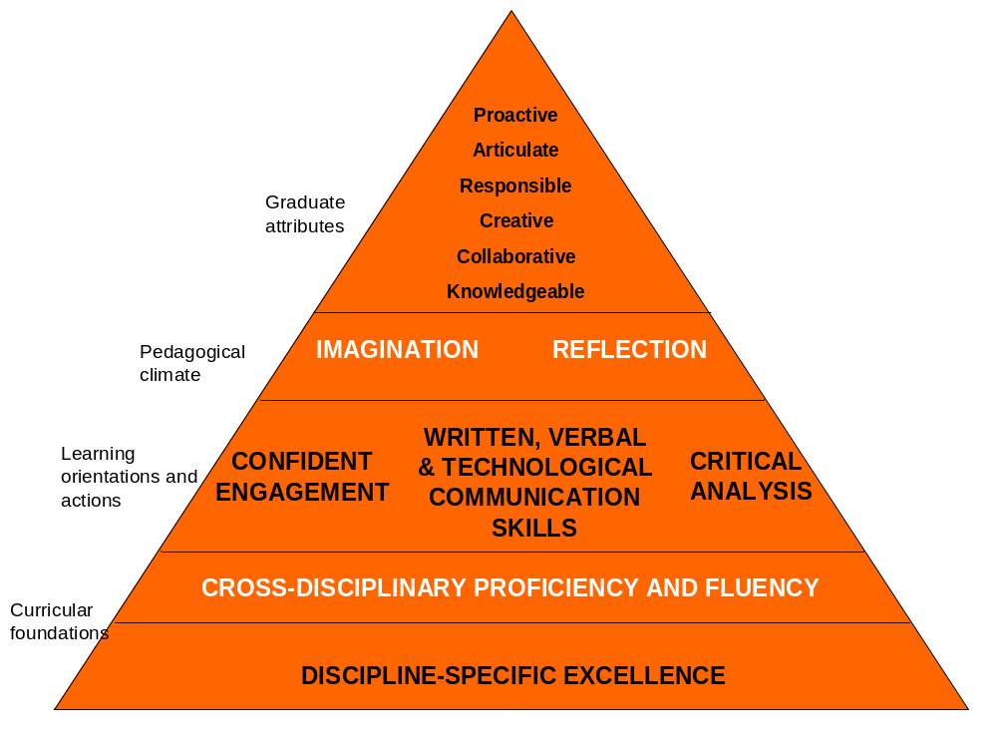
University of Limerick
Notes:
UL Conceptual Frame Work
Curricular Foundations:
Discipline-specific excellence (deep, critical understanding of what constitutes knowledge in a particular social context—its epistemic, political and ideological values)
Cross-disciplinary proficiency and fluency (acquaintance with broad range of social contexts in which knowledge is constituted differently, originating from different, sometimes opposing epistemic, political or ideological values)…so that graduates “will be distinguished by their ability to interact and work effectively both within and beyond their disciplines, a competence that is seen as vital to the multi-disciplinary, innovative orientations required in economies and societies of the future”
Learning orientations and actions: supporting the delivery of the curriculum, manifesting themselves as
Teaching and learning interactions
Assessment norms
Learning outcomes
Learning dynamics across the curriculum
Pedagogical Climate: encouraging creativity, new conversations, new ideas, new skills, new connections
Hence, the Broadening of the Curriculum Project currently underway.
Since graduate attributes are in a sense the measure of the quality of the experience, graduate attributes have to be defined before the Broadening of the Curriculum can move forward. “…a list of graduate attributes will form a
strong principle-based bedrock for the elaboration, development and delivery of UL’s enhanced, broader curriculum” (Broadening the Curriculum Briefing Paper, June 2011, online at: http://www3.ul.ie/ctl/sites/default/files/Broad%20curriculum%20briefing%20paper.pdf )

Slide 6
Attributes of Graduate Writers
A fundamental, reasoned, even researched, understanding of the goal of their communication
A critical awareness of their own research and writing processes
The ability to evaluate how language is functioning to make meaning beyond mere denotation
A critical awareness of audience expectations and preferences and how to write for multiple audiences, sometimes within the same text
That form and content choices mark a writer as either belonging or not being recognised as belonging to a particular disciplinary community of practice
Notes:
How Language is Functioning: Functions to include or exclude
Functions to establish relationship between writer and topic, writer and audience
Textual, interpersonal, ideational functions; rhetorical functions; semantic functions
Writing skills workshops break down aspects of a text into its components and looks at the features of each component part within its disciplinary context. This kind of training increases a student’s level of literacy.
Collaborative writing exercises encourage teamwork, the development of negotiation and interpersonal skills.
Comparison and contrast assignments encourage and develop organizational, analytical, and evaluative skills.
Argumentative writing requires that students think systematically, discriminate, synthesize large amounts of complex data to formulate justifiable conclusions or to make responsible recommendations.
Requiring that students document the sources that inspired their ideas; teaches responsibility and respect for the work and ideas of others.
Writing assignments on computers, submitting work through online plagiarism-detection software, and receiving online feedback increases students’ IT literacy.
Recursive writing exercises in which writing undergoes several stages of development, that allows for “rethinking” of every aspect of the project, even allowing a student to scrap the project and start over, when combined with frequent and productive instructor feedback on both the content and the form, encourages deeper learning.

Slide 7
Bottom-Up
John Hilsdon, Learning Development unit at Plymouth University and the Writing for Assignments E-library (WrAssE)
‘Do you write like an engineer?’ mini-module for first-year engineers, Lawrence Cleary, Regional Writing Centre, UL

Slide 8
Writing in STEM subjects
The Learning Development team guided by John Hilsdon, Plymouth University, and the Learn Higher Online resources.
https://www1.plymouth.ac.uk/learningdevelopment/Pages/default.aspx
http://www.learningdevelopment.plymouth.ac.uk/
http://www.learningdevelopment.plymouth.ac.uk/wrasse/
Notes:
Go to Study Guides. Click on one of the study guide topics. Then go to the bottom of the page. Click on video resource. Check out critical thinking. The report writing.
Go to the report writing cite on the study guide site and to Technology 6th year on WrAssE.

Slide 9
Embedding Writing into a Module: WID
ME4001 Introduction to Engineering
  4 hours of lectures on report writing
  4 hours of tutorials where students are challenged to determine whether they write like an engineer or not
Genre awareness vs. Genre performance
See ME4001 Introduction to Engineering tutorial material at the University of Limerick Regional Writing Centre

Slide 10
Activity: Organization of Information
What is each sentence about?
What is each paragraph about?
How is the information organized?
Information usually moves from given information to new information, providing context for the new information.
Exercise: Rewrite the paragraph graphed for given and new information in your colour-coded feedback so that it is more clear what your paragraph is about..
Notes:
Give Handout: blank table. Ask audience if they would work in groups.
Teacher presents text which was used in last tutorial, so they are familiar with it. LF points to correspondences within the paragraph, which help give order to what is being talked about. These correspondences can be mapped.
Next, LF introduces table of themes and rhemes of the same paragraph. Notes the direction information travels in. Hands out blank table.
Students work on sample text (in lieu of the color-coded feedback we would have provided on their own texts had they been students).
Text Organization
Cohesion largely depends on repetition and logical order.
What is the sentence about?
How does the theme of this sentence contribute to the paragraph, and does it have a logical relationship to the sentences preceding and following?
How is your information organized? Can you chart it?

