Slide 1
Employability Skills Workshop
Enhancing the Employability of STEM Student Ambassadors - resources by Enhancing the Employability of STEM Student Ambassadors project is licensed under a Creative Commons Attribution-NonCommercial-ShareAlike 3.0 Unported License
This activity was undertaken as a part of the National HE STEM Programme, via the South West Spoke. For more information on South West Spoke projects, please see www.hestem-sw.org.uk For more information on the overall national programme, please see www.hestem.ac.uk

Slide 2
Introductions
Working in pairs find out the following details about your partner and then be prepared to tell the rest of the group about them. However you must pitch your presentation to the group as if they were 7 year old primary age pupils!
* Where you went to school
what degree you are studying and what year
about the ambassador/work activities you have done so far
about your future job plans – PhD, industry, teaching
Notes:
Suggestion: After everyone at the induction has introduced themselves, do a short ice-breaker activity e.g.:
Split members of the induction group into pairs
In each pair have one person as person A and the other person as person B
For a few minutes have person A explain what they do for a living to person B as though person B were 7 years old
After a few minutes swap them round but this time person B explains what they do for a living to person A as though person A were 15 years old
After a few minutes get feedback from the group on how they went about the above, difficulties they may have had and techniques they may have used to explain.

Slide 3
Today’s objectives
By the end of today’s session, we hope you will have:
An understanding of what employability skills are
Why they are important
What skills you already have
Ideas on how to evidence your skills in a job application or interview
Ideas about how you can increase your employability skills

Slide 4
What are Employability Skills
‘A set of attributes, skills and knowledge that all labour market participants should possess to ensure they have the capability of being effective in the workplace – to the benefit of themselves, their employer and the wider economy.’
CBI, 2010

Slide 5
Employability Skills are
Teamwork
Business and Customer Awareness
Problem Solving and Creativity
Communication and Literacy
Application of Numeracy
IT Skills
Positive Attitude
Entrepreneurship
Notes:
Ask students to brainstorm what skills they think employability skills include
Show them the list, discuss any differences

Slide 6
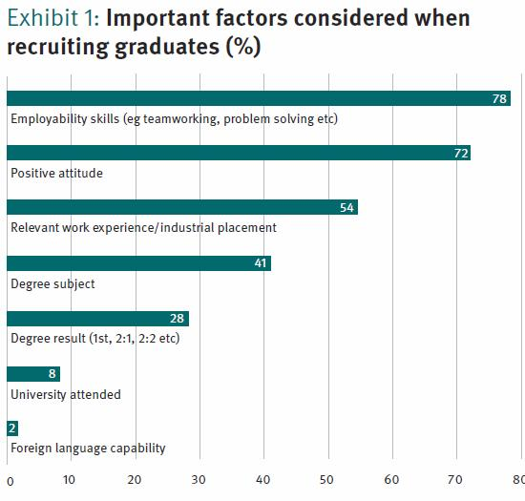
Why do you need them?
Employers look
for them
Notes:
Highlight difficult to get job in current climate, these skills even more valuable

Slide 7
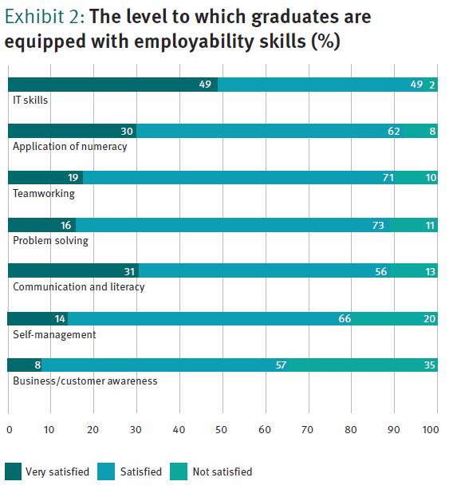
But often potential employees don’t have them
Or is it that potential employees aren’t demonstrating that they have them?

Slide 8
Skills that Employers want and how they can be developed
Personal audit of Employability Skills

Slide 9
Job Applications
What employers are seeking on job applications
Creating a CV
Responding to advertisements
Covering letter

Slide 10

Job Applications – Airbus

Slide 11
How can being a Student Ambassador help you acquire employability skills?
New challenge, different skills
Different audience, improve skills
Working with different people
More experience, more examples

Slide 12
What can STEM Ambassadors do?
Link with schools or colleges to create long-term partnerships
Mentor students on specific projects – within the curriculum or beyond
STEM Clubs – encourage schools to consider Clubs or assisting with on-going activity
Offer careers advice during a school careers event
Support STEMNET activities advertised through the UK-wide quarterly newsletter
Support teacher CPD – working with Science Learning Centres, NCETM etc
Assist with delivering Enhancement & Enrichment schemes from the STEM Directories
You can also view the latest requests for STEM Ambassadors on
STEMNetworking at: http://networking.stemnet.org.uk/
Notes:
This is a good point in the induction to focus on talking about specific activities available in your sub-region in which STEM Ambassadors can get involved. The above slide is mainly meant as a generic list of types of activities which will obviously vary slightly between sub-regions.
Show photos, examples of activities and resources.
Give latest schedule of activities for which you are recruiting STEM Ambassadors support – most of which should be available to view on STEMNetworking

Slide 13
Next Steps
Do more volunteering to address your skills gap
Re-analyse your skills using the audit sheet
Complete a case study sheet
Keep a record of examples to use in job applications and interviews
Notes:
More information on STEMNET website on the insurance provided.

