Slide 1

Engineering community-based learning at the University of Bristol
Kate Miller, Centre for Public Engagement

Slide 2
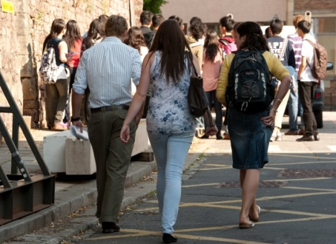
Overview of projects
3rd year research projects and 4th year design projects
Undergraduates interns scoped potential community placements
  Contacting and liaising with community partners
  Co-designing feasible projects
  Recruiting academic supervisors

Slide 3
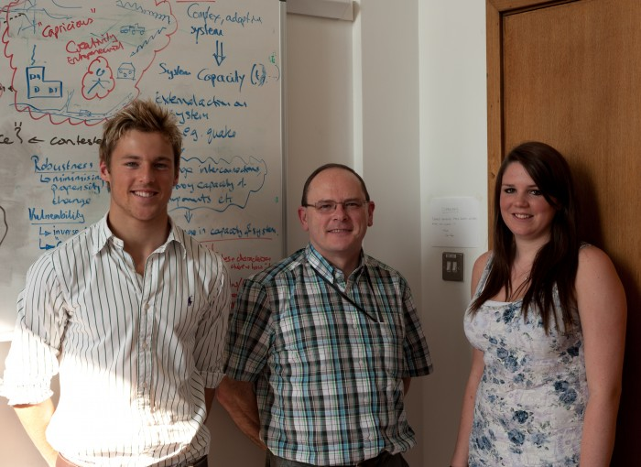
Why use interns?
Technical knowledge of engineering problems
Knowledge of civil engineering undergraduate course
Potential to inspire their peers

Slide 4

Outcomes (so far)
11 projects scoped with 8 community partners
9 projects obtained academic supervisors
6 projects (but 7 groups of students) taking place
Projects underway...

Slide 5
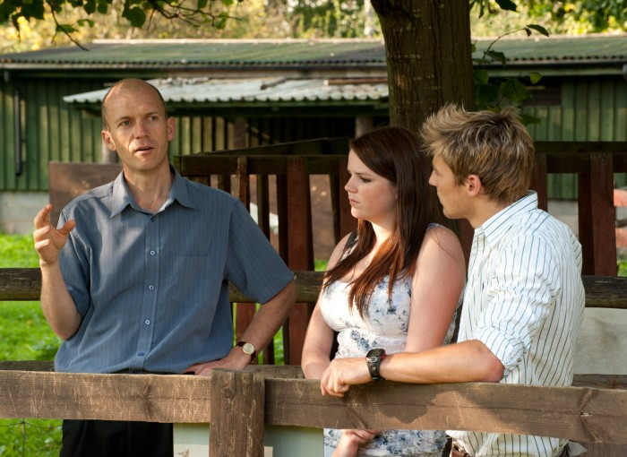
Initial findings
Interns:
  Valuable experience, working with wide range of partners
  Inspired them to do projects
Students:
  Chance to do something tangible
  Enhancing skills through opportunities like stakeholder meetings

Slide 6

Initial findings
Supervisors:
  Need to consider what they get out of it
  Matching research expertise to project is essential
Community partners:
  Have to bear in mind the time they can devote to projects
  Initial discussions about future developments

Slide 7
Challenges
Assessment of projects (especially as part of wider curriculum)
Linking to Department’s plans for undergraduate learning
Need to consider value to all partners involved in project

Slide 8
What are the drivers for community based learning projects?

Slide 9
How can you scope community-based projects?

Slide 10
What are some of the barriers to developing community based learning projects?

