Slide 1




HE STEM Practice Transfer Adapter – June Update
The Bradford Community of Practice
Mutty Dad,
University of Bradford

Slide 2
CONTENTS
PTA and Bradford
Achievements to Date
  The Faraday Challenge
Project Outputs
Dissemination
Initial Evaluation
General Feedback

Slide 3

PTA and Bradford
The University of Bradford
  Outreach at Bradford
Building STEM at Bradford
STEM Laboratory
HE STEM North East Spoke

Slide 4
Achievements
4 Peer Reviews
2 Visits
  University of Hertfordshire
  Royal Institution & Imperial College
New Partnerships
STEM at Bradford Blog?

Slide 5







Achievements - Reviews
Faraday Challenge
Reach Out Lab Vs. L’Oreal Lab
Astronomy Day
NG Bailey Robot Challenge

Slide 6
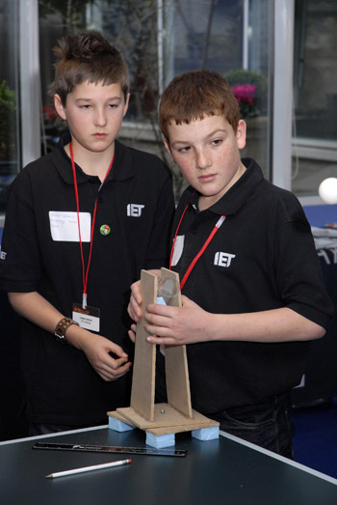
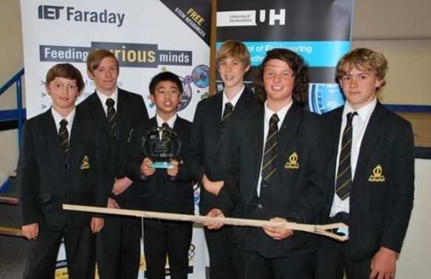

Faraday Challenge
The Visit
The Programme
The Learning Outcome
The Community of Practice

Slide 7
PTA Project Outputs
PTA Booklet
  STEM a Changing Landscape
  Peer Reviews
  Summary of CoP
  Bradford STEM Activities
  STEM Lab
Dissemination Event
New Partnerships
New programme development and delivery

Slide 8
Dissemination
Launch of Bradford STEM Lab Build
11 July 2012
Robot Wars –
27 June 2012**
Bradford Engineering Festival!!!
October 2012

Slide 9
Initial Evaluation
Build capacity for peer review and practice
New form of evaluation and marketing
Opportunity to work with new partners
News method of learning and transfer
Raised awareness of good practice
Synchronise and Harmonise STEM Outreach

Slide 10
General Feedback
Benefits to STEM at Bradford and the University of Bradford Understanding of other practice Community of Practice Flexible and Creative Evaluation | Benefits to our partners and stakeholders Access to actual activity to learn from Strategic input into planning New Opportunities of involvement
Benefits to our WP/Outreach and University Community Raised awareness of STEM Outreach New resource for the university Increase in no of STEM Ambassadors | Key challenges of the Practice Transfer Adapter Securing time for peer reviews Retaining focus and continuity Maintaining credibility Synchronising the blog

Slide 11
Thank You!
Any Question?

Slide 12
http://blogs.brad.ac.uk/stem-at-bradford/
Janet Midgley/Mutty Dad,
University of Bradford
Richmond Building
Bradford
West Yorkshire
BD7 1DP
j.midgley@bradfod.ac.uk
01274 232231
m.dad1@bradford.ac.uk
01274 236363

