Slide 1

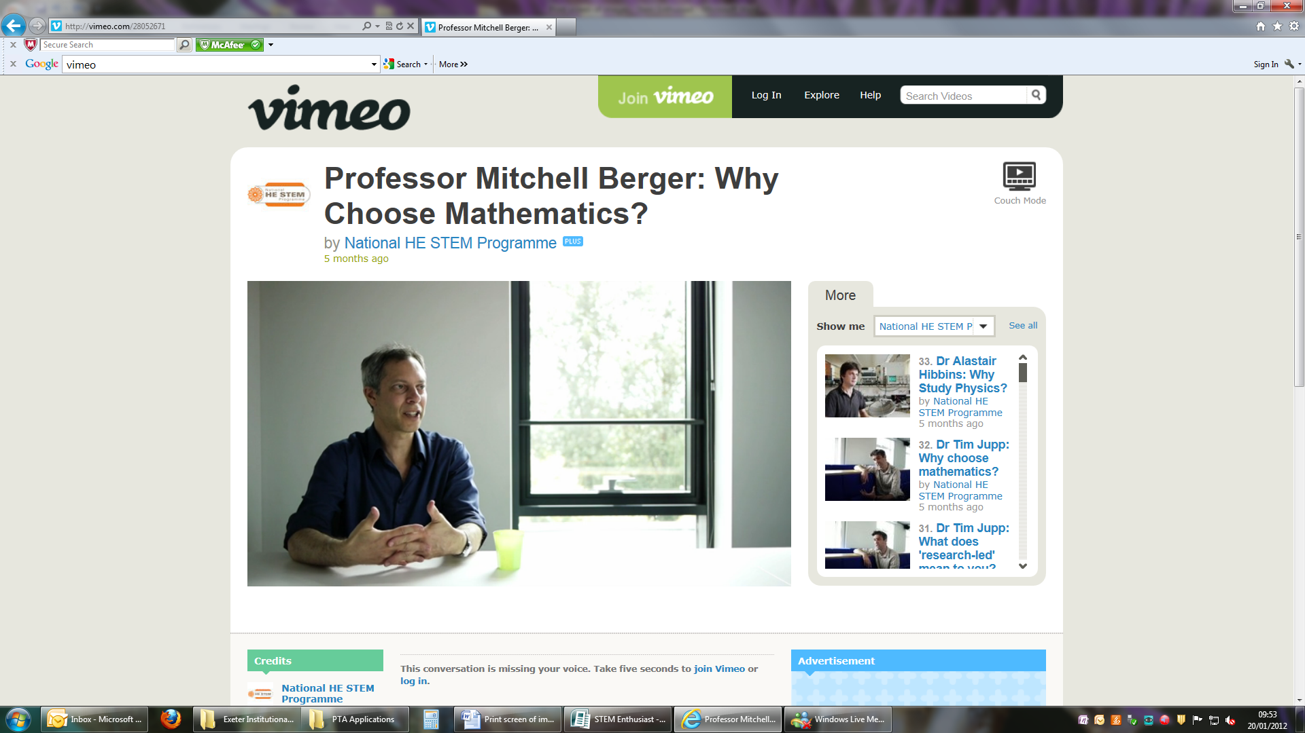
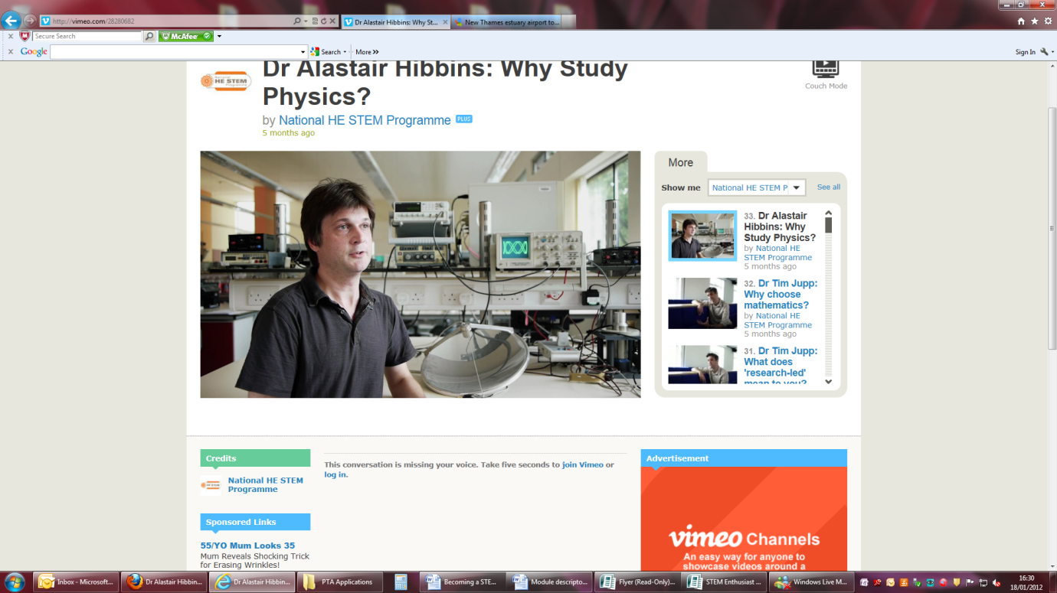
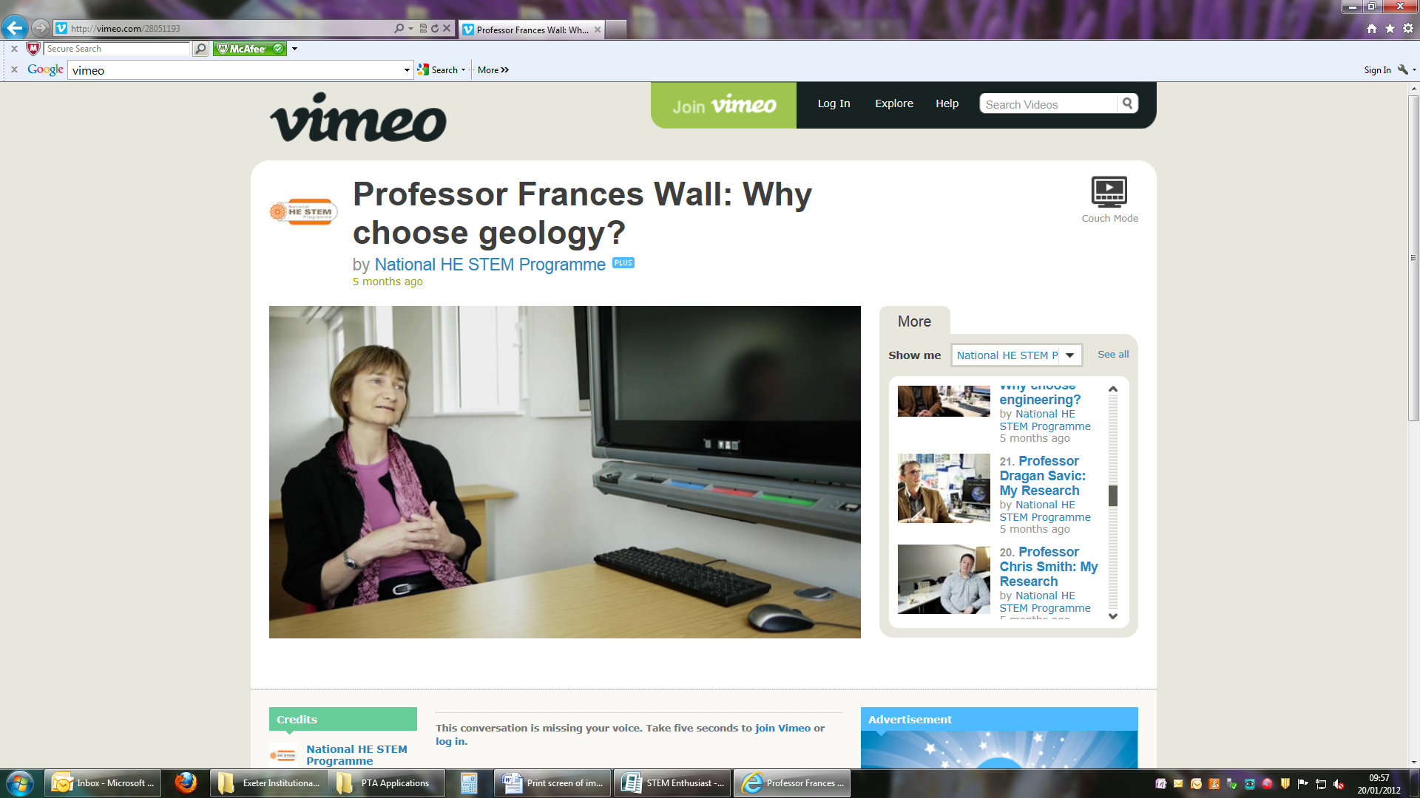
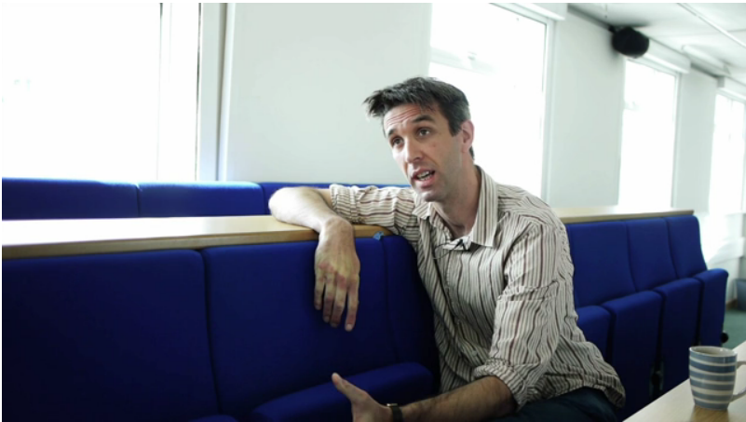
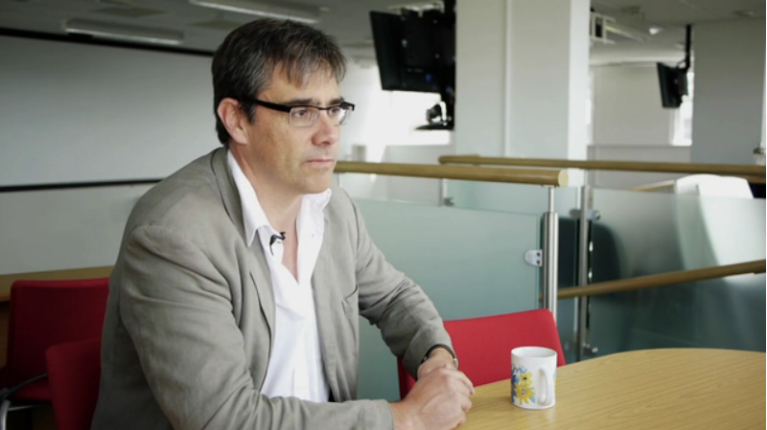
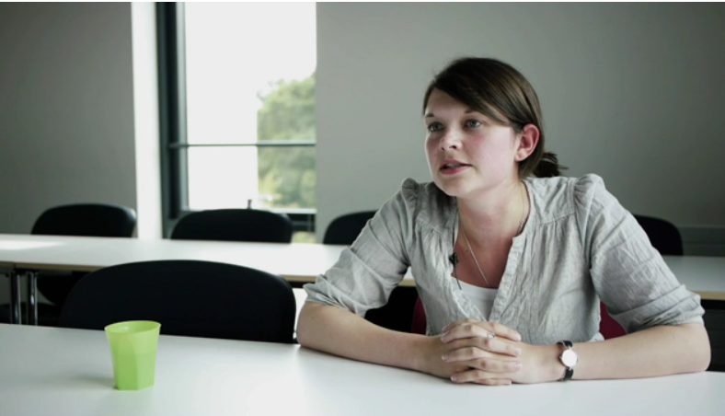
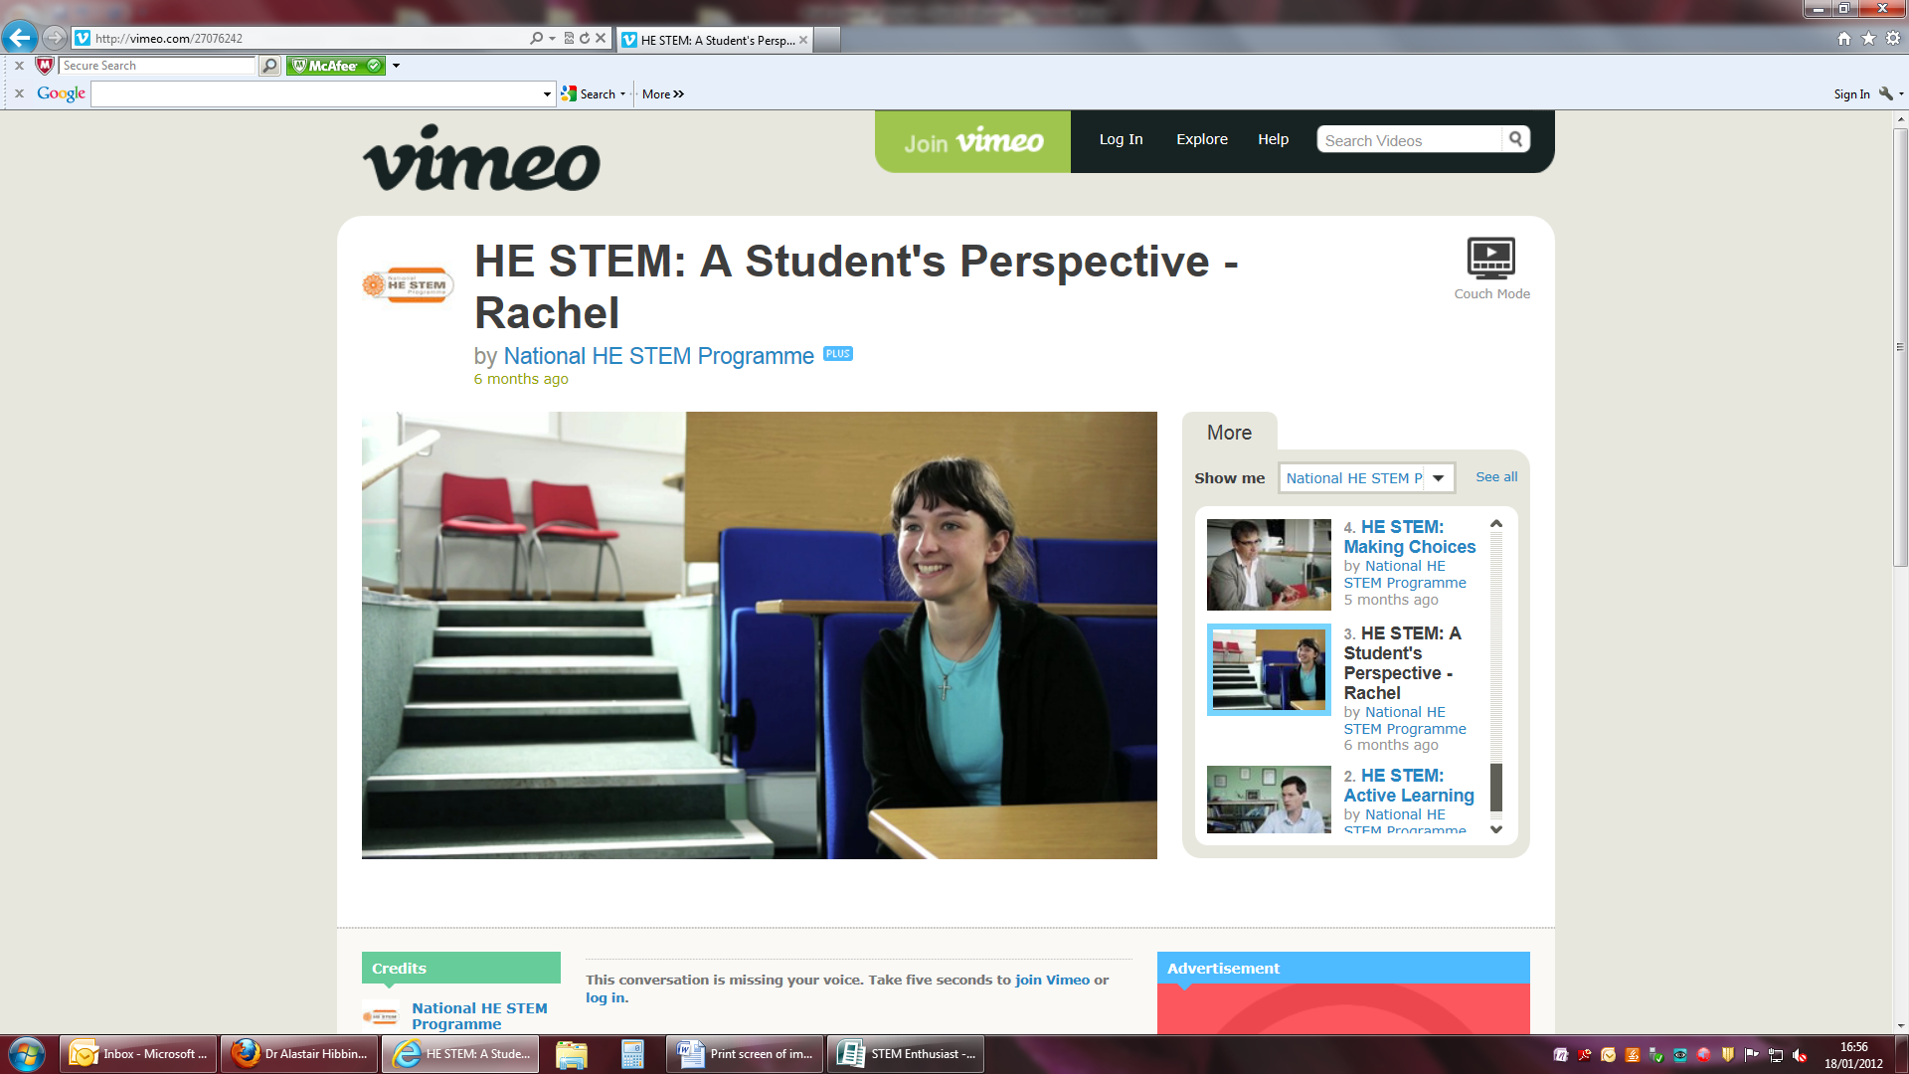
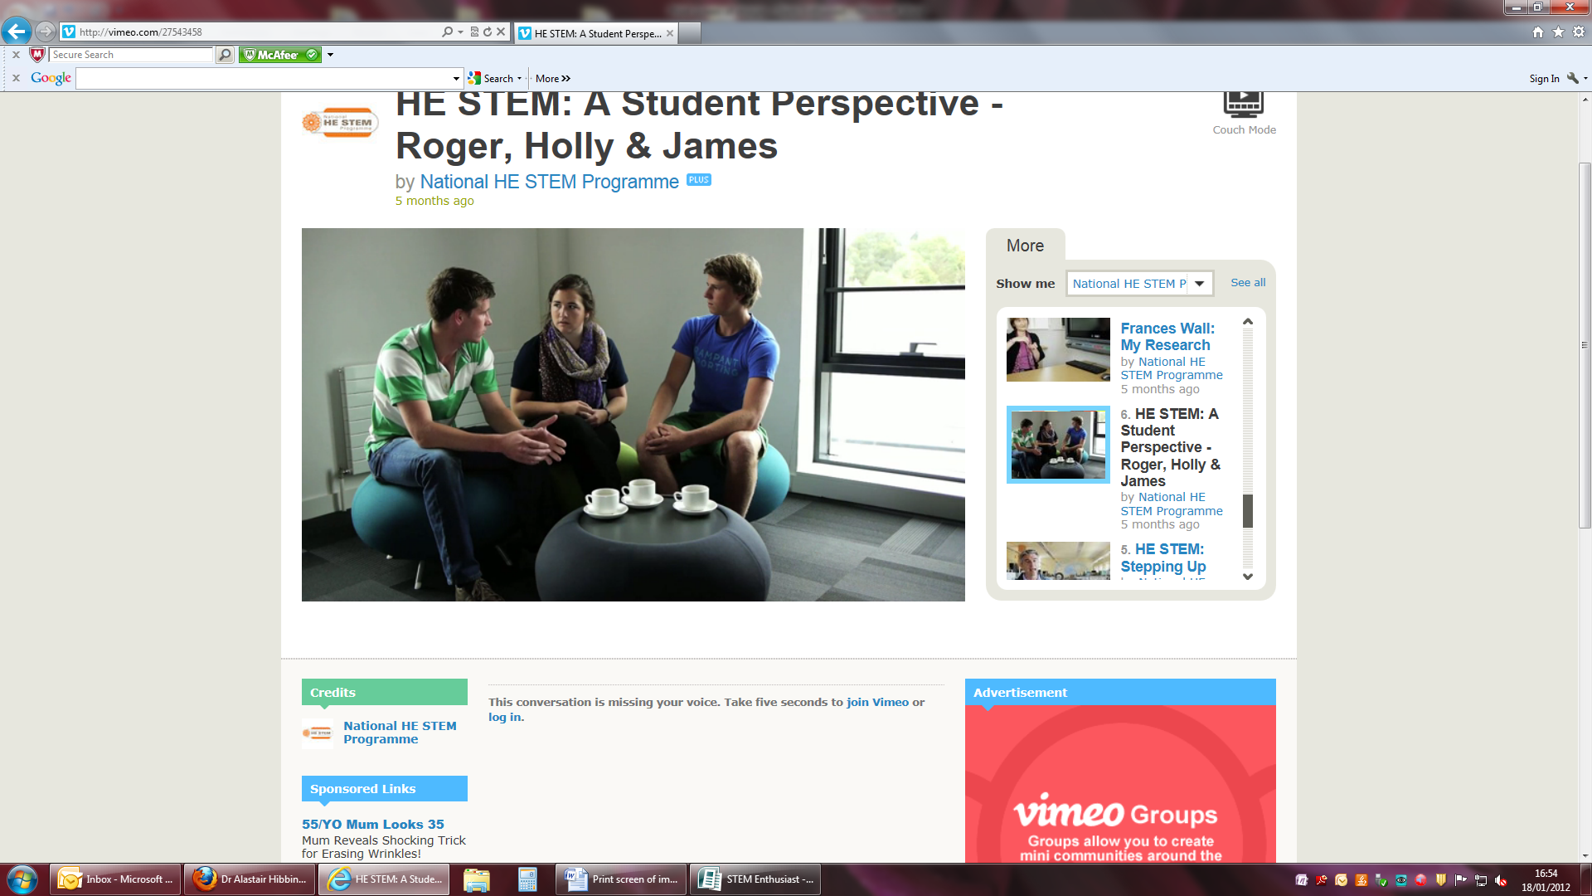
‘Becoming a STEM Enthusiast’
Aims of the project
This HE STEM-funded project was a collaboration between the College of Engineering, Mathematics
and Physical Sciences and Education Enhancement at the University of Exeter
The aim was to produce a series of video vignettes for use in outreach activities, staff development
programmes and promotion of STEM subjects generally
Videos feature student stories on their experience of transitioning to University, the key similarities
and differences between STEM subjects and how they prepared for higher level study
Staff speak about the excitement of working in STEM subjects, how they convey this in their teaching
and their approaches to the link between teaching and their research
Professor Mitch Berger speaks about his research in applications of Geometry in astrophysics, physics and biology
Progress made to date
We have engaged with 15 members of academic staff from our College of Engineering, Maths and
Physical Sciences as interviewees alongside four students who were filmed as a group describing high
points and challenges of studying in their subject area
We have been met by enthusiasm of academics for this project and willingness to contribute to both
the outreach and staff development outputs
We have established a shared steering group with Exeter’s Community of Practice project, with
representation from internal and external academics to consolidate learning and share best practice
We have started to disseminate our project through workshops and other activities for outreach
practitioners, staff developers and other discipline-based networks
We have already achieved beyond the original threshold of videos cited in the project proposal
Dr Alastair Hibbins speaks about research in undergraduate physics programmes
Professor Frances Wall explains what makes an understanding of geology so relevant to important issues such as climate change
Dr Tim Jupp, Lecturer in Maths and Computer Science, explores the use of student-led research projects to explore real life applications of mathematical prediction
Professor Peter Cox, Professor of Climate System Dynamics, speaks about the value of using news stories in teaching
Future intentions
Dr Zena Wood, Teaching Fellow in Computer Science underlines the importance of tutorials for active learning
Student Rachel speaks about the experience of studying Mathematics
To incorporate the Resources into our PG Cert programme for new lecturers and our
Learning and Teaching in HE Programme for Graduate Teaching Assistants
To continue disseminating our work throughout the South West HE STEM network
and beyond
To make these resources openly available through JORUM and through Open Exeter
to enable other institutions to embed them, as required, into similar programmes
For more information about the project and resources available, please contact:
Jane Rowe, Project Lead
Education Enhancement, University of Exeter
E: J.L.Rowe@exeter.ac.uk, T: 01392 724511
Students Roger, Holly and James give their perspective on transitioning from A-Level to University

