Slide 1
Supporting Graduate Attributes through Writing Development in Coventry and in Limerick
Íde O’Sullivan and Lawrence Cleary,
Regional Writing Centre, University of Limerick
Lisa Ganobcsik-Williams, Centre for Academic Writing Coventry University

Slide 2
Graduate Attributes at the University of Limerick
UL Strategic Plan: Pioneering and Connected, Strategic Plan 2011-2015.
Colloquium on Broadening the Curriculum, January 2011.
Rationale for Broadening of the Curriculum Project: Position paper issued in June of 2011.
Three Graduate Attributes Workshops in September and October, 2011.
February 2012: Distribution of a Graduate Attributes statement.
  http://www3.ul.ie/broadeningthecurriculum/
Notes:
A graduate of Yale, UL President, Professor Don Barry, has always strongly advocated for a greater role for liberal arts values in an institution that has always had strong ties to industry, beginning its life as a National Institute of Higher Education, a higher education institution established to provide higher, university-level technical education, considered above the standard of the Regional Technical College system.
Hence, the Broadening of the Curriculum Project currently underway.
Since graduate attributes are in a sense the measure of the quality of the experience, graduate attributes have to be defined before the Broadening of the Curriculum can move forward. “…a list of graduate attributes will form a
strong principle-based bedrock for the elaboration, development and delivery of UL’s enhanced, broader curriculum” (Broadening the Curriculum Briefing Paper, June 2011, online at: http://www3.ul.ie/ctl/sites/default/files/Broad%20curriculum%20briefing%20paper.pdf )

Slide 3
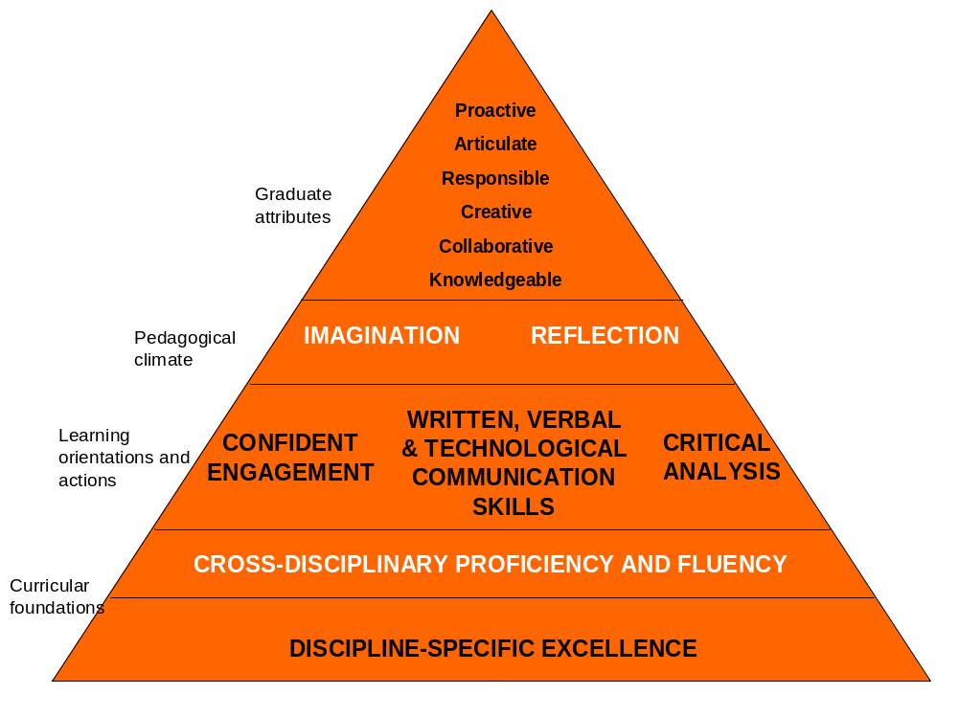
Notes:
Conceptual Frame Work
Curricular Foundations:
Discipline-specific excellence (deep, critical understanding of what constitutes knowledge in a particular social context—its epistemic, political and ideological values)
Cross-disciplinary proficiency and fluency (acquaintance with broad range of social contexts in which knowledge is constituted differently, originating from different, sometimes opposing epistemic, political or ideological values)…so that graduates “will be distinguished by their ability to interact and work effectively both within and beyond their disciplines, a competence that is seen as vital to the multi-disciplinary, innovative orientations required in economies and societies of the future”
Learning orientations and actions: supporting the delivery of the curriculum, manifesting themselves as
Teaching and learning interactions
Assessment norms
Learning outcomes
Learning dynamics across the curriculum
Pedagogical Climate: encouraging creativity, new conversations, new ideas, new skills, new connections

Slide 4
Direction of Initiative
Top-Down: National Goals→Institutional Goals→Learning Outcomes
Bottom-up: Stakeholder (employers/educators/students) input→Teaching & Learning Committee, Executive Committee, Academic Council and Academic Programme Review Committee→ Curricula design and the total student experience
Notes:
Stakeholders feedback to the Teaching & Learning Commitee, the Executive Committee, The Academic Council and APRC. This information informs the availability of curricula and extra-curricula conditions through which desired graduate attributes can be achieved.

Slide 5
Writing Development, UL
Centre for Teaching and Learning
  Specialist Diploma in Specialist Diploma in Teaching, Learning and Scholarship
  Writers’ Retreats
  First Seven Weeks
  Student Evaluation of Teaching
Notes:
Specialist Diploma in Teaching, Learning and Scholarship— enhance communication, presenting research, interacting effectively with learners, confidence and competence in academic writing and publishing, interpersonal skills, exercising effective pedagogical and supervision skills, receiving and acting on feedback in both research and teaching settings, enhancing and developing academic competence and engaging actively in own career development.
Writers’ Retreats—competence in academic writing and publication
First Seven Weeks—orientation for first-years to supports and experiences available in university
Student Evaluation of Teaching—reinforcing bottom up constructive feedback from students to teachers on their performance

Slide 6
Writing Development, UL
Regional Writing Centre
  Who we talk to:
    Staff, undergraduates, postgraduates, post-doc researchers
  What we offer:
    One-to-one peer-tutoring in writing
    Workshops on writing from the Writing Centre
    Workshops in modules or as supplements to modules
    Writing in Disciplines and Writing to Learn initiatives
    Writers’ Group facilitation
    Modules on Writing
    Training the Trainers Workshops
Notes:
Related attributes: confident, critical communicators with a framework for writing in any context; writers with a framework for autonomous, life-long development as writers, including strategy development; teachers who can pass this framework onto others.
Lisa Ganobcsik-Williams directs the Centre for Academic Writing at Coventry University. She has prepared the following slides to give insight into Coventry University’s ‘whole institution’ approach to developing student writing as a graduate attribute.
[show slide 1]

Slide 7
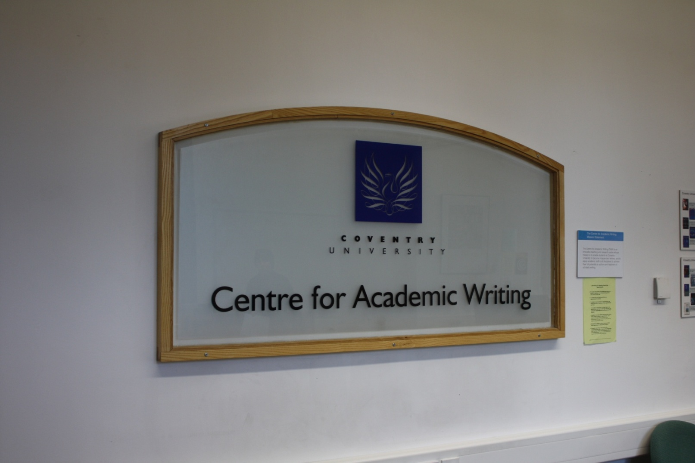
‘Whole-institution’ strategy for writing development: CAW as a strategic priority within the University
Notes:
The Centre for Academic Writing, or CAW, was established as a ‘strategic priority’ at Coventry University in 2004, and is an example of a ‘top-down’, ‘whole institution’ strategy to develop students’ writing on a continuing basis. CAW’s philosophy is that [read slide 2]

Slide 8
A Continuum of Writing Development
Educators and educational managers should view the development of students’ writing skills as a progression on a continuum that spans the move from schools and further education into higher education, and continues throughout a student’s degree course.
Notes:
‘Educators and educational managers should view the development of students’ writing skills as a progression on a continuum that spans the move from schools and further education into higher education, and continues throughout a student’s degree course’
[show slide 3]

Slide 9
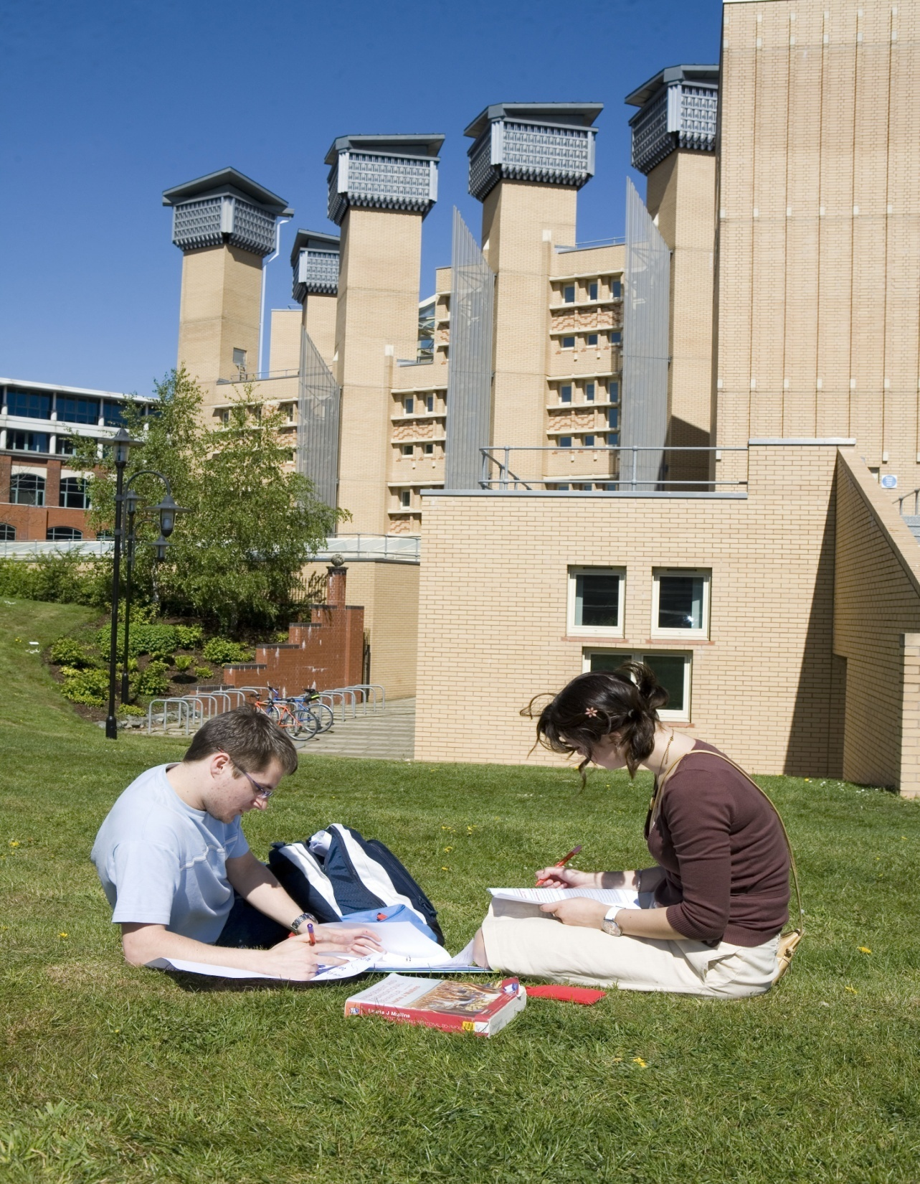
Students working on their writing next to the Centre for Academic Writing, Coventry University
Notes:
These are students working on their writing next to CAW, [show slide 4]

Slide 10
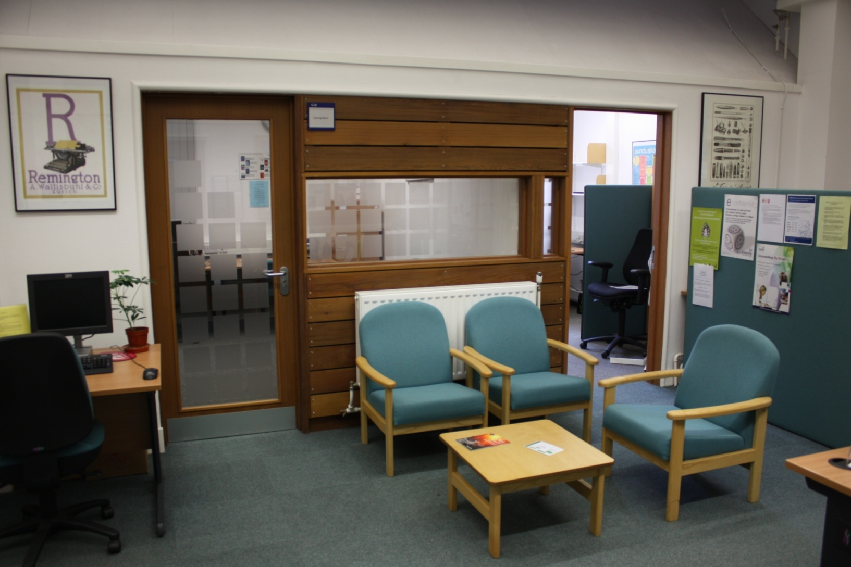
Centre for Academic Writing reception area & tutoring rooms
Notes:
and here are the reception area and tutoring rooms in CAW.
[show slide 5]

Slide 11
‘to enable students to become independent writers’
20-minute bookable-on-the-day writing tutorials
50-minute bookable-in-advance writing tutorials
Undergraduate and postgraduate workshops on common writing topics
‘protected writing time’ (‘drop in and write’) sessions
3rd Yr Dissertation Writing Sessions
Postgraduate ‘Active Writing Sessions’
Add+Vantage modules (dedicated credit-bearing Academic Writing modules)
‘Writing for Scholarly Publication’ Masters module
CU Harvard Reference Style
Notes:
The main aim of CAW’s mission statement is ‘to enable students to become independent writers’. CAW offers the following types of support to undergraduate and postgraduate students. [read out list on slide 5]. [then show slide 6

Slide 12
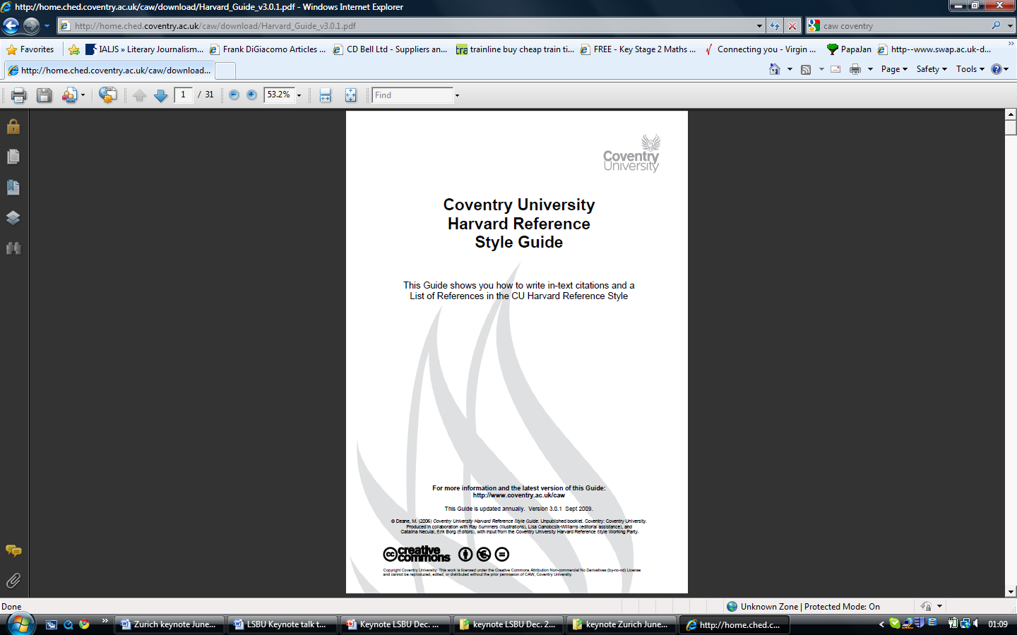
CU Harvard Reference Guide and Glossary
Notes:
on CU Harvard Reference guide created by CAW and used by all students] [then show slide 7

Slide 13
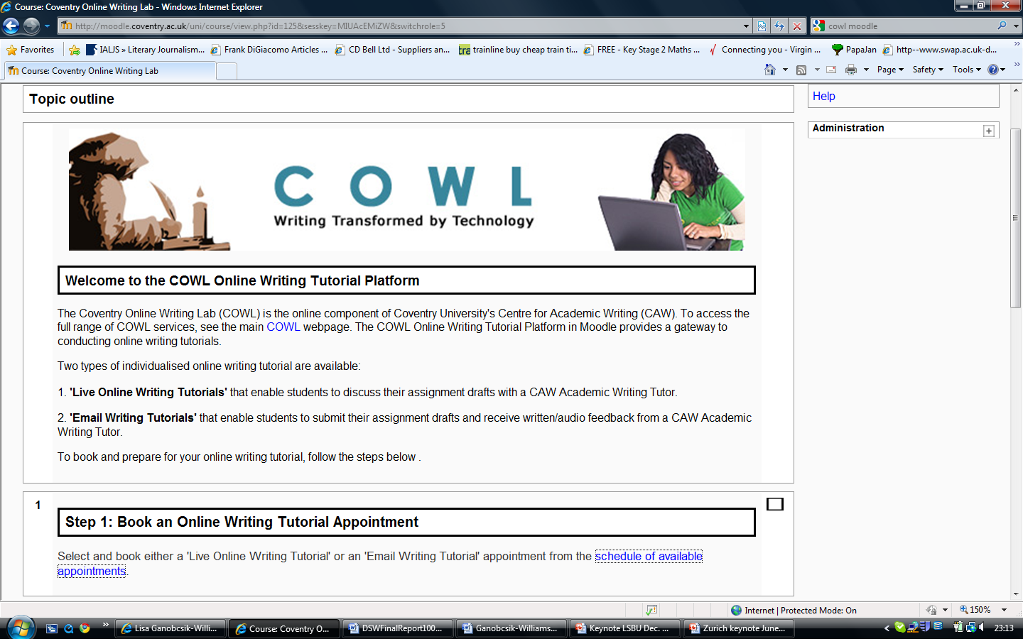
Coventry Online writing lab (COWL) in Moodle
Notes:
and say that CAW also offers online writing tutorials to students].
Students’ writing is also supported through CAW lecturers working with academics from around the University to introduce strategies for teaching writing in many degree programmes and modules. This is the second aim of CAW’s mission statement [read slide 8].

Slide 14
‘to equip academic staff in all disciplines to achieve their full potential as teachers of scholarly writing’
Teaching ‘Writing in the Disciplines’ (WiD)
Supporting ‘Writing Across the Curriculum’ (WAC) with writing strategies

Slide 15
Attributes of Graduate Writers
A fundamental, reasoned, even researched, understanding of the goal of their communication
A critical awareness of their own research and writing processes
The ability to evaluate how language is functioning to make meaning beyond mere denotation
A critical awareness of audience expectations and preferences and how to write for multiple audiences, sometimes within the same text
That form and content choices mark a writer as either belonging or not being recognised as belonging to a particular disciplinary community of practice
Notes:
How Language is Functioning: Functions to include or exclude
Functions to establish relationship between writer and topic, writer and audience
Textual, interpersonal, ideational functions; rhetorical functions; semantic functions
Writing skills workshops break down aspects of a text into its components and looks at the features of each component part within its disciplinary context. This kind of training increases a student’s level of literacy.
Collaborative writing exercises encourage teamwork, the development of negotiation and interpersonal skills.
Comparison and contrast assignments encourage and develop organizational, analytical, and evaluative skills.
Argumentative writing requires that students think systematically, discriminate, synthesize large amounts of complex data to formulate justifiable conclusions or to make responsible recommendations.
Requiring that students document the sources that inspired their ideas; teaches responsibility and respect for the work and ideas of others.
Writing assignments on computers, submitting work through online plagiarism-detection software, and receiving online feedback increases students’ IT literacy.
Recursive writing exercises in which writing undergoes several stages of development, that allows for “rethinking” of every aspect of the project, even allowing a student to scrap the project and start over, when combined with frequent and productive instructor feedback on both the content and the form, encourages deeper learning.

Slide 16
Activity:
Organization of Information
What is each sentence about?
What is each paragraph about?
How is the information organized?
Information usually moves from given information to new information, providing context for the new information.
Exercise: Rewrite the paragraph graphed for given and new information in your colour-coded feedback so that it is more clear what your paragraph is about..
Notes:
Give Handout: blank table. Ask audience if they would work in groups.
Teacher presents text which was used in last tutorial, so they are familiar with it. LF points to correspondences within the paragraph, which help give order to what is being talked about. These correspondences can be mapped.
Next, LF introduces table of themes and rhemes of the same paragraph. Notes the direction information travels in. Hands out blank table.
Students work on sample text (in lieu of the color-coded feedback we would have provided on their own texts had they been students).
Text Organization
Cohesion largely depends on repetition and logical order.
What is the sentence about?
How does the theme of this sentence contribute to the paragraph, and does it have a logical relationship to the sentences preceding and following?
How is your information organized? Can you chart it?

