Slide 1
Engineering Employability Project
Adele Merrison
UWE Learning and Teaching Fellow
Careers Consultant

Slide 2
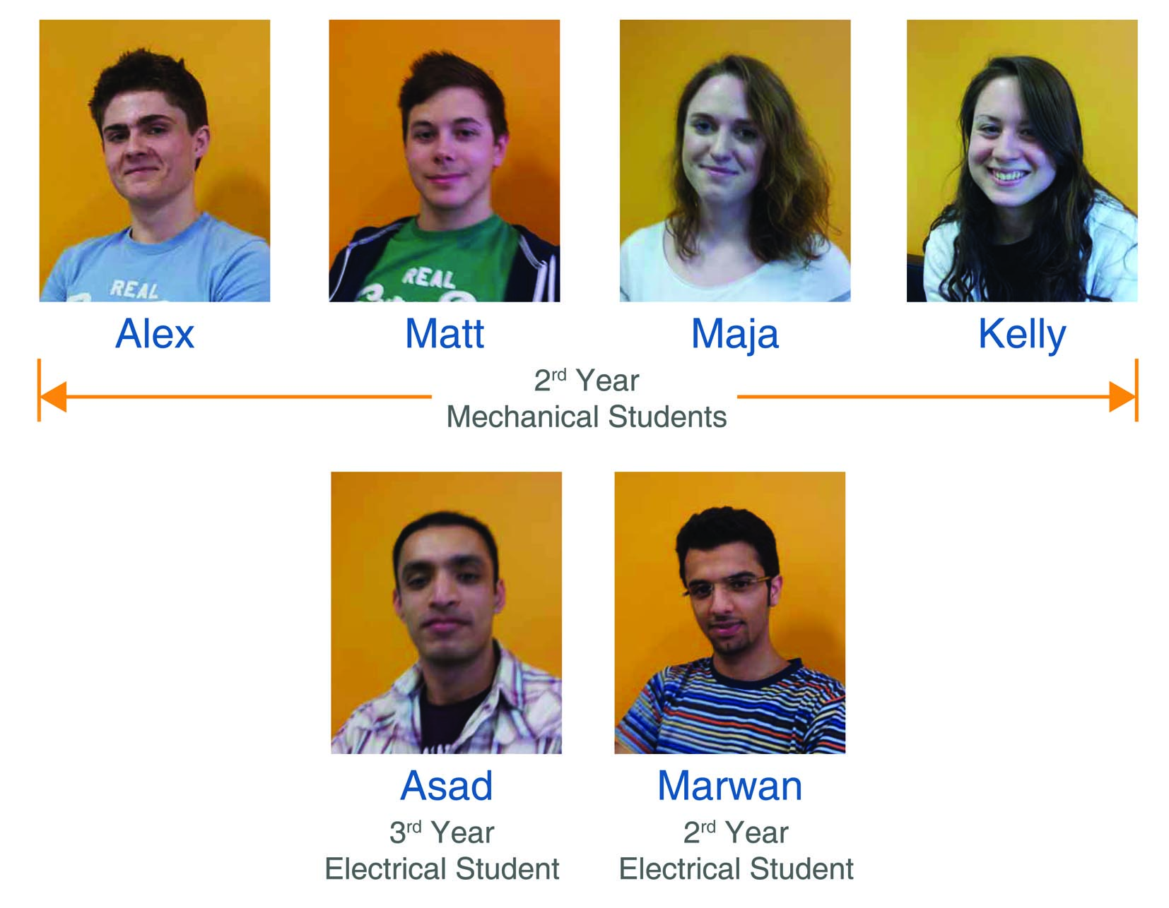

Slide 3
What we did…….
Student Led Engineering Employability Audit carried out between 7th March and 4th April 2012 by 6 students [2 electrical; 4 mechanical]
5 meetings, sector employers fair, Dropbox,
Outputs: blog, project report, dissemination events
Four strands:
Employer consultation
Mechanical and electrical engineering degrees module audit
Comparison of mechanical / electrical degrees
Personal career goals
Notes:
‘Student Voice aspect’ is of great interest in the current context of fee hike - we need to listen to the views of our customers but obviously without compromising the academic / intellectual integrity of our course offer
Academics and careers professionals are heavily involved in curriculum development and review but how often do we ask students to participate in in depth reviews? This is why I wanted to run this project at UWE.

Slide 4
How we did it differently
Engineering degrees rather than maths
Narrower focus on 5 soft skills / attributes
Employer input
Mechanical / electrical degree comparison
Personal career goals
Notes:
Oral communication , Self management, Project management & team working,
Problem solving, Commercial awareness
Arrived at via a session on skills graduate employers want but feel are lacking, informed by HE STEM research and other surveys.
List run past the employers who agreed these were the areas to focus on.

Slide 5
Employer consultation
Sources: Infineon, Airbus, GE Aviation, Zircon, Delphi, Broadcom, Aeopona, Hewlett Packard, Intel, Stirling Dynamics, Ultra Electronics
Survey: How can these 5 soft skills/ attributes be convincingly evidenced in applications and at interview?
Method: Employers’ Fair, email, ‘phone
Outcome: a range of concrete examples……
Notes:
Examples:
Communication: Phone interviews choice of words is assessed (i.e. slang); Group exercise: does the person listens to others, interrupt their conversation?
Self management: Evidence of ability to manage course and extra curricular commitments simultaneously; Whether any software is used to facilitate the workload
Project management and team working: Show some understanding of underlying theory, such as fault tree analysis and resource management; Team management –how would you approach someone that wasn’t doing their task?
Problem solving: They should have coherent and well thought out answers to questions ranging from the design of a particular solution right down to testing and comparison of the end result with the original requirements.
Commercial awareness: Awareness of the importance of the customer to the company; Share price, company acquisitions; “How long do you think it takes to develop a missile?”

Slide 6
Audit process
For each degree module:
Identification of current evidence gathering opportunities related to the 5 soft skills
Can it be improved?
Colour classification / grading
Suggestions for development of opportunities
Notes:
Blue – nothing can be changed
Green – already good
Red – needs substantial improvement
Yellow – needs some improvement
This was fascinating for me – eavesdropping on discussions that became quite heated at times in determining scope for soft skill development!
Will review recommendations at end of presentation

Slide 7
Comparison of opportunities
Found more opportunities for electrical than mechanical students to improve their soft skills
Examples of good practice:
Discussion and reflection with tutor on the group dynamics, to improve performance
Programming - tutors give vague answers unless asked very specific questions using correct vocabulary
Labs - students are asked why they did what they did [E], as opposed to simply filling out a worksheet [M]
Use of online tests to ensure students are managing their work
Notes:
Smaller intake – 30 vs 200 students
Loved the vague answers example – image of them playing 20 questions in the labs comes to mind!

Slide 8
Personal career goals?
Job profiles detailing the key skills required
How well does their degree prepare them by offering opportunities to acquire these?
What gaps if any are there? How can these be filled e.g. work experience, volunteering?
In addition to key skills covered in the audit, recognition that engineering is a global career so requires:
Language skills
Cultural competence / empathy
Flexibility e.g. living abroad
Notes:
Job profiles detailing the key skills required for that specific role
Piece of reflective writing – students found this and the blog the most difficult aspect of the project

Slide 9
Recommendations
Communication
Facilitation of more technical and group discussion in a range of settings
Compulsory involvement in presentations, to ensure every team member gets an opportunity to present
Group Projects
Cross disciplinary group projects, involving members of different courses, e.g. business, economics, marketing, engineering and mathematics
Rotation of group roles to extend experience
More marks given overall to the management aspect
Professional Practice Module
Offer an optional distance learning module for students on placement
Notes:
Group projects mirror workplace practice and should build commercial awareness as well.
Professional practice module:
to improve understanding of application of course material in the workplace, enhancing commercial awareness.
This module could be linked to an independent professional organisation such as ILM.

Slide 10
and some more…….
Self Management
Use a two-stage deadline in mechanical projects, to ensure students have completed the theoretical calculations and have dimensions for their physical model before they build it
Commercial Awareness
Conform to a report format used in industry
Use IET / IMechE format for group project logbooks
Give extra marks for considering cost-effectiveness or simplicity of design in production
Inclusion of an economics module to enhance students’ business awareness and understanding of profitability
Increased use of case studies of business success and failure
Question choice of components for a particular circuit design and justify going with one manufacturer over another.

Slide 11
Outputs / outcomes
Engineering Employability Project Blog
Engineering Employability Audit Report
Dissemination
Academic interest
Personal development
Notes:
Blog – all contributed over the duration of the project charting their progress and writing reflectively about the challenges encountered.
Report - describing the project’s rationale and findings including all the documents produced during the audit and their recommendations.
Dissemination events:
UWE’s Teaching and Learning Conference
UWE’s Department of Engineering, Design and Maths –staff development day
Here and UWE Event Engagement to Support the Advanced Engineering Sector
Mech course leader questioning student – blog quote:
academic for my course asking about what soft skill we were focusing on, what we had done so far and most importantly, if we had already found anything that we felt could be improved. It's great that the academic staff is showing an interest in this project. It shows that our findings could make a difference.
Blog quotes:
I was surprised how open and willing the employers were to share some information about their recruitment and selection processes. It felt like an unusual situation to be in - asking the employer about how they work and the skills they look for, instead of trying to sell myself as a potential employee.
By asking the employers at the employers fair about specific examples of the five key soft skills, I became more comfortable in talking to big companies, which was helpful for the telephone interview I had. Furthermore, working as a group in this project has also developed my team working skills.
Before I started this project, I imagined employers as being only interested in assessing technical skills and knowledge of the applicant rather than the person as a whole. It was very surprising to hear that they also assess if the person would fit in the company just by asking informal questions. Even where the employer is a very big multinational company they still worry whether or not a candidate would fit with the current employees.

