Slide 1
Linking initiatives around equality and diversity to strategic drivers
Putting Transition and Induction into Policy
22 May 2012
Chris Brill
Senior Policy Adviser
Equality Challenge Unit

Slide 2
Overview
What are the equality and diversity issues in the sector?
Does the work I am doing relate to equality and diversity?
What drivers can I link my work too?

Slide 3
Equality Challenge Unit
Equality Challenge Unit supports the higher education sector to realise the potential of all staff and students whatever their age, disability, gender identity, marital or civil partnership status, pregnancy or maternity status, race, religion or belief, sex, or sexual orientation to the benefit of those individuals, higher education institutions and society.

Slide 4
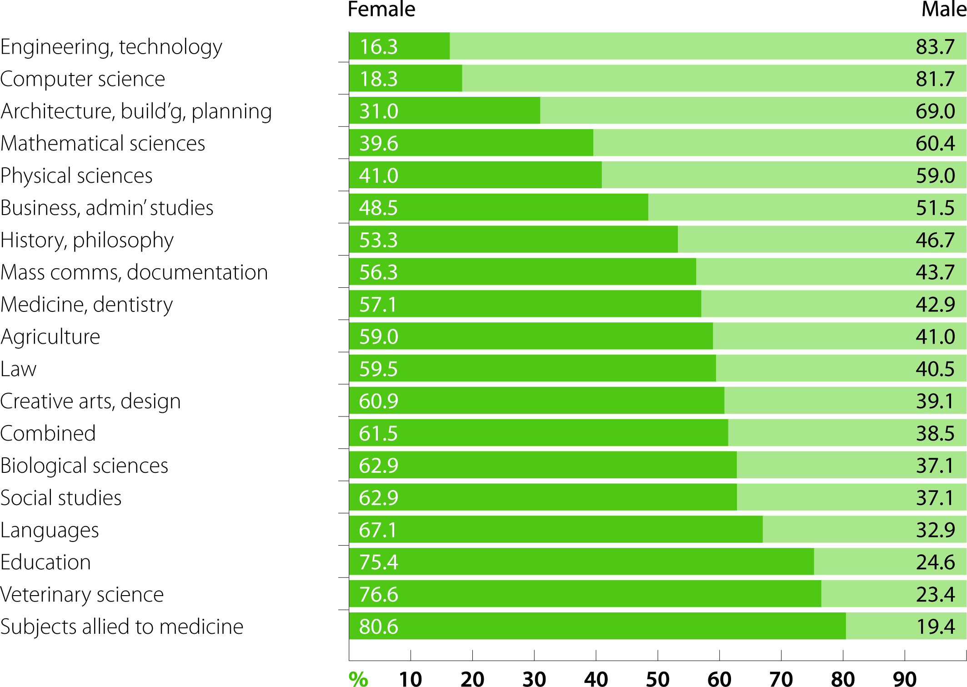
Subject area representation: female and male
[Source: Equality in higher education: statistical report 2011]

Slide 5
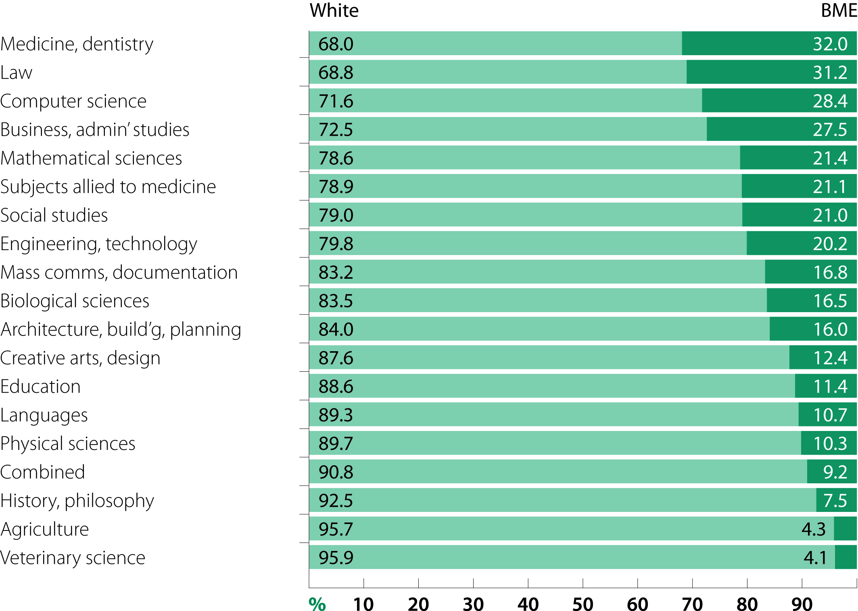
Subject area representation: ethnicity
[Source: Equality in higher education: statistical report 2011]

Slide 6
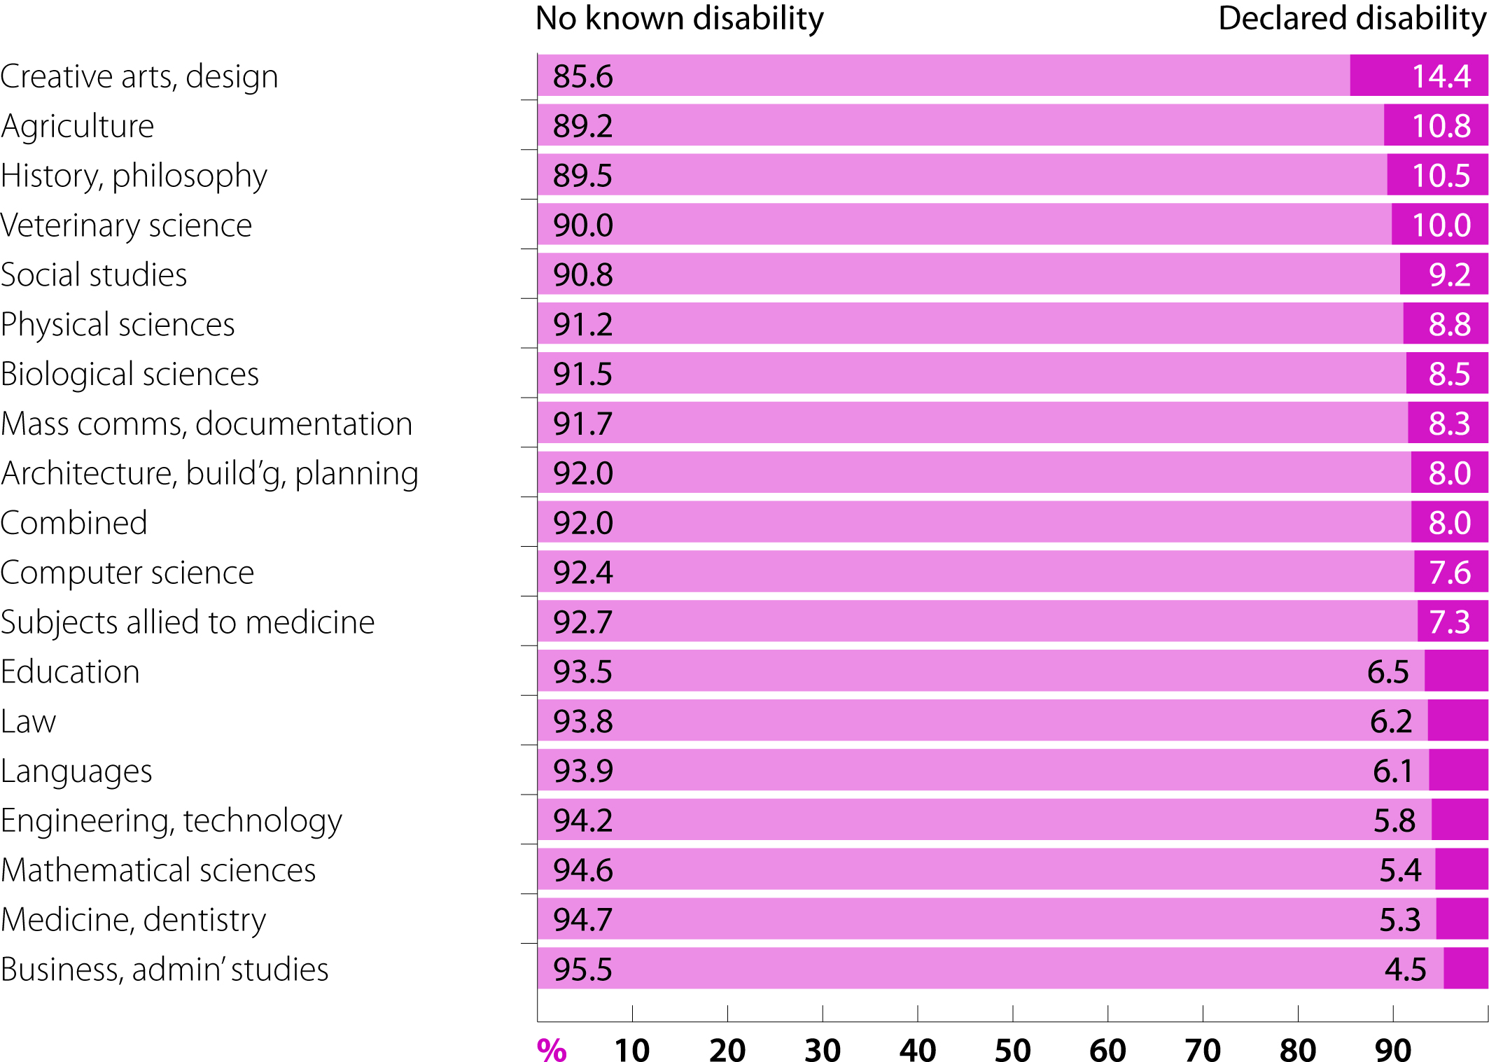
Subject area representation: disability status
[Source: Equality in higher education: statistical report 2011]

Slide 7
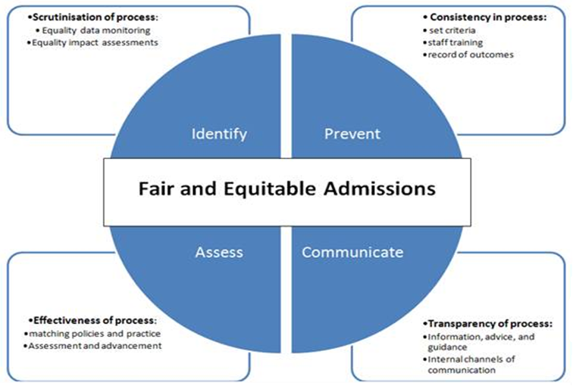
Admissions processes

Slide 8
Admissions – reflective questions
What checks and balances are in place to ensure admissions decision-making is consistent?
What measures are in place to ensure that admissions staff follow procedures outlined in central and devolved policies?
What mechanisms are in place to identify if elements of policy and practice discriminate against certain groups
What training is available to admissions staff?

Slide 9
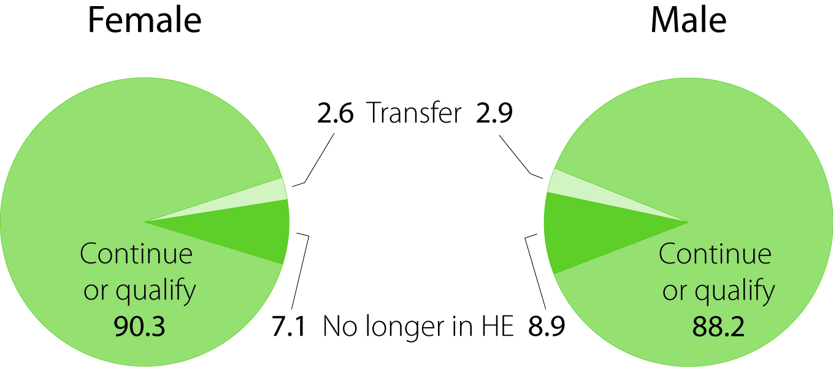
Continuation rates: female and male
[Source: Equality in higher education: statistical report 2011]

Slide 10
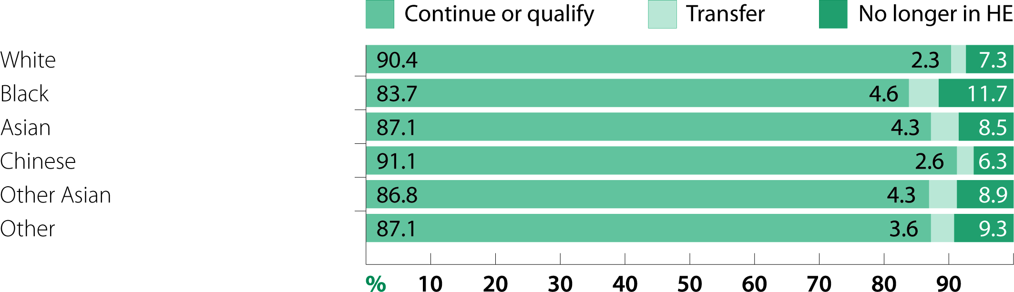
Continuation rates: ethnicity
[Source: Equality in higher education: statistical report 2011]

Slide 11
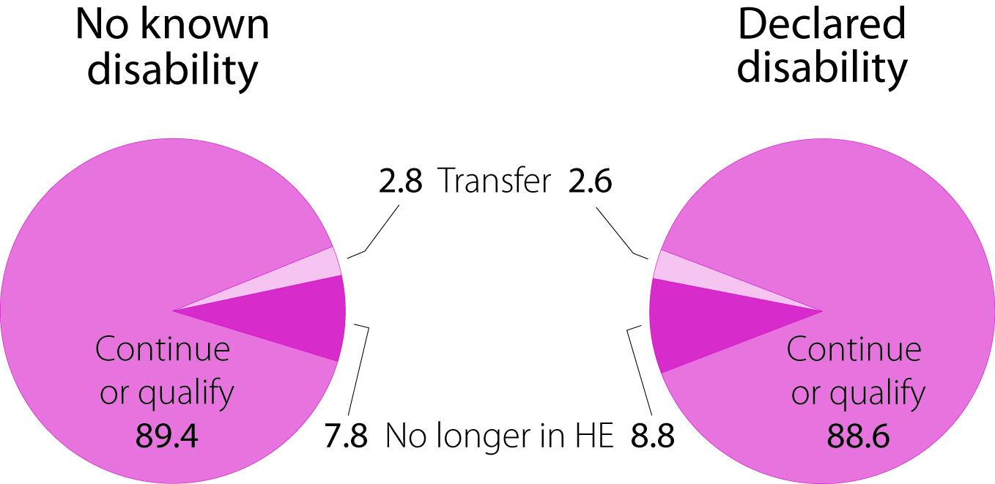
Continuation rates: disability status
[Source: Equality in higher education: statistical report 2011]

Slide 12
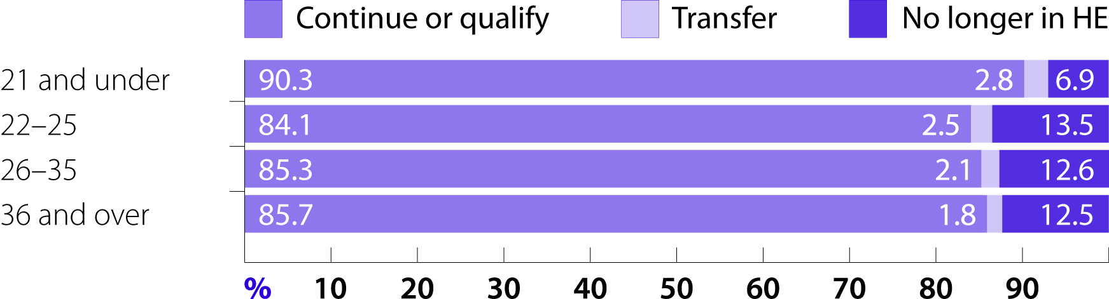
Continuation rates: age
[Source: Equality in higher education: statistical report 2011]

Slide 13
Progression and transition
Adjustments for different learning and teaching methods
Re-orientation - new campus and engaging with new staff
Introductory sessions, buddying and mentoring support integration
Providing a taster week at the host HEI

Slide 14
Progression and transition
Providing students with subject and/or programme handbooks well in advance of starting
Day-release arrangement
Ensuring reasonable adjustments are made across the whole of a student’s course, including elective modules in other departments.
Ensuring that the requirements for progression or transfer are genuine competence standards for the course

Slide 15
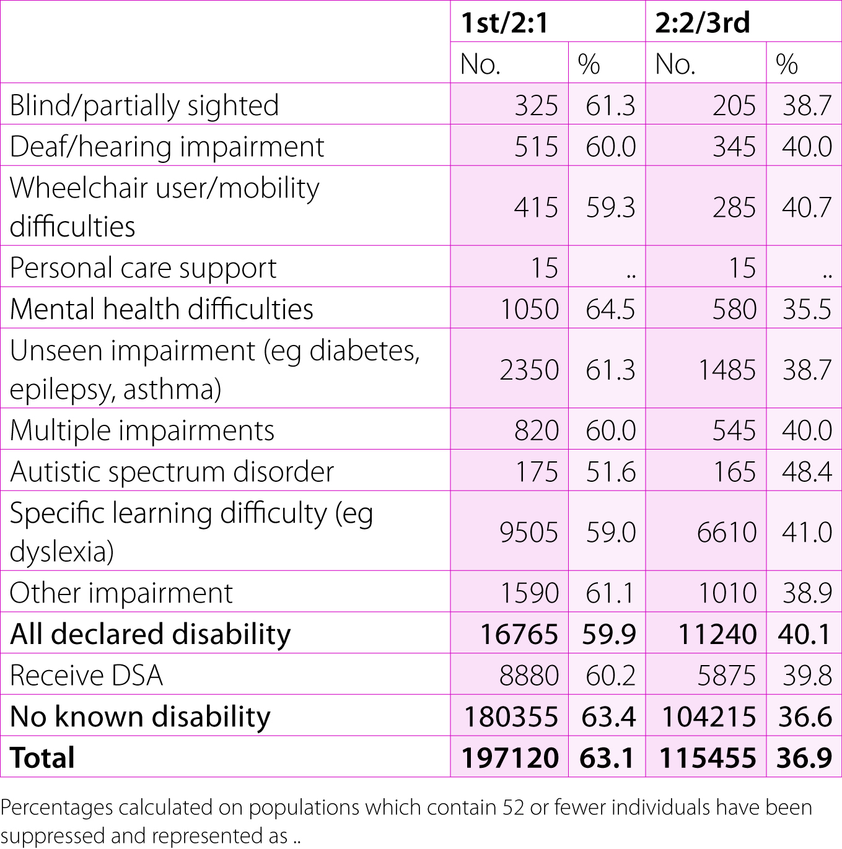
Degree attainment: impairment type
[Source: Equality in higher education: statistical report 2011]

Slide 16
Access agreements
(Office for Fair Access, OFFA)
All institutions who wished to charge above basic level must submit an access agreement by 31 May 2012
The agreement sets out how institutions will sustain or improve access, retention and student success among people from ‘under-represented groups’
“We (OFFA) now require a statement on how you have executed your responsibilities under the Equality Act 2010 in framing your access agreement.”

Slide 17
Equality Act and admissions
HEIs should ensure they do not discriminate against disabled applicants or students in relation to:
      the arrangements they make for determining admission
      the terms on which they make an offer to a disabled student
      the refusal or deliberate omission to accept an application from a disabled person.
HEIs must ensure they have set appropriate competence standards for specific course requirements (see section 2.4); must not discriminate in their induction procedures; and must ensure that a disabled person is introduced to an institution in a clearly structured and supported way, with an individually tailored induction programme if necessary.

Slide 18
Equality Act and progression and transition
HEIs must ensure that arrangements for progression, or for transferring between programmes, do not discriminate against people; reasonable adjustments may need to be made.
The HEI will need to make sure requirements for progression or transfer are genuine competence standards for the course.

Slide 19
The Equality Act: public sector equality duty
Public sector equality duty
      Eliminating discrimination
      Advancing equal opportunity
      Foster good relations
Equality objectives

Slide 20
HEFCE:
Equality and diversity scheme
2.1: To support the sector in achieving and maintaining an appropriately diverse student body and reducing inequalities of student opportunities and outcomes
2.2 To enable fair access to higher education so that all students, regardless of their background, are able to access the institution or programme that best meets their needs and aspirations
2.3 White Paper challenges – throughout the period of transition, impact assess work streams and monitor the cumulative effect of new fees and funding mechanisms. Seek to minimise disadvantages where they do occur.

Slide 21
Government drivers
UN Convention of for the rights of disabled people
      Article 24 – education
      Article 27 - Work and employment
Independent Living Strategy
      6.1 (action to improve specialist employment services for disabled people)
      10.3 (delivering the cross-government strategy for post 16 learners with learning difficulties/disabilities)
      [http://odi.dwp.gov.uk/roadmap-to-disability-equality/employment.php ]

Slide 22
ECU future work
‘Access, retention and success: aligning widening participation and equality strategies’
      What opportunities exist for aligning WP and E&D strategies
      What is currently being done in this respect
      Contact: freya.douglas@ecu.ac.uk

Slide 23
Contact details and resources
Chris.brill@ecu.ac.uk 020 7438 1021
www.ecu.ac.uk 020 7438 1010 (switchboard)

