Slide 1


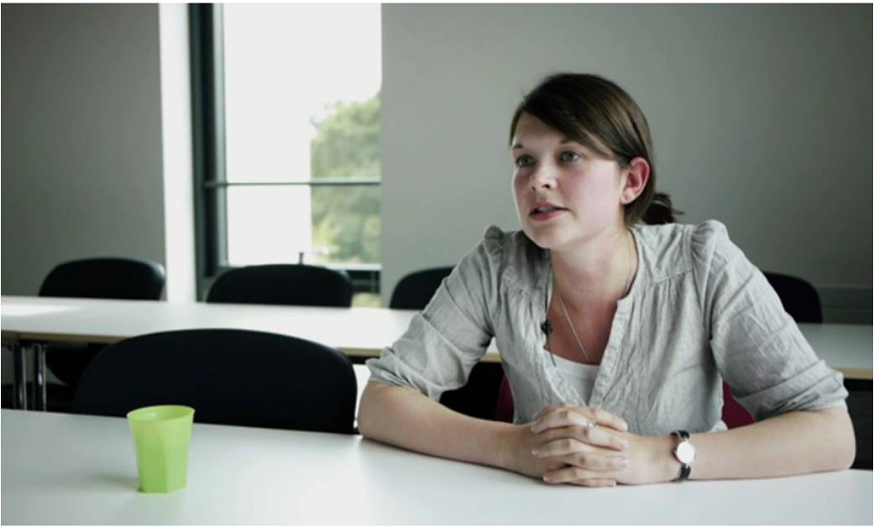
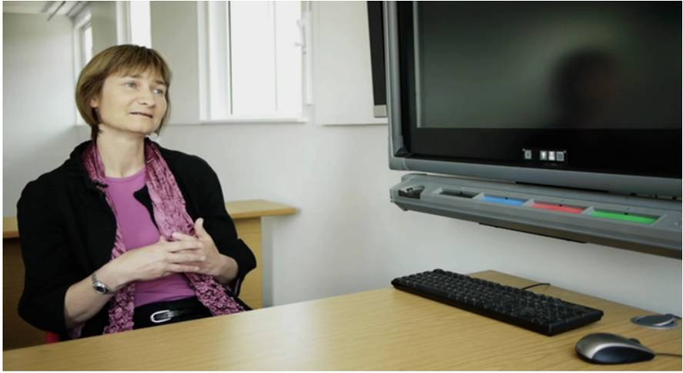
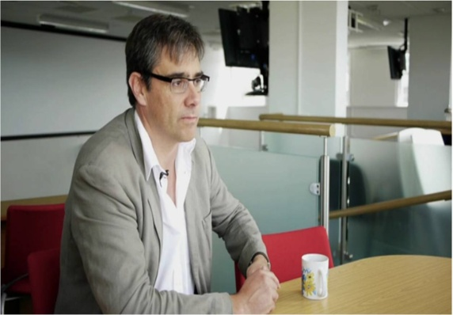
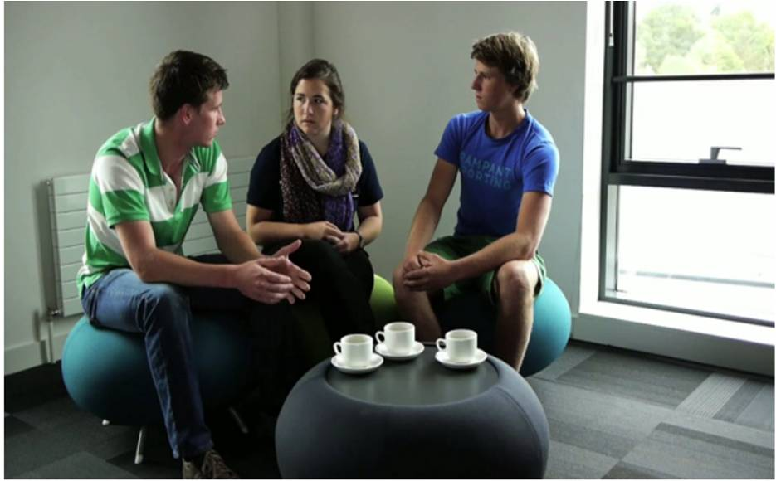
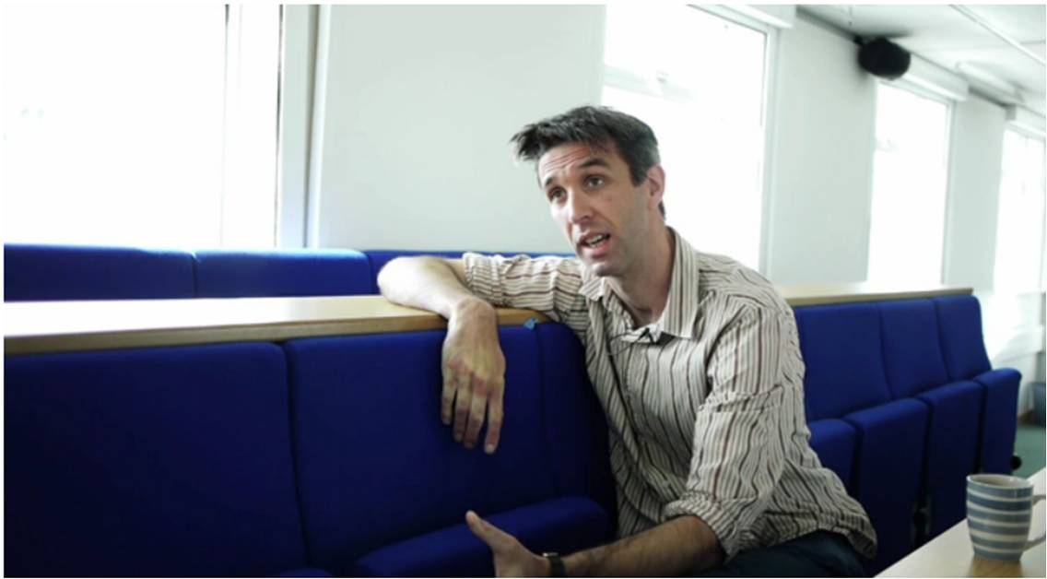
‘Becoming a STEM enthusiast’
A collaboration between Education Enhancement and the College of Engineering, Mathematics and Physical Sciences
Jane Rowe
Education Enhancement

Slide 2
STEM progression and WP
‘Despite the increase in the number of STEM postgraduates and graduates in recent years, the number of pupils taking A-levels in Maths and Sciences is not keeping pace.’ (Russell Group, 2009)
‘Science take-up is strongly skewed, with half of all A-level entries in science coming from just 18 per cent of schools.’ (Royal Society, 2006)
‘…students at private schools are twice more likely that their peers in comprehensive schools to study mathematics at A-level.’ (HE STEM Programme, 2012)
‘Most young people have no idea what a scientist actually does, apart from possibly doctors, vets, and more recently forensic scientists (from television dramas and documentaries)’ (Royal Astronomical Society )

Slide 3
Aim 1
To produce a range of video vignettes for use
in outreach activities
- the excitement and challenges of STEM subjects
- advice on preparing for HE level study
- relevance of STEM subjects
- application to the world of work

Slide 4
‘… for some students the route to [interest/engagement in STEM subjects] will start from an experience of STEM in the wider world, and thinking of STEM in school as a group of inter-related subjects helps to open up those doors… ‘
‘Inspiring teachers, sufficiently supported, are vital to raising students’ enjoyment of, enthusiasm for, and achievement in STEM subjects.’
(HE STEM Programme, 2012)

Slide 5
Aim 2
To produce a range of videos for staff
development purposes – reflections on:
- research-led teaching
- active learning
in STEM subjects
Notes:
Complementary objective to stimulate debate of learning and teaching in STEM subjects

Slide 6
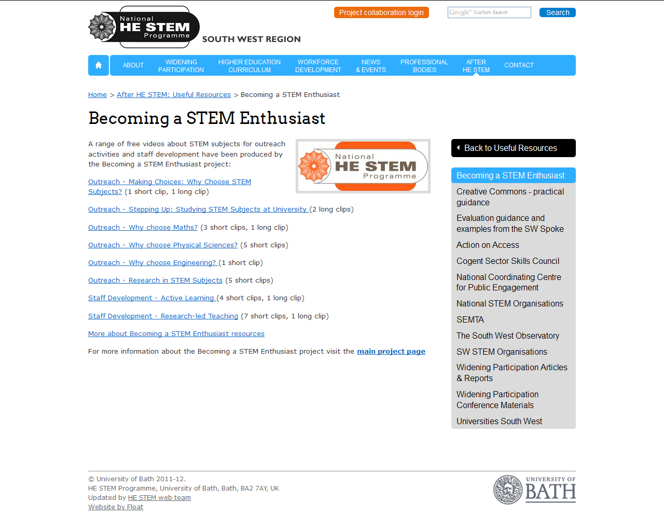
Weblink:
http://www.hestem-sw.org.uk/after-he-stem/useful-resources/becoming-a-stem-enthusiast

Slide 7
Dr Tim Jupp – Why choose Mathematics?
http://vimeo.com/28056387
Professor Peter Cox – Active learning in Maths
http://vimeo.com/28053486

Slide 8
Dissemination
Institute of Physics – videos sent to 207 members of Schools Outreach Officers Network
Institute of Mathematics and Its Applications – videos distributed via www.mathscareers.org.uk
SW Community of Outreach practioners
Career Pilot (14-19 advice on options)
South West Educational Developers Network

Slide 9
For more information:
Project Lead: Jane Rowe, Education Enhancement
J.L.Rowe@exeter.ac.uk)
Website:
http://www.hestem-sw.org.uk/after-he-stem/useful-resources/becoming-a-stem-enthusiast

