Slide 1



Slide 2

What is STEM?
Science
Technology
Engineering
Mathematics

Slide 3
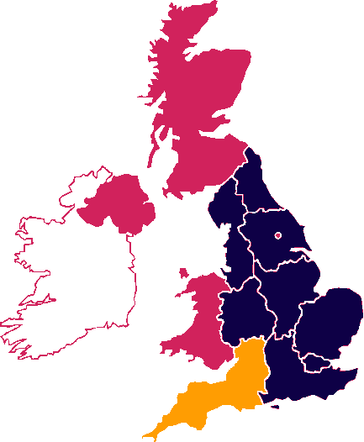
Regional STEM Centres.
LSIS STEM Centre East Midlands
Lough-borough College
SLC East Midlands NCETM RAEng
LSIS STEM Centre West Midlands
Birmingham Metropolitan College
SLC West Midlands NCETM RAEng
LSIS STEM Centre London
City & Islington College
SLC London NCETM RAEng
LSIS STEM Centre South East
Sussex Downs College
SLC South East NCETM RAEng
LSIS STEM Centre South West
Petroc
SLC South West NCETM RAEng
LSIS STEM Centre North East
Redcar & Cleve-land College
SLC North East NCETM RAEng
LSIS STEM Centre North West
Macclesfield College
SLC North West NCETM RAEng
LSIS STEM Centre Yorks & Humber
North Lindsey College
SLC Yorkshire & Humber NCETM RAEng
LSIS STEM Centre East of England
The College of West Anglia
SLC East of England NCETM RAEng
National STEM Centre
Consortium partners: NCETM, RAEng, NSLC
  Coherence with National STEM agenda
  National co-ordination of online support
  National communication plan
  Evaluation of programme
  National Stakeholder Management
  Convening STEM Advisory Group
  Data support

Slide 4



National Priorities
Equality and Diversity in STEM
Knowledge Transfer in STEM
Employer Engagement in STEM
Harnessing Technology in STEM
Science
Technology
Engineering
Mathematics

Slide 5
CBI Education & Skills survey 2009
350 employers
66% of employers reported difficulties recruiting STEM skilled staff, particularly at graduate and post-graduate level

Slide 6
Supply and demand in the processing industries by 2022
Employee group | Forecast demand | Forecast supply
Manager and professionals | 55,000 | 68,000 | Over supply of 13,000
Technicians and skilled operators | 72,000 | 31,600 | Short fall of 40,400

Slide 7
Two-thirds of employers who express a preference prefer STEM degrees
STEM 69%
Business 23%
Social sciences 5%
Humanities 2%
CBI Education and Skills survey 2009

Slide 8
What do employers want?
Skills (team work, problem solving etc) 78%
Positive attitude 72%
Relevant work experience 54%
Specific degree subject 41%
High degree result 28%
University attended 8%
Foreign language capability 2%
CBI Education and Skills Survey 2009

Slide 9

STEMNET creates opportunities to inspire young people in Science, Technology, Engineering and Mathematics (STEM)
Notes:
This enables young people to develop their creativity,
problem-solving and employability skills, widens their
choices and supports the UK’s future competitiveness.
STEMNET helps encourage young people to be well
informed about STEM, able to engage fully in debate, and
make decisions about STEM related issues.

Slide 10
The unique contribution of FE
A diverse, vibrant sector that every year educates and trains around 3 million people and is indispensible to STEM employers and the UK economy

Slide 11
STEM support from the post-16 sector
Contribute to the drive to increase STEM A level participation
Respond to local employers’ needs
Provide occupation-specific training in STEM
Support other STEM education providers (schools, private providers, HE)
Provide generic employability skills, including numeracy
Provide high quality careers advice and guidance on progression routes

Slide 12

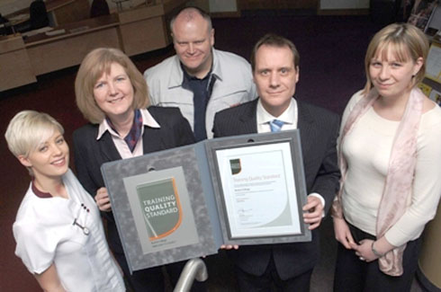
Workforce Development
More than 70 per cent of the 2020 workforce is in employment now
Further and higher education works with employers to offer opportunities for those already in work to develop skills

Slide 13

Development of higher level skills in the workplace can make a significant contribution to UK competitiveness
Universities and employers stand to gain many benefits from closer engagement

Slide 14
Why are higher level skills important?
Improve productivity
Improve competitiveness
Economic growth
Maximise innovation, creativity and enterprise

Slide 15
Why employers invest in higher level skills?
Increased innovation
Raised productivity
Improved quality of work / products
Improved client satisfaction
Worker Satisfaction
Reduced absenteeism
Better staff retention

Slide 16
National STEM Programme
Support the development of STEM provision that is more flexible, accessible and responsive to the needs of employers
Encouraging those currently within the workforce to develop enhanced knowledge and skills.

Slide 17
The Partners
Bath University
Exeter University
Petroc
Plymouth University
University of the West of England
Weymouth College
http://www.hestem-sw.org.uk/

Slide 18

Achieving value for the employer
How to achieve business value for the employer, professional development for the employee and the benefit of employer engagement to the business of the University?
Understanding employer needs.
Improving training for University and College staff to enable them to deliver a better service to employers.

Slide 19
Employer engagement
Continuing professional development
Course design and delivery
Small consultancy projects
Student projects and work placements
Research support
Knowledge Transfer partnerships
Bespoke Training

Slide 20

Settings: | 1/320s, f/11, ISO 100
Focal length: | 32mm (55mm for 35mm film)
Flash usage: | No flash
Exposure bias: | 0 EV
Keywords: | lost confused unsure uncertain unclear perplexed disoriented bewildered decision option life clarity chaos chaotic vague obscure undecided choice sign signpost concept conceptual idea inspiration answers lifestyle unknown preference alternative pick select confusion astray doubt doubtful conclusion inconclusive dubious trouble pressure stress frustration problem solution worried distraught worry

Slide 21
Improving Employer Engagement
Engage engineering employers in HE level workforce provision
Understanding employer engagement
Developing new approaches to employer engagement and embedding these within HEIs in the South West

Slide 22
Progression to higher level skills
Collaboration between further and higher education
Streamlining engagement for employers
Provide pathways to higher level skills for students

Slide 23
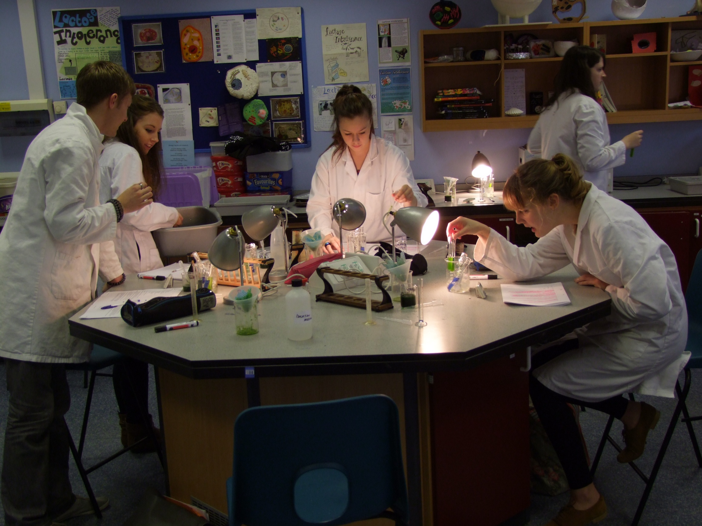

Slide 24
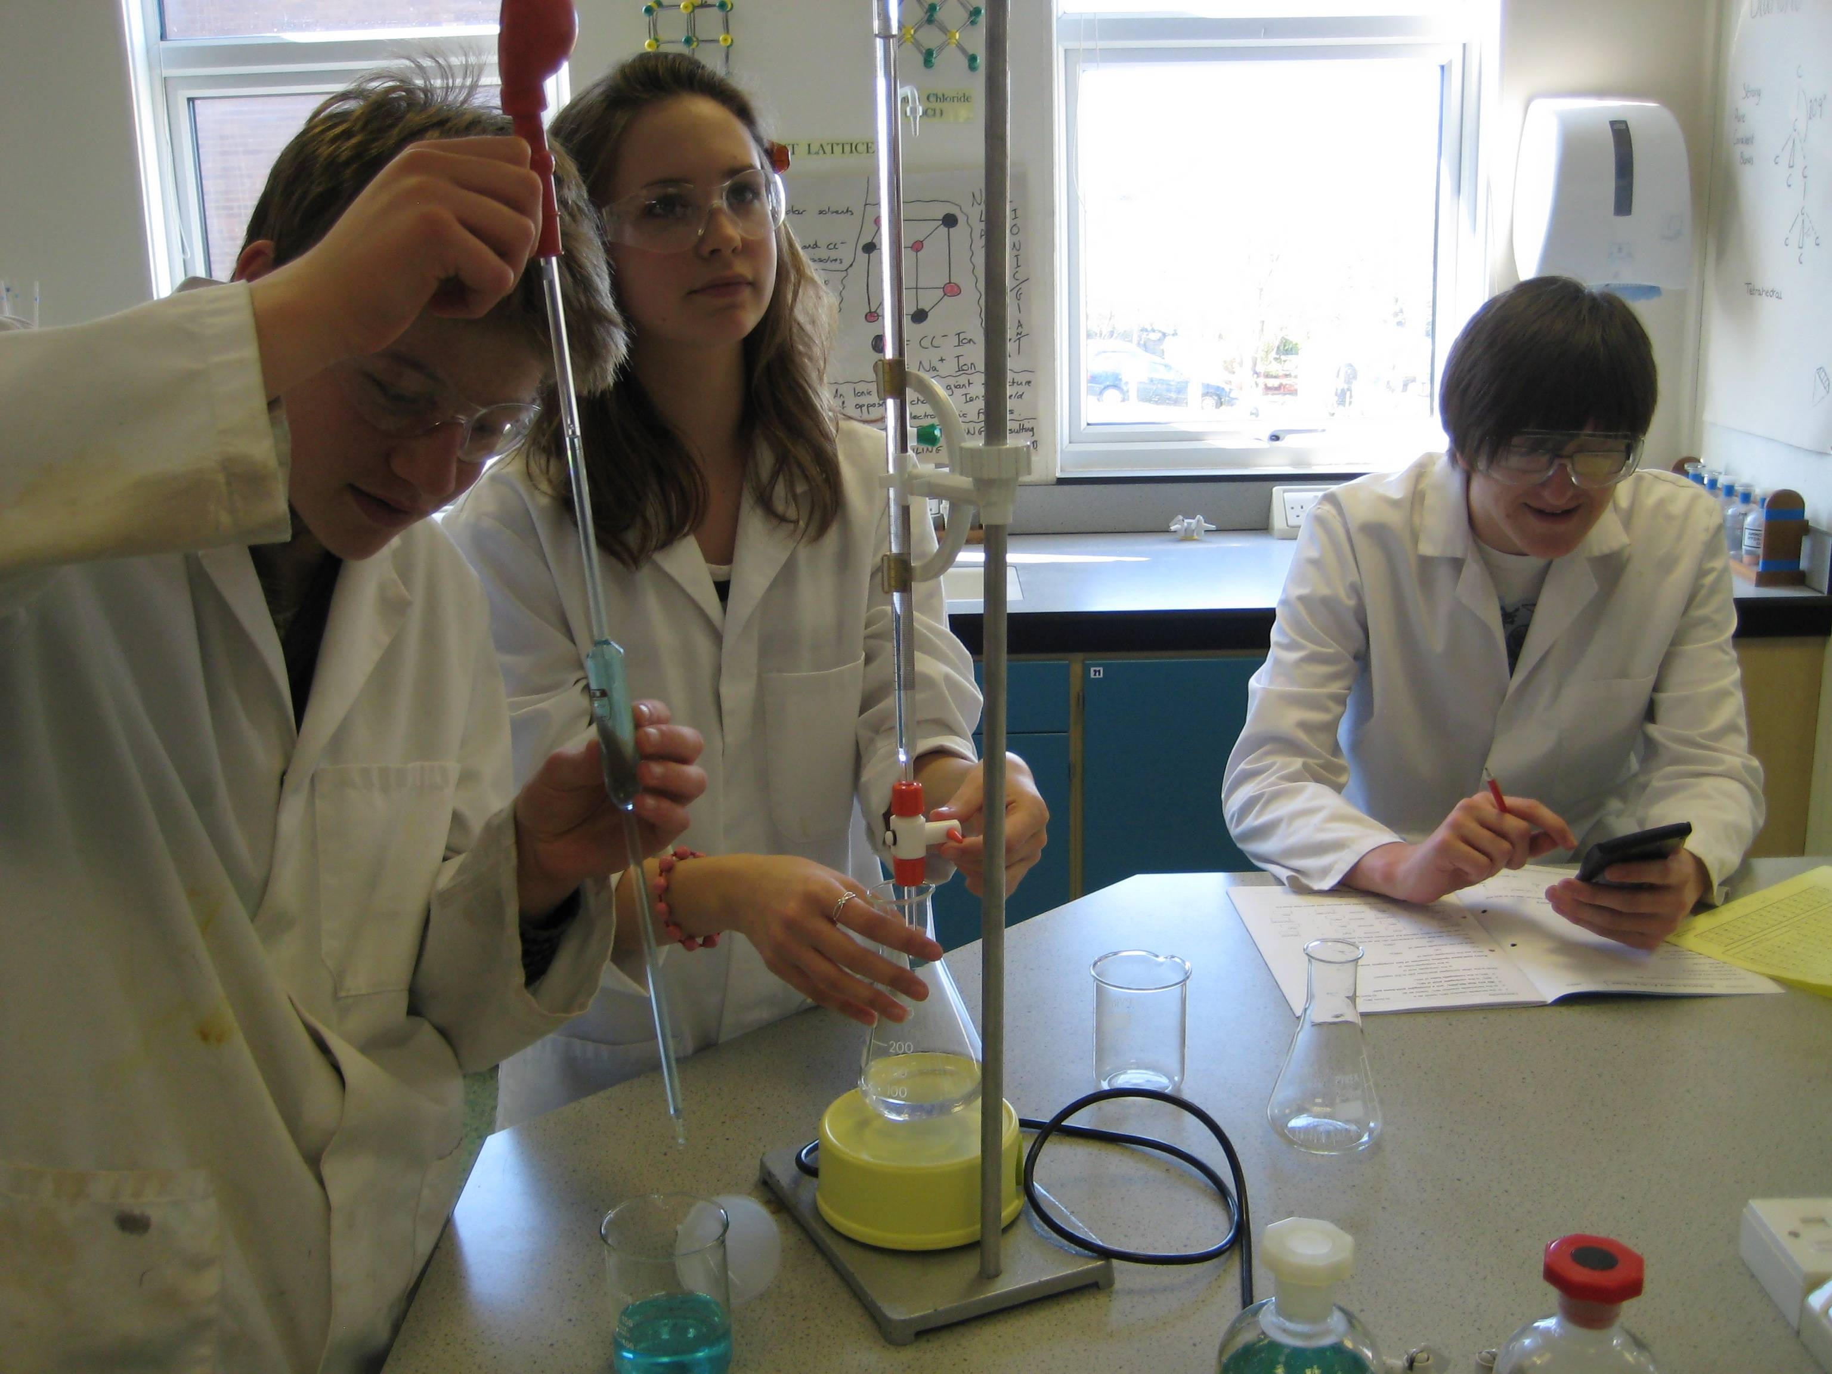

Slide 25


Slide 26


Slide 27


Slide 28
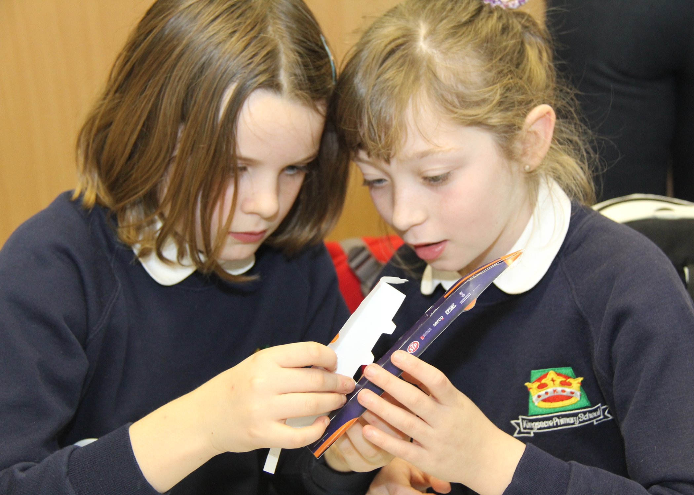

Slide 29
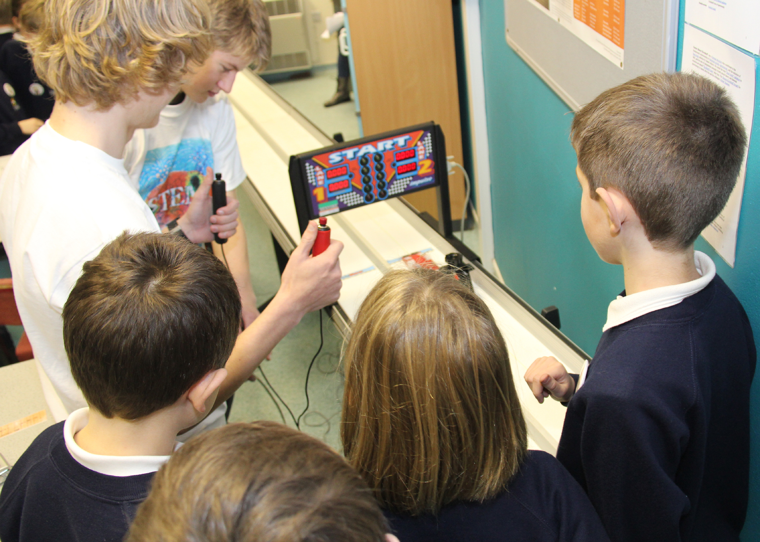

Slide 30


