Slide 1

Strategies for
Employer Engagement
NATIONAL HE STEM PROGRAMME SEMINAR - 25 May 2012, Bournemouth University
Dr Richard Bolden
Centre for Leadership Studies

Slide 2
Higher Level Skills Research Project
Institutional case studies (n=10)
Facilitators and barriers to
HE-Employer Engagement?
Defining
Sustaining
Supporting
Case studies of EE initiatives (n=27)
Notes:
Case studies of EE initiatives (n=27)
Institutional case studies (n=10)
Literature review
April 2007 - Dec 2009
University of Exeter in collaboration with Universities South West and CIHE
over 150 reports reviewed
Over 150 interviews conducted
In approx 25 HEIs and 10 FECs
Over 30 employers and employer groups consulted
Case studies in all English regions

Slide 3
Defining the focus of EE activity
Strategic fit for the HEI and its partners
Strategic Fit
Practical Fit
Specific Engagement Opportunity
People Fit
Connor and Hirsh (2008) Influence Through Collaboration
Notes:
Main drivers for engagement
To increase supply of graduates or certain skills
To improve productivity or ways of working
Additional drivers for engagement
Widening access though lifelong learning
To help create and apply new knowledge
To develop enterprise and innovation
To motivate staff and build relationships
Alignment with institutional strengths and strategic direction
A fit in terms of values, ethos and ways or working
A real business need
HE best placed as the learning provider
Benefits which the intended learners will easily recognise

Slide 4
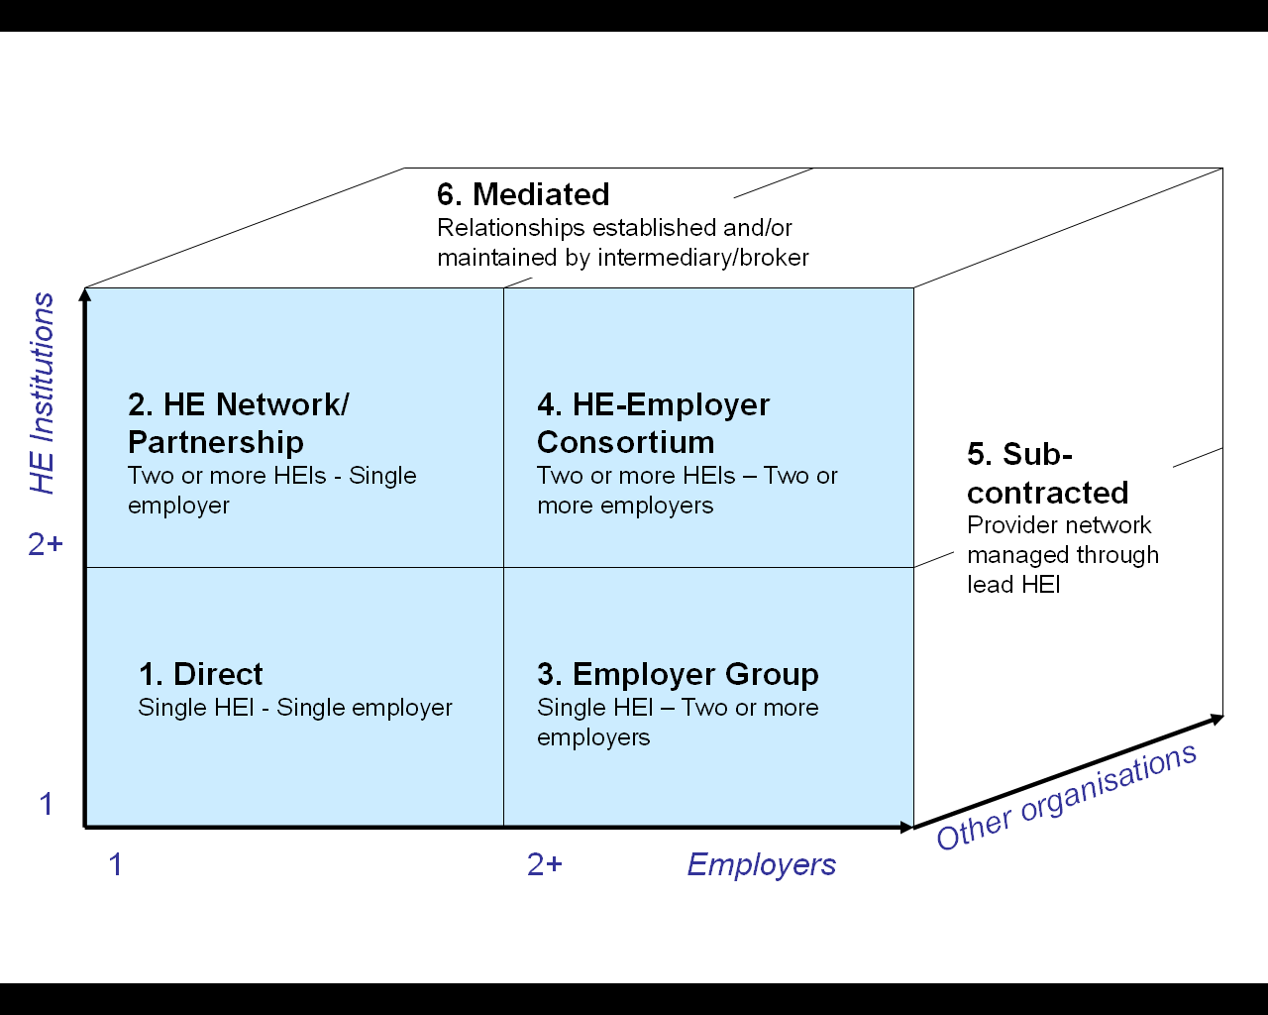
Defining the focus of EE activity
Strategic fit for the HEI and its partners
Finding partners and establishing the relationship
Notes:
Key stakeholders
HEIs
FE colleges
Private trainers
Employer groups
Business Link
RDAs
SSCs
Professional bodies
…

Slide 5
Defining the focus of EE activity
Strategic fit for the HEI and its partners
Finding partners and establishing the relationship
Designing and delivering an appropriate learning package
I. Major new ventures with employers
e.g. new foundation degrees, MSc programmes
I. Major new ventures with employers
e.g. new foundation degrees, MSc programmes
II. Enhancing existing provision
e.g. integrating work based modules into degree programmes
II. Enhancing existing provision
e.g. integrating work based modules into degree programmes
III. Short bespoke courses, workshops and seminars
e.g. CPD, access to HE, forums (often unaccredited)
III. Short bespoke courses, workshops and seminars
e.g. CPD, access to HE, forums (often unaccredited)
IV. Assessment or accreditation of in-company learning
e.g. awarding academic credits for in-house provision
IV. Assessment or accreditation of in-company learning
e.g. awarding academic credits for in-house provision
Notes:
Creative adaptation of existing HE offerings
Employers can offer complementary learning experiences
Effective development of new or bespoke courses
Accreditation where appropriate
A learning design suitable for the target group of learners

Slide 6

Supporting Employer Engagement
Staff resourcing
and capability
Subject
knowledge
Teaching experience
Customer focus & service orientation
Resourcing for EE

Slide 7

Supporting Employer Engagement
Staff resourcing
and capability
Culture and systems supportive of collaboration
Bridging
cultures
Flexible approach
to purpose of HE
Time and incentives
for academics
Financial & admin flexibility

Slide 8

Supporting Employer Engagement
Staff resourcing
and capability
Culture and systems supportive of collaboration
Funding and investment
Public funding for development
Recognising the real cost of employer engagement
Assessing sustainability
& financial risk
Notes:
Are our staff capable of doing what we’re asking of them?
Are they recognised & rewarded for this activity?
Are our financial and administrative systems up to the job?
Are we capable of responding in a ‘business like’ way?

Slide 9

Developing, sustaining and leading EE
An academic with passion for the work
Collaborative approach
Role clarity
Ensure buy-in
Build in continuity
Support at senior levels
Need for ongoing leadership
Recognise complex leadership needs

Slide 10
Institutional approaches to EE
Changing contexts for EE
● Evolving approach  Impact of policy, context, etc.  Future plans, aspirations and challenges
Supporting and resourcing EE
Structures for teaching & learning
Communicating and embedding approach
● Structures of responsibility in HEI top teams
● Outsourcing and partnerships
● Organisational support infrastructure
● Resourcing (human, financial, facilities)
● Employer input to curriculum
● Changing forms of learning delivery
● Student employability and work experience
● Accreditation of learning
● Building and sustaining relationships with employers
● Branding and promotion
● Institutional culture change
● Support, reward and recognition systems
Strategic purpose of EE
● Relationship to academic mission  Key beneficiaries  Role of HE in society

Slide 11
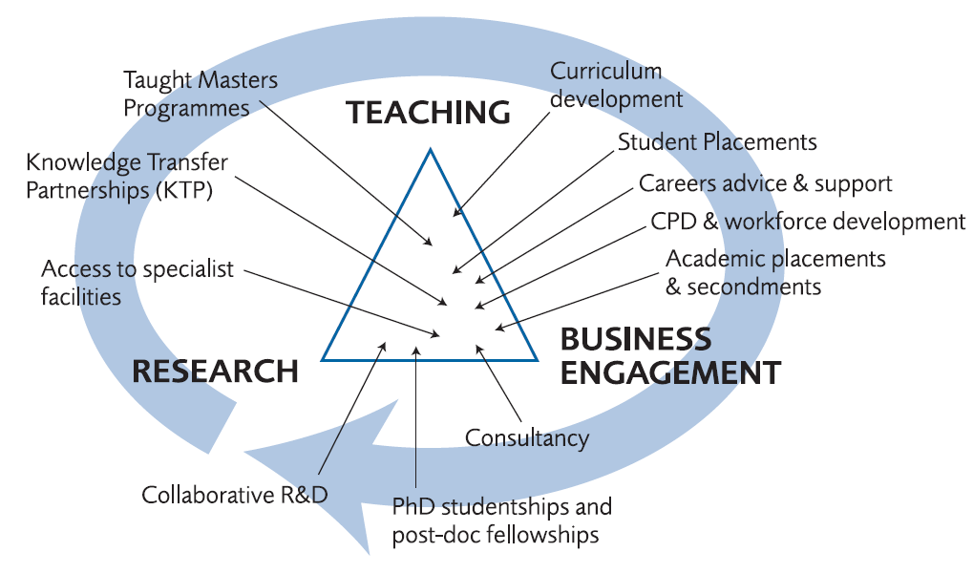
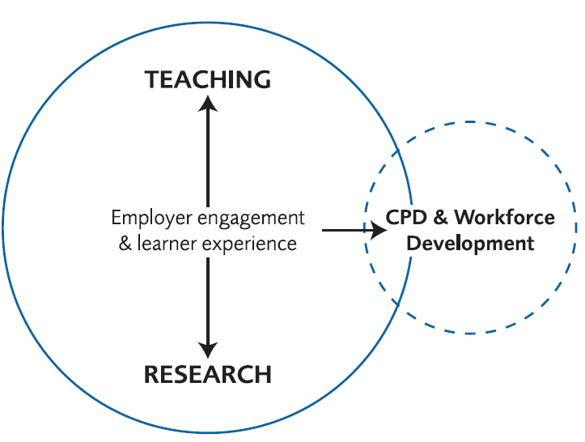
Putting engagement at the heart of HE

Slide 12





A leadership challenge?

Slide 13

Building genuine partnerships
“The key to successful partnerships is developing a relationship based on mutual respect and understanding. To use the analogy from the Native American proverb “never judge a man until you walk a mile in his moccasins”, universities, employers and other organisations/bodies with an interest in the development of a high-skills economy must take time to get to know one another – to develop an appreciation of the unique contribution of (and pressures on) each partner and what each partner could do to facilitate better working relations.” (Bolden et al., 2009)

Slide 14


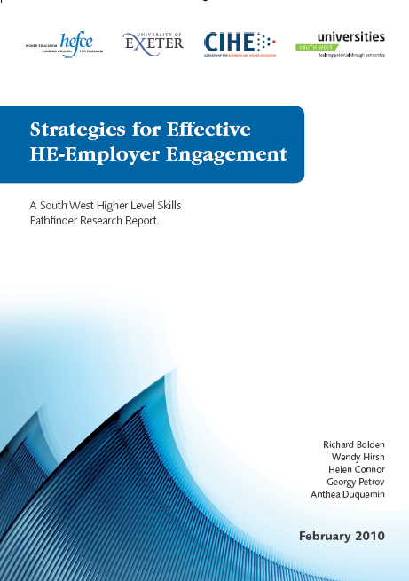
Further details
Richard.Bolden@exeter.ac.uk
www.exeter.ac.uk/leadership

