Slide 1




HERE to Stay? Findings from the HERE Project 2008 - 2011
Ed Foster & Sarah Lawther - Nottingham Trent University
Christine Keenan & Natalie Bates – Bournemouth University
Becka Colley & Ruth Lefever – University of Bradford
Notes:
1

Slide 2
Session goals
Share some of the findings from the HERE Project, particularly
  Why students had doubts in the first place, and
  What helped them to stay
Provide participants the opportunity to reflect on their own practice and consider how to make improvements at their own institution

Slide 3

HERE Project
Higher Education: Retention & Engagement
Two areas of work
- Impact of doubting on student retention
- Impact that couse teams can make on retention
Focus on first year
Notes:
3

Slide 4
Doubting
Defined as having doubts about the course/ university serious enough to consider leaving
How many students are doubters in the literature?
  21% Rickinson and Rutherford (1995) – 39% Sodexo (2010)
  Yorke & Longden (2008) – 25% (rising to 40% if less informed about course)
Doubting as a cause of withdrawal
  Gradual accumulation of doubts - Ozga and Sukhnandan (1998)
Differences between doubters and leavers
  Internal factors - Mackie (2001), ability to adapt - Roberts et al (2003)
But UK progression is good
  NAO (2007) suggests that progression to yr 2 is approx 90%
  Our work is therefore also about engagement

Slide 5
Engagement
Retention is the minimum form of engagement
Kuh et al (2008) describe student engagement as:
  “the quality of effort students themselves devote to educationally purposeful activities that contribute directly to desired outcomes and the effort institutions devote to using effective educational practices”.
  ‘… positive, statistically significant effect on persistence, even after controlling for background characteristics....’ (Kuh et al, 2008, p551)
Astin (1985) - engagement (involvement) along a continuum
Hardy and Bryson (2010) student engagement
  Belonging, emotional engagement
  More than the classroom activities
  Multiple loci

Slide 6
Methodology
Strand 1 – Doubting
Welcome Week Surveys & Student Transition Surveys (2009 & 2011) to all first year undergraduates (online) (n=2,995)
Student focus groups with doubters and non doubters
Analysis of persistence
Strand 2 – programme team impact
Interviews with 10 programme teams
  what do programmes do to support retention?
Survey of students on same programme
Created case studies of 10 programmes across the three institutions
Notes:
All first year undergraduates May 2009
Limitations
Voluntary responses
May not be accessing students not engaged with university
NEXT TIME – UCAS TARRIF, WHAT DOES GET STUDENTS ENGAGED ETC. Talk about changes…ask more quantiative questions and explore where we need further information – when they doubted,

Slide 7

Key Findings

Slide 8
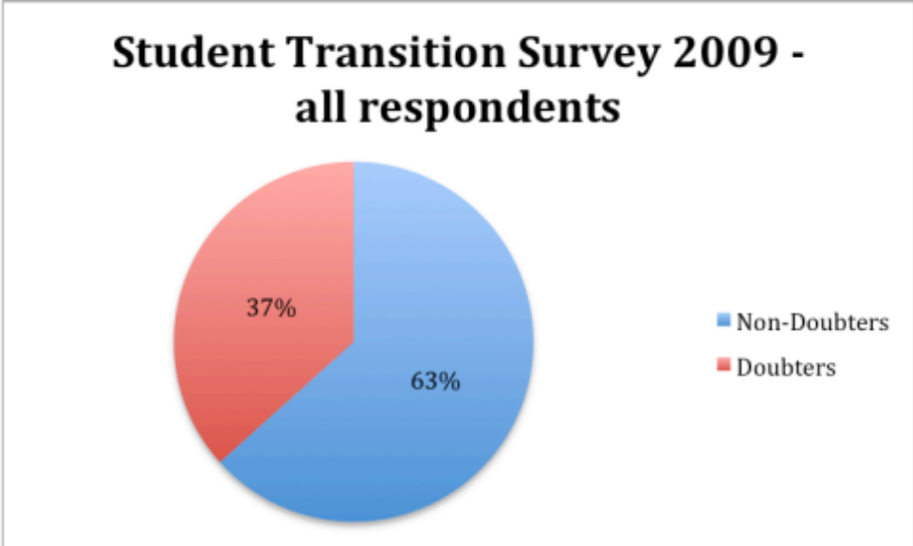
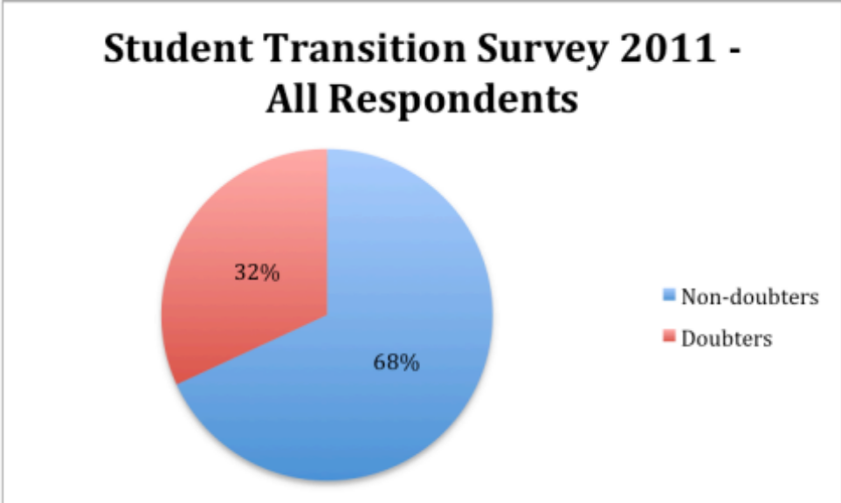
Finding a)
Approximately one third of first year students have experienced doubts sufficiently strong to make them consider withdrawing at some point during the first year
Notes:
At NTU, most had decided to stay

Slide 9
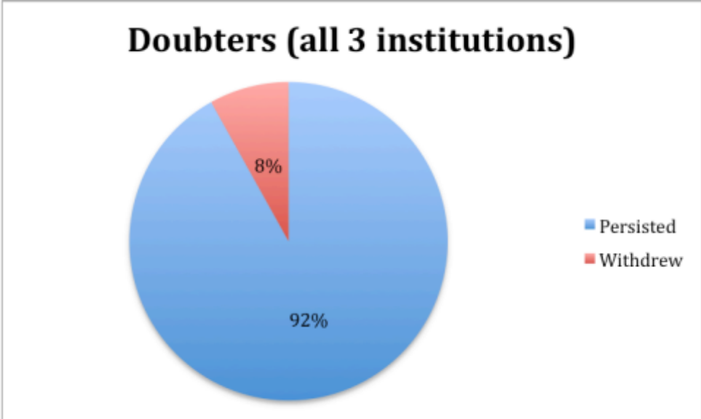
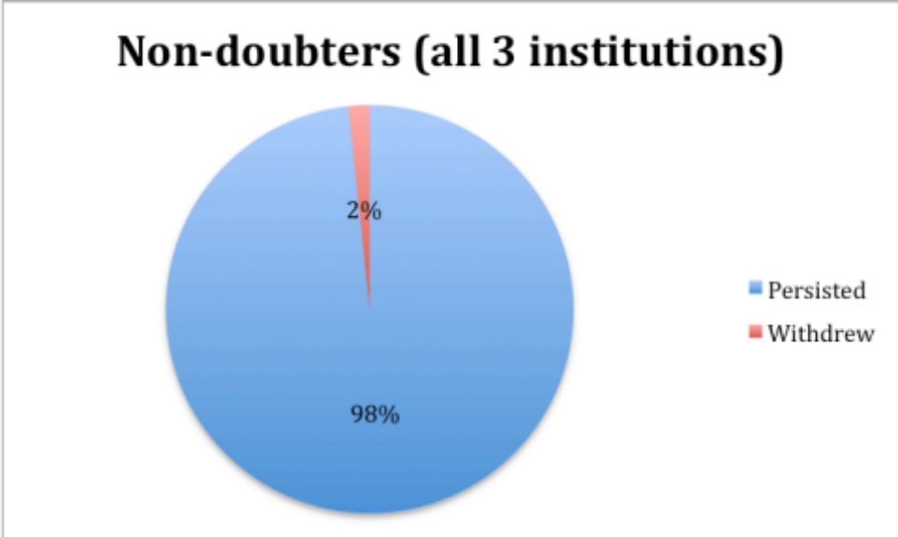
Finding b)
Doubters are more likely to leave than non-doubters
483 students granted us permission to monitor their persistence
  182 doubters
  301 non-doubters
    Tested Dec 2009 - Overall progression better than institutional benchmarks
Implications
  Links to other UK research & supports Ozga & Sukhnandan’s model
    Withdrawal not due to a sudden shock
Notes:
Small number of non-doubters who withdrew

Slide 10

Finding c)
Doubters reported a poorer quality experience than students who have not doubted
Measured 17 student experience factors
  For example ‘my subject is interesting’
  Tested both the importance and actual experience of a factor
  In most instances importance was higher than the actual experience
    Exceptions – social, peer & family support
  Average gap for non-doubters = 12%
  Average gap for doubters = 29%
  Tested seriousness in 2011, more serious doubts = poorer experience reported
  Factor analysis grouped the Student Experience Factors into 3 variables
    Academic Experience Variables
    Support, Resources and Future Goals
    Student Lifestyle
  Strongest link between academic experience and likelihood of early withdrawal

Slide 11
Poorer quality experience cont.
Doubters reported:
  Less likely to understand differences between FE & HE
  Less likely to have had difference explained
  Less likely to find pre-arrival course accurate
  Finding course less enjoyable
  Fewer friends & less likely to find course ‘friendly’
  Less likely to feel that they belonged
  Studies harder to cope with
    At UoB actually scored lower grades
  Feeling less confident to ask for help
Overall gave an impression of being far less well engaged with their peers, their course and their university
Evidence about UCAS tariff was inconclusive
  “I don’t seem very involved
  with the University to be honest …
  probably if I see my tutor on the road,
  he wouldn’t recognise me”.

Slide 12

Finding d)
Students usually report more than one reason for doubting
Doubting appears to become a state of mind
Looked for differences between doubters who stayed & doubters who left
Doubters who left reported a more negative experience overall

Slide 13
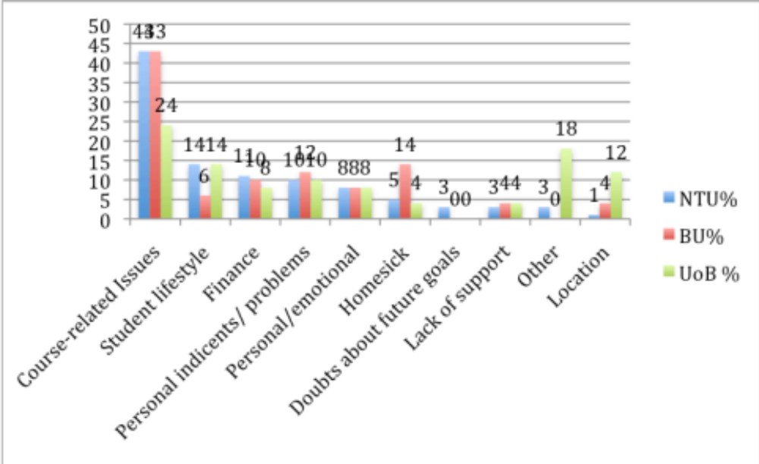
Finding e)
The primary reasons for doubting are associated with student perceptions of the course
Similar to other studies
  for example Yorke & Longden 2008
Course was the main focus for most students
Most important academic reason was ‘doubts about coping’
2009 Student Transition Survey

Slide 14
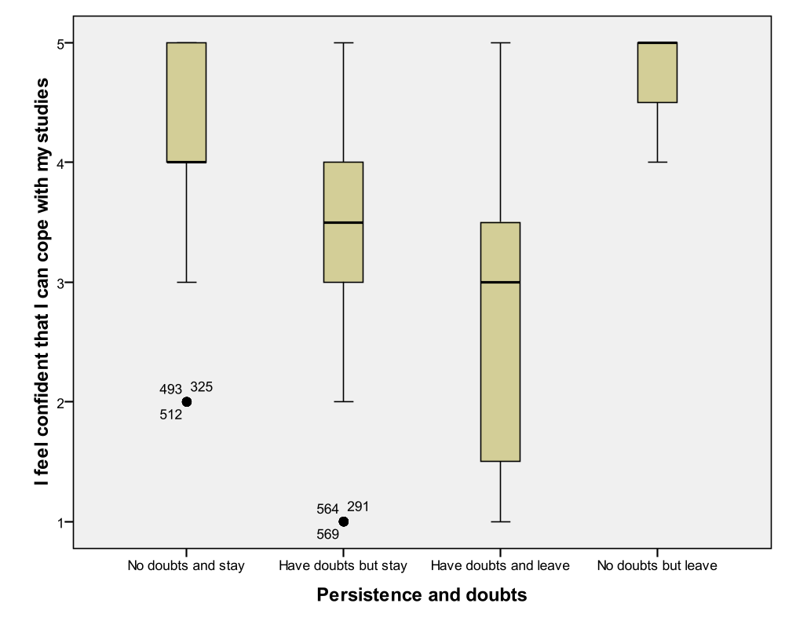
Confidence
Cramers V test: strongest association with doubting was ‘I feel confident that I can cope with my coursework’.
14
Notes:
14
A Cramers V test was applied to 17 variables that asked students about learning and teaching. The variable with the strongest association with doubting was ‘I feel confident that I can cope with my coursework’. Examples of 17 variables were - My fellow students are supportive
My family is supportive
I have easy access to University resources (e.g. computers, library books that I need)
I would know where to go within the university if I had a problem
I like the house/flat/halls that I am living in
I have an enjoyable social life
I am confident that I will have enough money to complete my course
Completing my degree will help me achieve future goals (eg career)
Further analysis was carried out that looked at confidence in coping with studies and the progression of students within the sample.
FIGURE 2
The box plot (Figure 2) illustrates those students who had not had doubts rated their confidence to cope with coursework higher than those students who had doubts and stayed. The students who rated their confidence lowest were students who had doubts and left. This suggests that strategies to increase student confidence in coping with their studies may decrease their likelihood of doubting and subsequent withdrawal.
The box plot (Figure 1) illustrates how the scores given by these students in answer to the statement ‘I feel confident that I can cope with my studies’ (rated from 1-5 where 1= strongly disagree and 5= strongly agree) varies among students who have had no doubts and stayed (non-doubters), have had doubts and stayed, had have doubts and left and have had no doubts and left. The ‘box’ illustrates the middle fifty percent of cases. The thick black line across the box illustrates the median value. The vertical lines either side of the box (with a T at each end) indicate the remaining cases except the outliers which are indicated by a dot (with the reference number of each case alongside).
Interesting group – no doubts and leave – but 4 are non doubters (12 left who were doubters)

Slide 15
Finding f)
There were four main reasons cited by doubters for staying
‘Support from friends and family’
‘Adapting to course/ university’
‘Determination/ internal factors’
‘Future goals/ employment’
Impact of friends & family undervalued by students
  Importance 13th of 17 Student Experience Factors
  More likely to experience supportive friends
  In 2009, open question
    Friends & family most important (friends at university)
  In 2011, when asked to choose from options, most important reason
    Friendship features scarcely at all

Slide 16

Finding g)
The primary times for considering leaving are immediately before and after Christmas
Weather, tiredness & January blues will play a factor, but
Also key times for first assessments & feedback
Relatively few of our respondents stated that they had doubts before arriving at University
  Perhaps had already withdrawn, or had forgotten early stresses

Slide 17
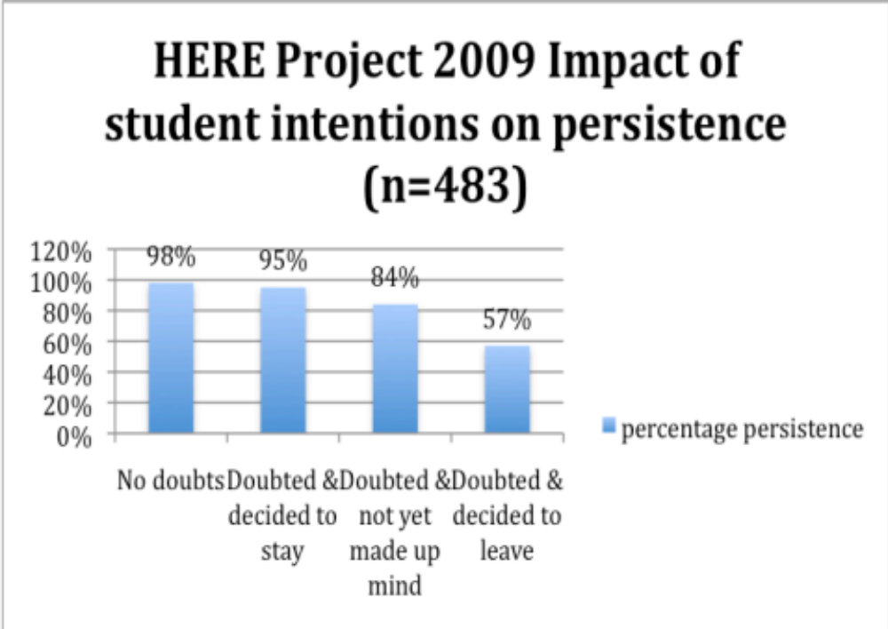
Finding h)
Students reported different degrees of doubting

Slide 18
Finding i)
Some student groups appear more likely to doubt than others
Students are more likely to be doubters if they are in the following groups
  Female – but less likely to actually leave
    Prior US studies suggest that female students suffer a dip in confidence during the first year not recovered until the second
    Male doubters were far more likely to leave
  Student with disabilities – also more likely to leave
  Part-time students – more likely to leave
  Accommodation (living in private halls more likely to doubt)

Slide 19

What do we do with this knowledge?

Slide 20
How do we respond to this data?
Staff capacity building
Student capacity building
What needs to change?
Who needs to change?
How do we change?
Who checks change took place?
Acad-
emic
Social
Services
Student engagement & belonging
Institutional
management &
co-ordination
Pre-entry in HE Beyond HE
What Works
Institutional Retention & Success model (2012)

Slide 21
First Year Experience Models (Wilson 2009)
1st Generation
  Co-curricular change, Student Support Services, SU, specialist advice etc
2nd Generation
  Curriculum changes, transition modules
3rd Generation
  Whole institutional change, policy, interconnectedness, links between services and the academic environment

Slide 22
Discussion
With regards to retention & engagement, what is your institution good at (or at least your part of the institution)?
If you wanted to bring about change, where would you go first?
Who is the biggest lever you have access to?

Slide 23

The HERE Project toolkit
One approach to change

Slide 24
The HERE Project toolkit
Based on
  Feedback from doubters
  Interviews and feedback from programme teams
Contains 9 recommendations for programme teams to improve retention
  Each with suggested actions
  Diagnosis comes as part of the first theme
Broadly around two themes
  Reducing doubting in the first place
  Supporting doubters
Designed as a resource for discussion and staff development
  Suggest teams implement strategies that work for them

Slide 25
Using the toolkit
Aimed at programme teams
  Tool for discussion
  Team meetings
  Away days
  Staff development events
  In a perfect world, would be facilitated
  Has been used to bring about change at institutional level
    E.g. NTU enhanced academic tutorials programme
Experiences so far
  Staff just grateful for the opportunity to discuss
  Interesting that communication across programmes weaker than we expected
  Staff tend to just ‘leap in’

Slide 26
Stages
Stage 1
Take Stock
‘Identify students at risk’
Programme leader
Look at formal & informal data
Ask questions
What do you already know?
Stage 2
Consider ‘student transition’ & ‘social integration’
Team meeting/ away day
Reflect on own practices, discuss recommendations & make plans
Stage 1
Review
Subsequent team meetings
Review progress, reflect and consider other themes

Slide 27
9 Recommendations
Reducing doubting
Identify and respond to students at risk
  Formal & informal, individuals, groups, times, assessments
Help students to make the transition to being effective learners at university
  Understand differences between FE & HE, assessment & feedback
Relationship and communication with staff
  Village in the city, communication across the programme
Help students to make more informed decisions about choosing the right course in the first place
  Open days, pre-arrival communication

Slide 28
Recommendations
Supporting doubters
Improve social integration
  Pre-arrival activity induction, group work & field trips
Improve a sense of belonging to the programme
  Peers, community building within and beyond the programme
Foster motivation and help students understand how the programme can help them achieve their future goals
  See future selves, relate learning to goals, work experiences
Encourage students’ active engagement with the curriculum
  Active learning, formative feedback
Ensure that there is good communication about and access to additional student support
  Keep team aware of support & communicate to students

Slide 29

Conclusion

Slide 30
Conclusion
We know why students leave
We have a pretty good idea why they stay
But do our systems and processes maximise the chances of students staying & succeeding?

