Slide 1
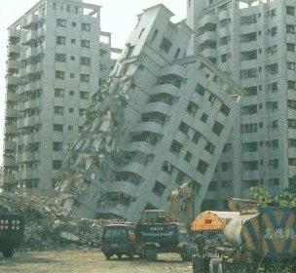
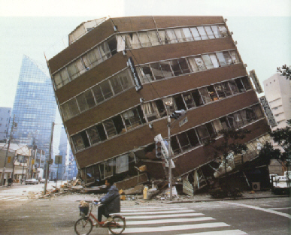
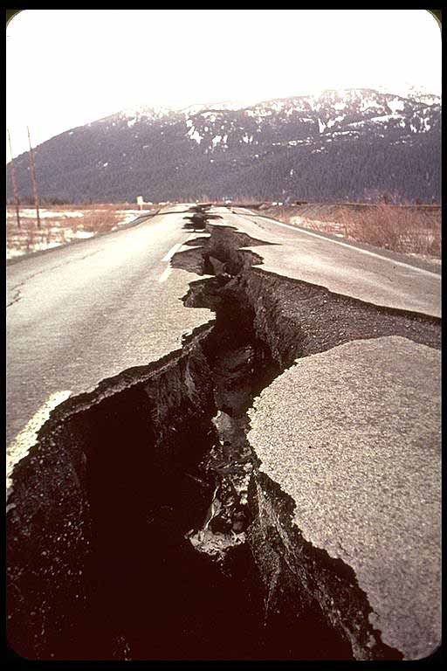
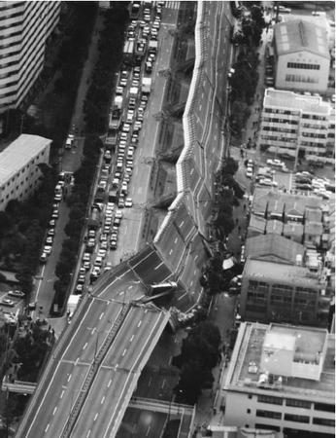
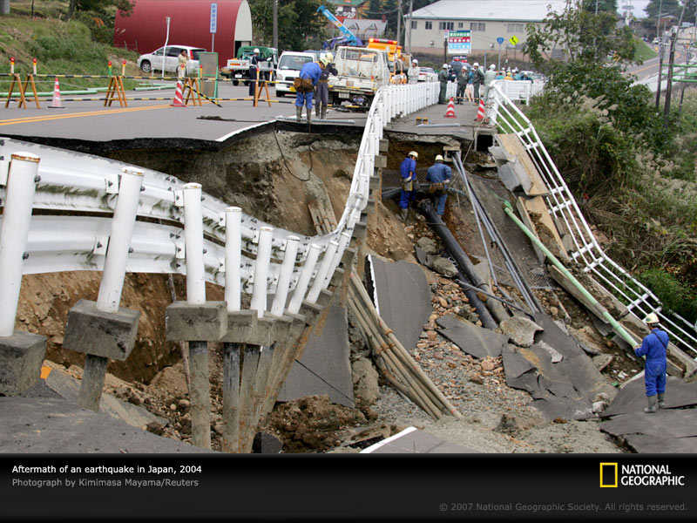
Earthquakes

Slide 2

How do scientists measure Earthquakes?
An Earthquake is:
a sudden movement called a tremor in the Earth’s Crust.
It is caused by the release of pressure which causes shock (or seismic ) waves
We are going to investigate :
how scientists measure these seismic waves.
How scientists make sense of the results they obtain
How do scientists locate where an Earthquake is coming from (its epicentre).
How scientists can work out which way a tectonic plate is moving.

Slide 3
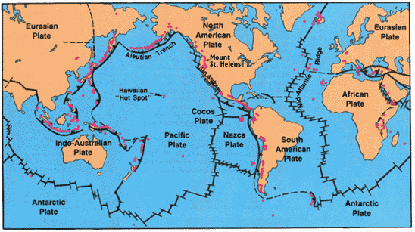
Where Do Earthquakes occur?

Slide 4

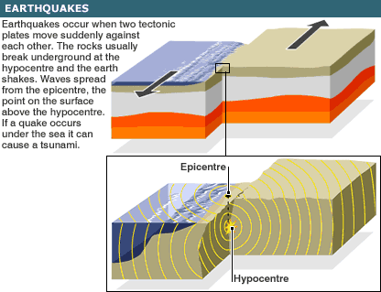
What causes Earthquakes?
We have a model to show you how these Tectonic plates move- it’s a bit like huge glaciers floating around each other in a very crowded sea.
As two plates slide against each other it is not a smooth action- they push against each other then suddenly slip. This causes shock waves like a drop of water falling into a puddle.
Tectonic plates slide past each other – this is not smooth
Shock waves
Radiate like rings in a puddle becoming less strong as they get further away

Slide 5
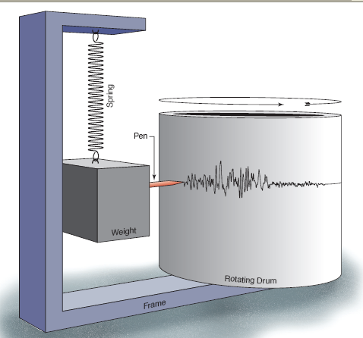
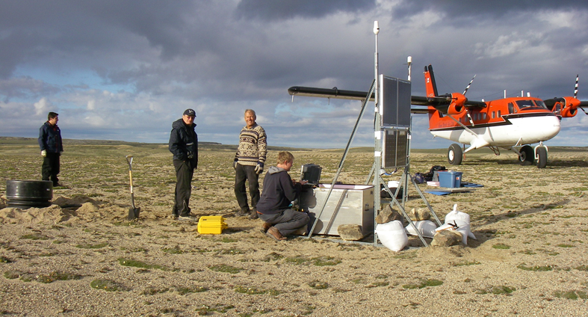
How do we measure Earthquakes?
Seismometers ( or seismographs) rely on inertia of a large weight- in the picture this weight is suspended by a spring. As the ground moves due to the Earthquake so the drum moves in relation to the weight (and the pencil attached to it). The spring amplifies the movement so that it can be recorded on the chart attached to the revolving drum. The chart is called a seismogram

Slide 6
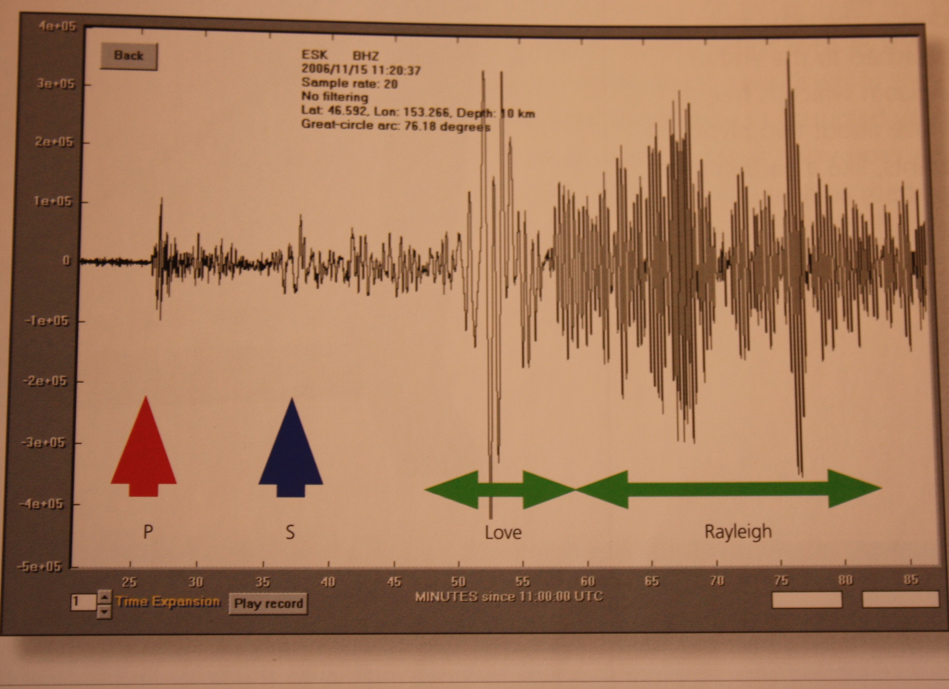
Interpreting the seismogram

Slide 7
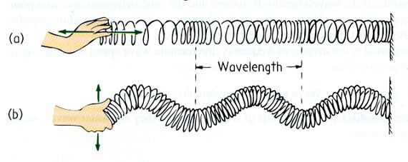
The main types of waves produced by an Earthquake
Lets use a slinky to show you what they are like……
These two types of wave move at different speeds.
Use your slinkies to decide which wave moves the fastest.
Longitudinal or P wave
Transverse or S wave

Slide 8
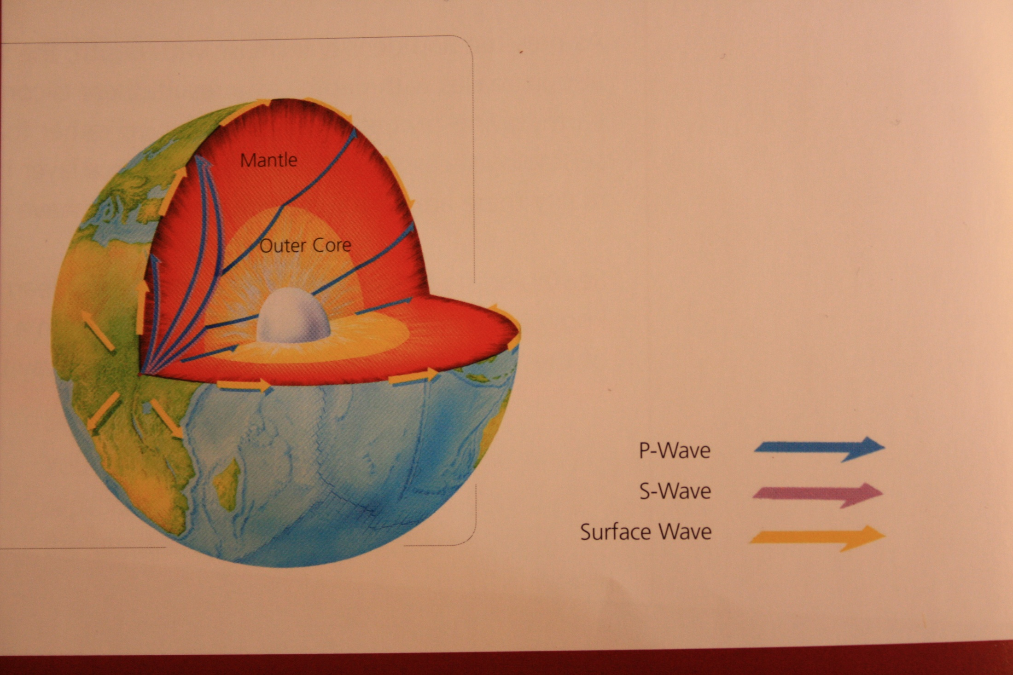
How seismic waves travel around and through the Earth.
P waves are the only seismic waves that can travel through the liquid outer core. They are the fastest waves
S waves travel through the mantle and Earth’s crust. They are slower than P waves and cannot travel through fluids
Surface waves are slower than P and S waves.

Slide 9
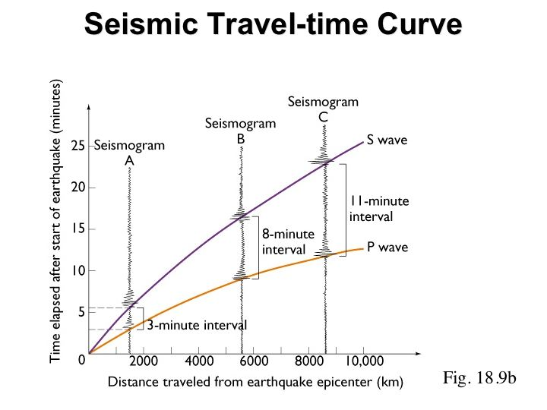
Locating the centre of an Earthquake.
Scientists use the fact that P and S waves move at different speeds to help them to determine where an Earthquake is coming from.
They have theoretical models of travel times for different types of waves.
P wave
S Wave

Slide 10
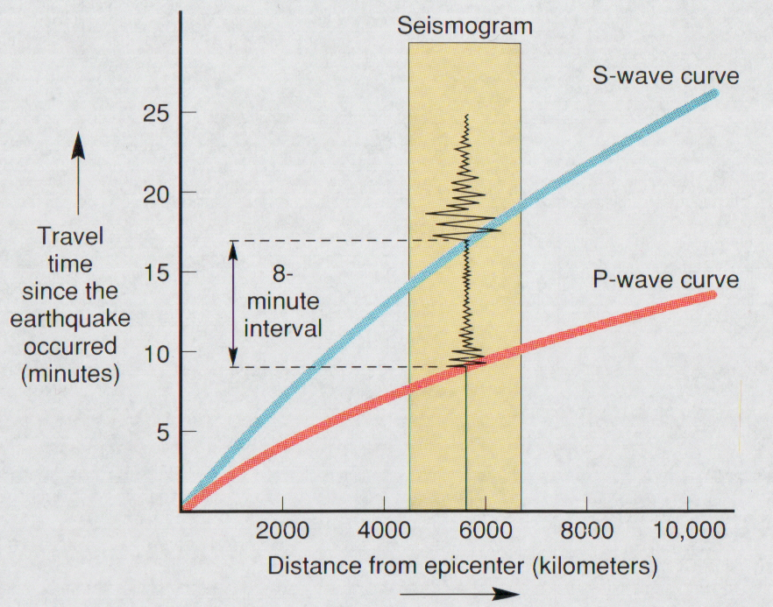
The Seismogram is then placed on the Travel-time curve. Looking down to the x axis gives the distance between the Earthquake and the Station. What is the distance for this seismogram?

Slide 11
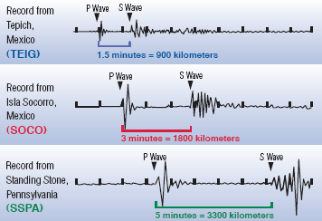
Locating an Earthquake
The time interval between P and S wave needs to be measured at 3 or more different stations
Station 1
Station 2
Station 3
Notes:
The mathematicians amongst you will enjoy this. There are 2 kinds of waves produced by an Earthquake. These are P waves (longitudinal) and S waves (transverse). Using Slinkies we can make these different waves- use volunteers to demonstrate.
P waves travel faster than S waves so they reach the seismometers first.
In this example 3 seismometers have recorded the shockwaves from an Earthquake. The shockwaves take different times to reach each seismometer according to the distance the waves have had to travel.

Slide 12
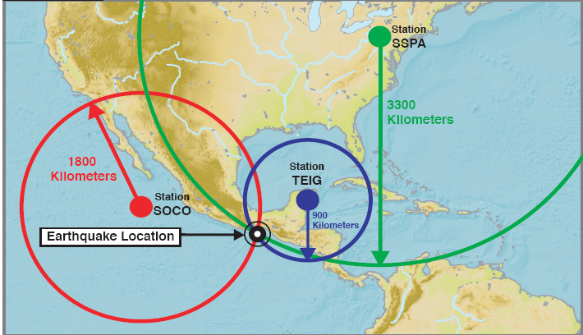
Locating an Earthquake
Second thing to do: Make circles of radius distance from shock wave
Where they intersect is the centre of the Earthquake
station3
Station 1
Station 2

Slide 13
Activity
Working in groups of 4.
We would like you to use some seismograms to work out how far away
the Earthquake epicentre is from your Station.
We will then combine this information to work out where the epicentre is.

Slide 14
In which direction is the Plate moving?
Using the box and slinkies I’d like you to do an investigation.
The box represents a Tectonic Plate and the slinkies represent the seismic waves.
Make sure you hold the slinkies so that they are the same length and the coils are evenly spaced.
what happens when you hit the box? Look carefully at the slinkies.
Hit the box

Slide 15
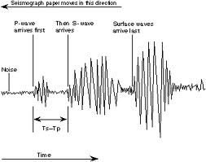
In which direction is the Plate moving ?
What did you notice?
What you have seen is a compression pulse and an expansion pulse.
Compression and expansion pulses show up differently on seismograms:
Look closely at the first trace does it go up or down?

Slide 16
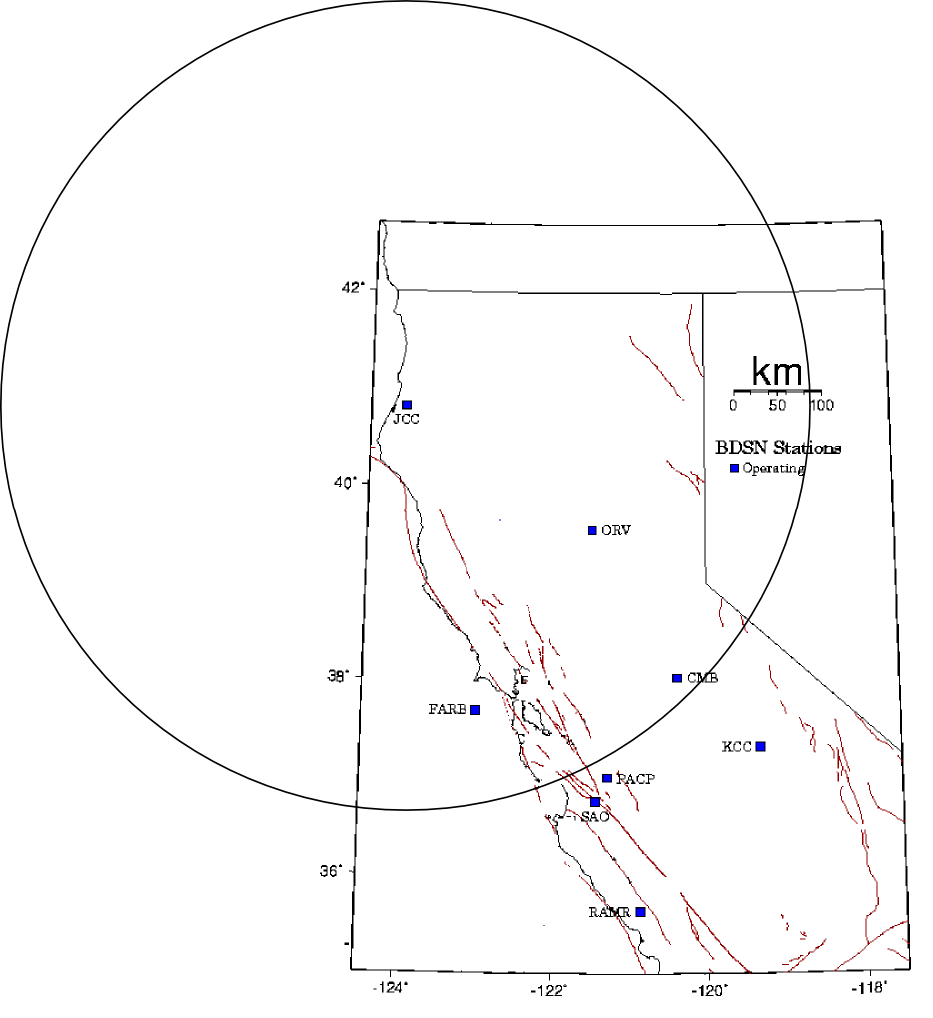
Results
JCC station should have found :
A distance of roughly 460km
and an extensional motion.

Slide 17

Results
PACP station should have found :
A distance of roughly 40km
and an extensional motion.

Slide 18
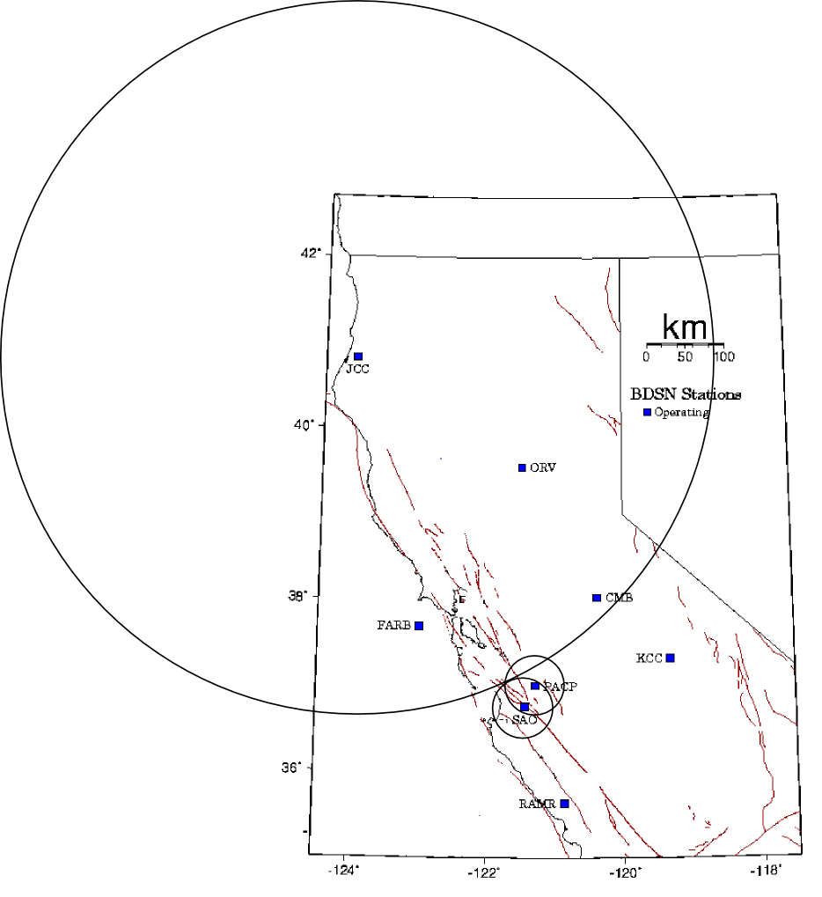
Results
SAO station should have found :
A distance of roughly 40km
and a compressive motion.

Slide 19
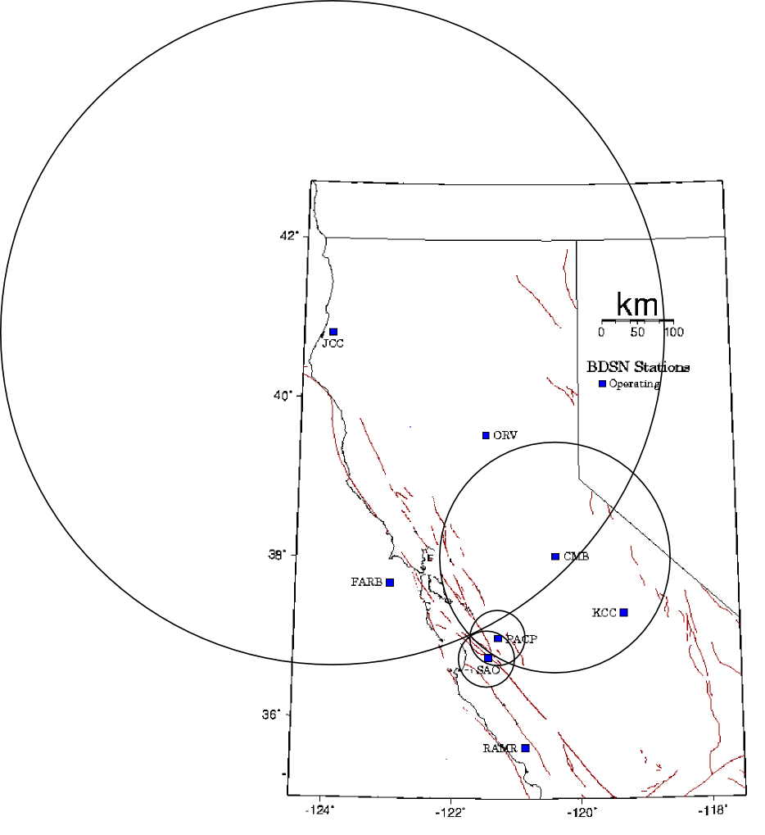
Results
CMB station should have found :
A distance of roughly 160km
and a compressive motion.

Slide 20
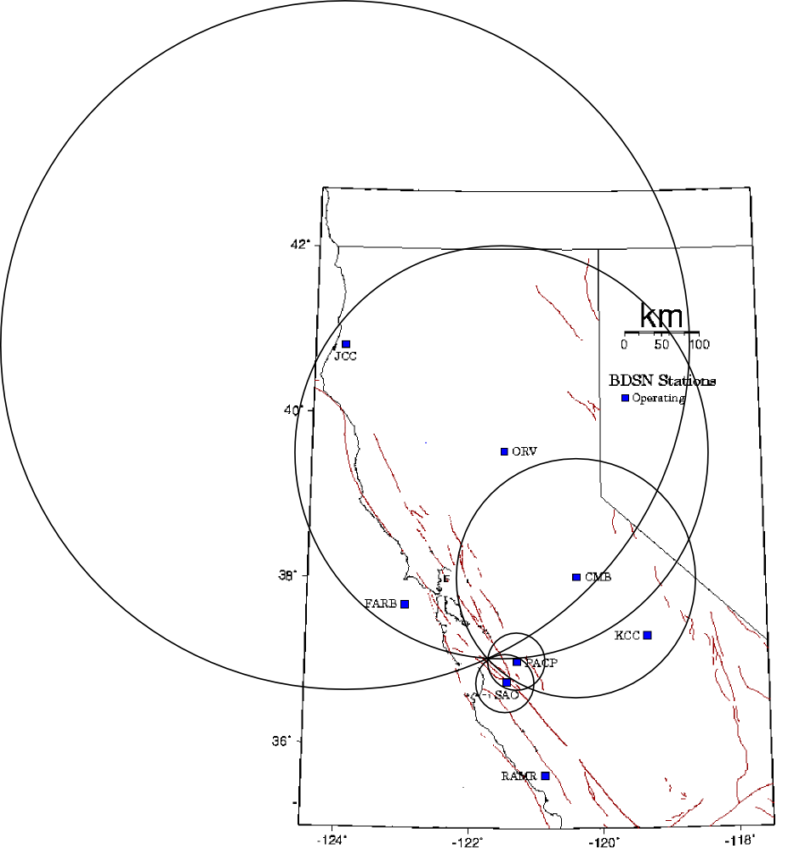
Results
ORV station should have found :
A distance of roughly 280km
and a compressive motion.

Slide 21
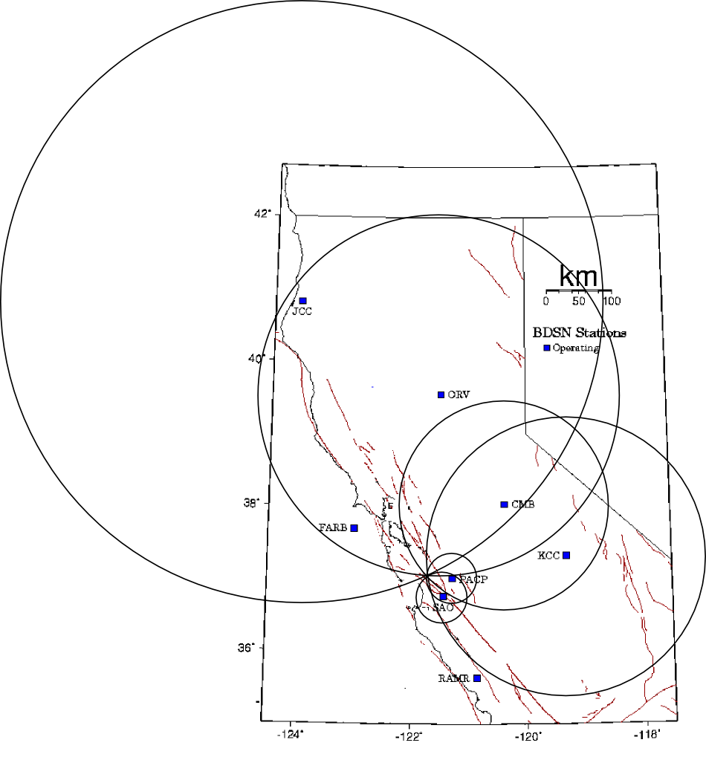
Results
KCC station should have found :
A distance of roughly 210km
and compressive motion.

Slide 22

Results
FARB station should have found :
A distance of roughly 130km
and a compressive motion.

Slide 23
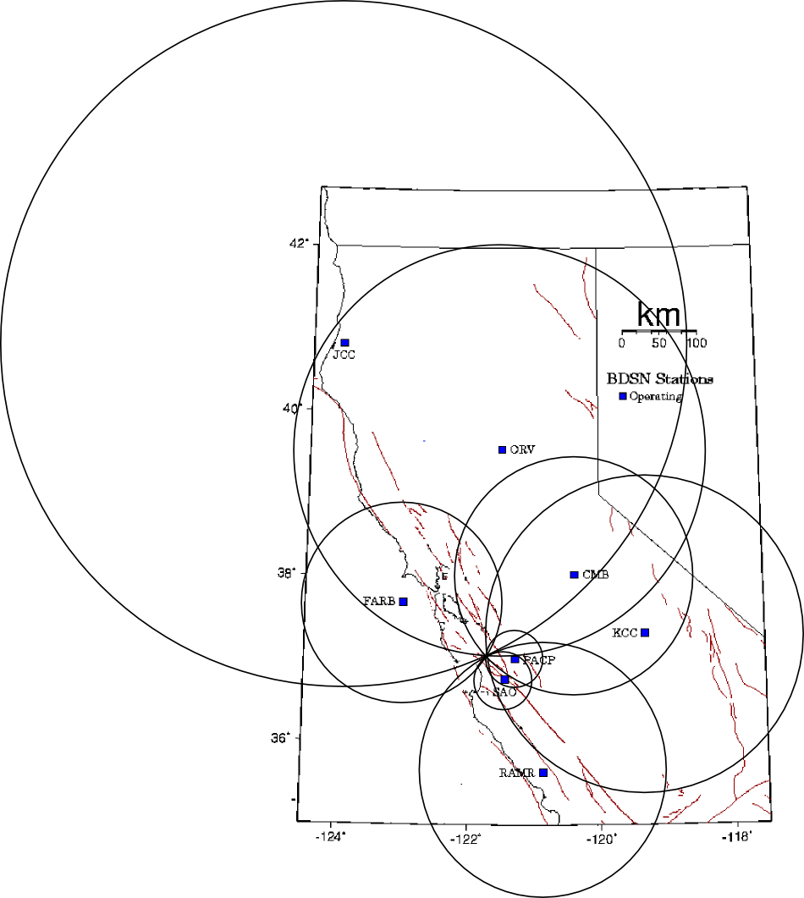
Results
RAMR station should have found :
A distance of roughly 170km
and a compressive motion.

Slide 24
Summary
So, in summary we find that motion on the
fault has caused the east block to move
Southwards and the west block to
Move Northwards. This is
consistent with the plate
movements of the region.

