Slide 1
HE STEM Employability Skills
Train the Trainers Workshop
Enhancing the Employability of STEM Student Ambassadors - resources by Enhancing the Employability of STEM Student Ambassadors project is licensed under a Creative Commons Attribution-NonCommercial-ShareAlike 3.0 Unported License
This activity was undertaken as a part of the National HE STEM Programme, via the South West Spoke. For more information on South West Spoke projects, please see www.hestem-sw.org.uk For more information on the overall national programme, please see www.hestem.ac.uk

Slide 2
Icebreakers
Why use icebreakers?

Slide 3
Icebreakers
Participants meet each other
Energises participants
Lowers inhibitions and encourages group work
Useful tool for forming groups
Encourages dialogue

Slide 4
Objectives
To give participants tips on delivering training
To provide an overview of the employability skills training
Explain to participants their role in the training
Give participants an opportunity to deliver activities
Participants are confident about delivering their parts of the training
Notes:
When gone through objectives ask why we have objectives – SpecificMeasurableAchievableRealisticTimely – linked to evaluation

Slide 5
What makes a good training session?
Knowing your audience
Having good objectives - plan
Listening to participants needs
Enabling interaction between participants
Using questions – facilitate not lecture
Anecdotes and case studies
Reflection
Feedback
Evaluation

Slide 6
Practicalities
Number of attendees
Room Layout and environment
Resources and AV
Breaks
Housekeeping

Slide 7
Employability Skills Workshop

Slide 8
Introductions
Please introduce yourself and tell us briefly:
what degree you are studying and what year
about the ambassador/work activities you have done so far
About your future job plans – PhD, industry, teaching

Slide 9
Today’s objectives
By the end of today’s session, we hope you will have:
An understanding of what employability skills are
Why they are important
What skills you already have
Ideas on how to evidence these skills in a job application or interview
Ideas about how you can increase your employability skills

Slide 10
What are Employability Skills?
‘A set of attributes, skills and knowledge that all labour market participants should possess to ensure they have the capability of being effective in the workplace – to the benefit of themselves, their employer and the wider economy.’
CBI, 2010

Slide 11
Employability Skills are
Teamwork
Business and Customer Awareness
Problem Solving and Creativity
Communication and Literacy
Application of Numeracy
IT Skills
Positive Attitude
Entrepreneurship
Notes:
Ask students to brainstorm what skills they think employability skills include
Show them the list, discuss any differences

Slide 12
Employability Skills Game
What do the trainers need to do?
Introduce the game
Encourage discussion and teamwork
Give anecdotes and pose questions
Circulate amongst groups and monitor progress
Timings

Slide 13
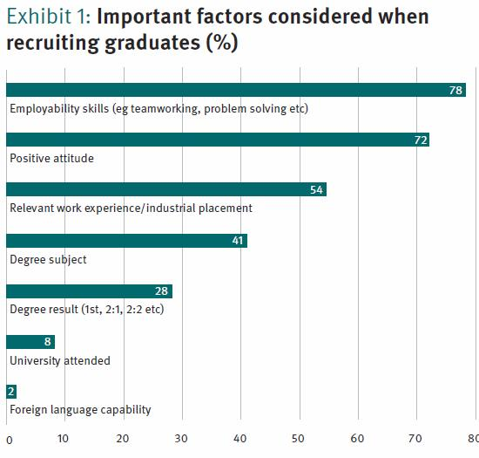
Why do you need them?
Employers look
for them
Notes:
Highlight difficult to get job in current climate, these skills even more valuable

Slide 14
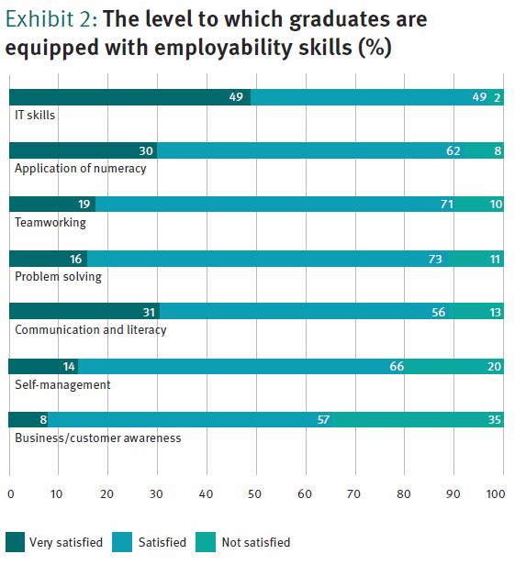
But often potential employees don’t have them
Or is it that potential employees aren’t demonstrating that they have them?

Slide 15
How do we get a job?
Search for jobs
Fill out a job application
Attend assessment centre
Interview
Reference

Slide 16
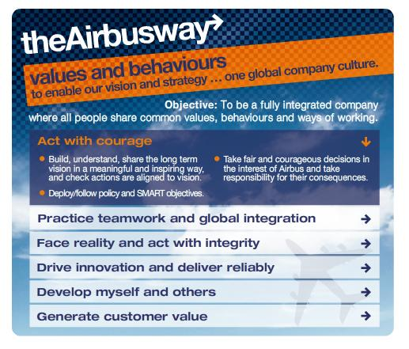
Job Applications – Airbus
Notes:
http://www.airbus.com/work/graduates/deg/how-to-apply/

Slide 17
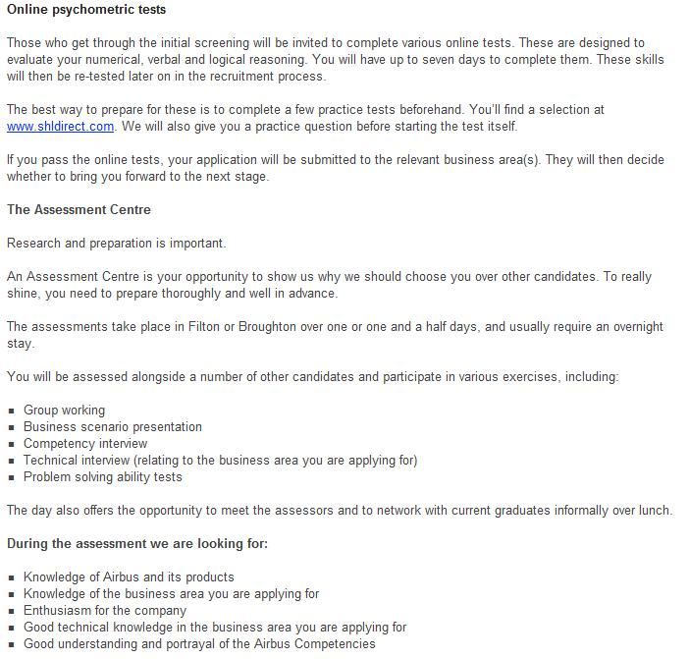
Assessment

Slide 18
Interviews
Many of the questions you’ll get asked will be about employability skills
Each pick a question from the bag
Discuss in your group the following:
What is the interviewer asking?
How would you answer?
What preparation could you do before the interview for that question?

Slide 19
Interview game
What is the objective of the game?
What is your role?
How might you improve it?

Slide 20
References
What is the employer looking for?
Who should you choose as a referee?
How can you influence a reference?
Notes:
Buzz words

Slide 21
Personal Audit of Employability Skills
Notes:
Depending on time do interview practice using examples from audit

Slide 22
How can being a student Ambassador help you acquire employability skills?
New challenge, different skills
Different audience, improve skills
Working with different people
More experience, more examples

Slide 23
Next Steps
Do more volunteering to address your skills gap
Re-analyse your skills using the audit sheet
Fill out the case study sheet
Keep a record of examples to use in job applications and interviews

