Slide 1

Supporting STEM (Science, Technology, Engineering and Maths) in HE
- Technology-enabled Employer Engagement
Dr Carolyn Morton, Associate Head of Department, Forensic, Analytical and Chemical Sciences
Dr Adrian Crew, Research Fellow, Dept of Applied Sciences
Paige Stringer and Emily Horrocks, L2 BSc Forensic Science students

Slide 2
Why?
Employability –
Awareness – employer and student
Enhancement
Issues with employer engagement
Time
Perceived benefit
Project
– streamline the process with advantages for employers and students

Slide 3

The National HE STEM Programme
Enabling the HE sector to engage with schools, enhance curricula, support graduates and develop the workforce

Slide 4

Meta-Project:
“Get STEM working: innovation with employer and student engagement”
Project Lead: Bournemouth University

Slide 5




Six Sub-Projects
University of Bath
University of Bristol
Bournemouth University
University of Exeter
Plymouth University
University of the West of England

Slide 6
Technology-enabled engagement between employer and student
“Dragons’ Den” using video conferencing between
Employers from analytical and forensic science sectors
and
Year 2 BSc Forensic Science students undertaking a module in analytical chemistry

Slide 7
Aims:
Employer contact
– expand links, enhance curriculum, potential collaborations, work experience, employment
Student experience
  increase motivation, see relevance of study, develop presentation and IT skills
Develop guidelines to facilitate adoption of similar approaches by others

Slide 8
Approach:
Recruit willing employers
Develop appropriate task for students
Compare two technologies
  Video conferencing (VCON) – Polycom system
  Online Flash Meeting

Slide 9
Student tasks
Volunteer students -10 minute presentation (PowerPoint) + 10 minute feedback/discussion
All students - short written assessment on relevance of lab techniques used with reference to the video presentations and discussion

Slide 10
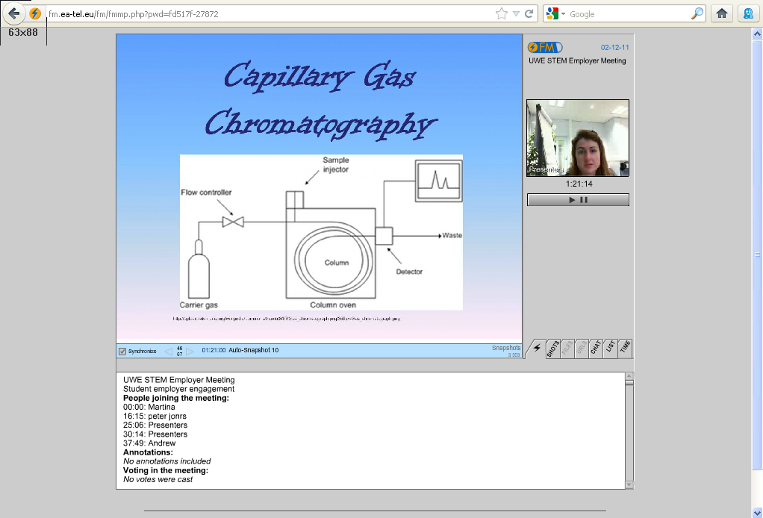
Technology 1: Online Meeting
FlashMeeting online meeting technology
Notes:
Show short video clips – students and employers talking – FM and VCON

Slide 11
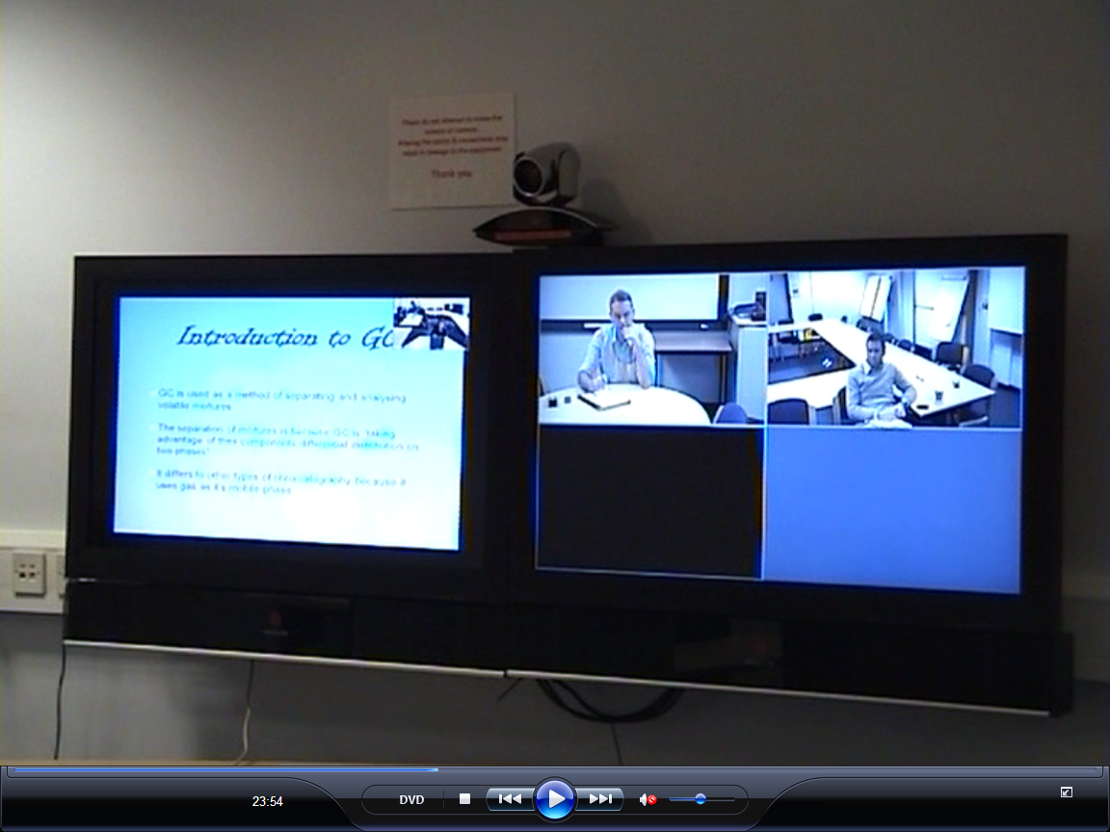
Technology 2:Videoconferencing
Polycom Videoconferencing (VCON) system

Slide 12
Student view
Paige Stringer
Emily Horrocks

Slide 13
Results (i): Presenting Students
Held a positive view of initiative:
Experience
    – presentation skills
    – technology
    – communication with experts
Confirmation of quality of learning by experts
    – building confidence in skillset
    – affirmation of relevance of skills to employers

Slide 14
Results (ii): Non-participating students
Initially held negative view of initiative:
“Additional” assessment
Outside of comfort zone
Perceived potential reduction in grades
  In fact, average grade was identical for both practical write-up and presentation-based assessment = 61%

Slide 15
Results (iii): Employer Reaction
Can this provide an early indication of potential employees?
Demonstrate potential strengths in:
- Communication skills
- Interest in the subject
- High academic standard

Slide 16
Employer Reaction (contd)
Improved awareness and recognition of skills acquired by students
Future potential collaboration opportunities with individual students?
Process initiated employer interest in course content and student learning
Potential benefit to ALL students on the BSc Forensic Science course

Slide 17
Conclusions from project
Both technologies are fit-for-purpose
VCON is the technology of choice
Presentations proved the ability of the students involved
Employers viewed the technology as a very important tool
Presenters may gain significant advantages
All students on the IAS course may improve from the presentations.

Slide 18
Is this relevant?
How straightforward is the technology?
Relevance?
- module perceived as difficult but useful for employability skills (specific or generic)
- employers who would be interested to learn what skills our students develop or talent-spot

Slide 19
How straightforward is the technology?
UWE has invested in superb VCON facilities
- employers without VCON can phone in
free and easy to use (need practice session)
easily booked and technical support available
Flash Meeting needs the organiser to register via OU (initially)
All participants sent url link
So – quite straightforward

Slide 20
If you are interested in having a go or discussing any of this please e-mail either of us
Carolyn.Morton@uwe.ac.uk
Adrian.Crew@uwe.ac.uk
Any questions?

