Slide 1

Customer Relationship Management Systems
Cerian Ayres, Head of Quality Petroc
LSIS South West STEM Advisor

Slide 2
Dedicated team of staff (Directorate of Employers) responsible for the implementation and achievement of our employer engagement strategy.
Share the practice of this team amongst other teams within the organisation.
Share organisational best practice with colleagues from HEIs’ and colleagues within the FE and Skills Sector within the South West region as Petroc is the LSIS South West Regional STEM Centre.

Slide 3
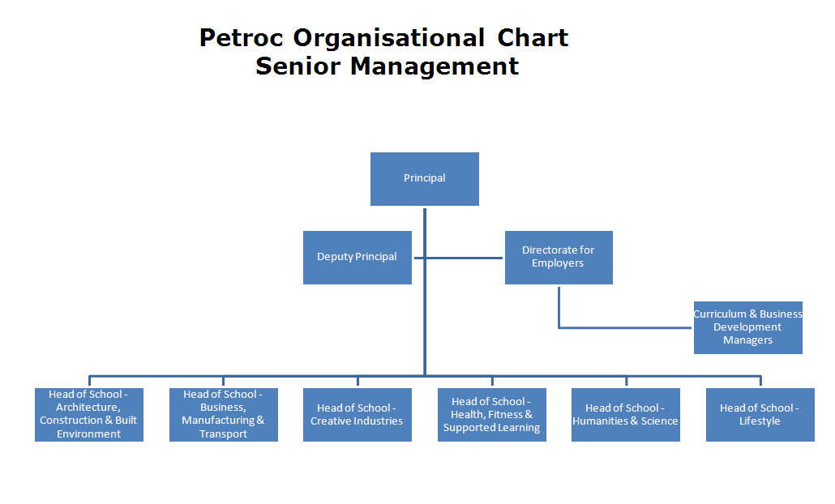

Slide 4
To further develop the dedicated employer interface:-CRM (Customer Relationship Management resource) so that our systems operations are flexible and responsive to the needs of business.
To use the CRM to review the extent and nature of STEM industry employer engagement in terms of Engineering.
Develop an Organisational Needs Analysis resource that will be of use to colleagues directly involved with employer engagement.
Develop our ability as an organisation to provide information, advice and guidance for employers
Develop the ability of staff within the organisation to support employers.
Develop a number of on line resources to enable staff to undertake CPD flexibly that addresses effective employer engagement:-CRM Guide, Case Studies of effective practice, ONA Guide.

Slide 5
PETROC
Petroc was the only partner that had a fully functioning CRM system operating across the organisation upon starting the project.
System - designed in-house 5 years ago - linked to the College’s learner records.
The system tracks an ‘engagement’ from the point of enquiry to enrolment and automatically generates emails requesting action from relevant personnel.
Checks whether an enquiry has been responded to within the 48 hour threshold expected by the Senior Management Team.

Slide 6
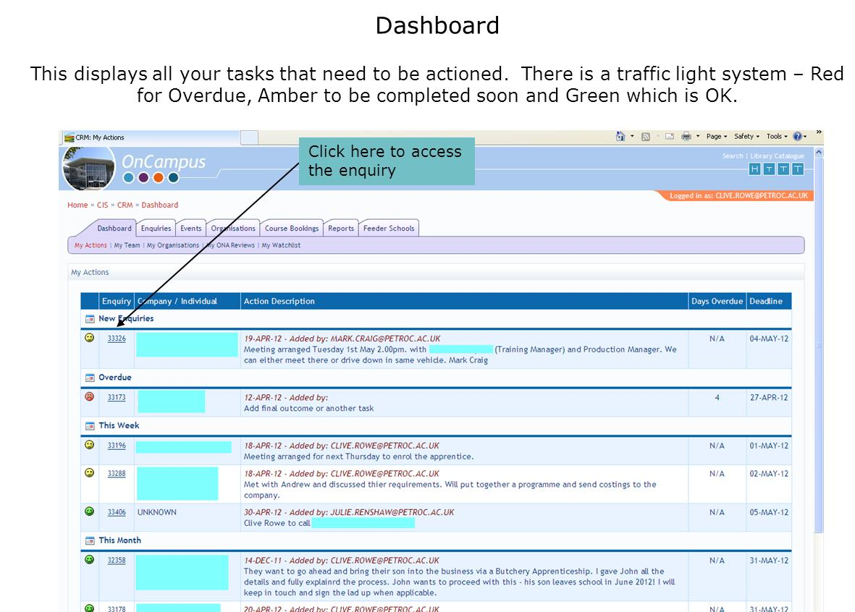

Slide 7
It also:
provides a sole point of entry for any employer enquiry;
ensures that the enquiry reaches the correct person for resolution;
tracks, records and monitors all enquiries; and
provides a vehicle for multiple strand enquiries.

Slide 8
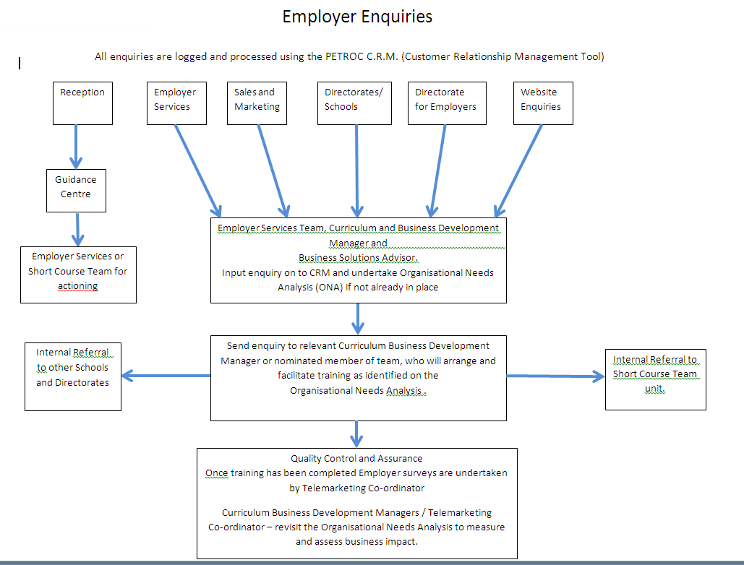

Slide 9
The system is well integrated into the management and operations of Petroc College’s dedicated employer-facing directorate but was used less often by staff working outside this department.
Petroc therefore used this project to review the current system and extend its use, particularly within the School of Business, Manufacturing and Transport

Slide 10
14-16 Co-ordinator and Deputy Additional Learning Support Manager that describes how the CRM system is used:
“The CRM [system] is an important tool that: improves effectiveness for users; acts as a conduit for knowledge transfer; enables staff to be more informed and prepared for communicating with employers and schools; enables staff to be aware of the current relationship; and shows partners what we can do with the organisation and can assist with the flow of information”

Slide 11
The research resulted in modifications to the system to improve its operation. More specifically, this included additional tabs and more functionality in relation to STEM employers.
Reporting functions, including the ability to filter the results for STEM-related employers.
CPD guidance describing the functionality of the system and ‘step by step’ instructions on how to use it. This incorporates a word document, a short film and PowerPoint presentation slides. (Petroc, 2012)
An enhanced CRM system with increased functionality.

Slide 12


Rex Witts – Weymouth College
Responding to a community’s employment needs

Slide 13
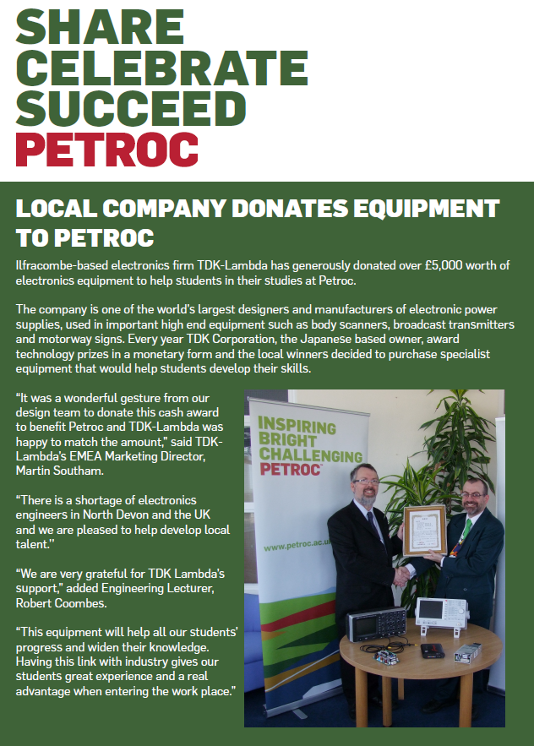


Robert Coombes – Petroc
Working with Industry
Robin Jeffery – TDK Lambda
How universities should work with industry

Slide 14
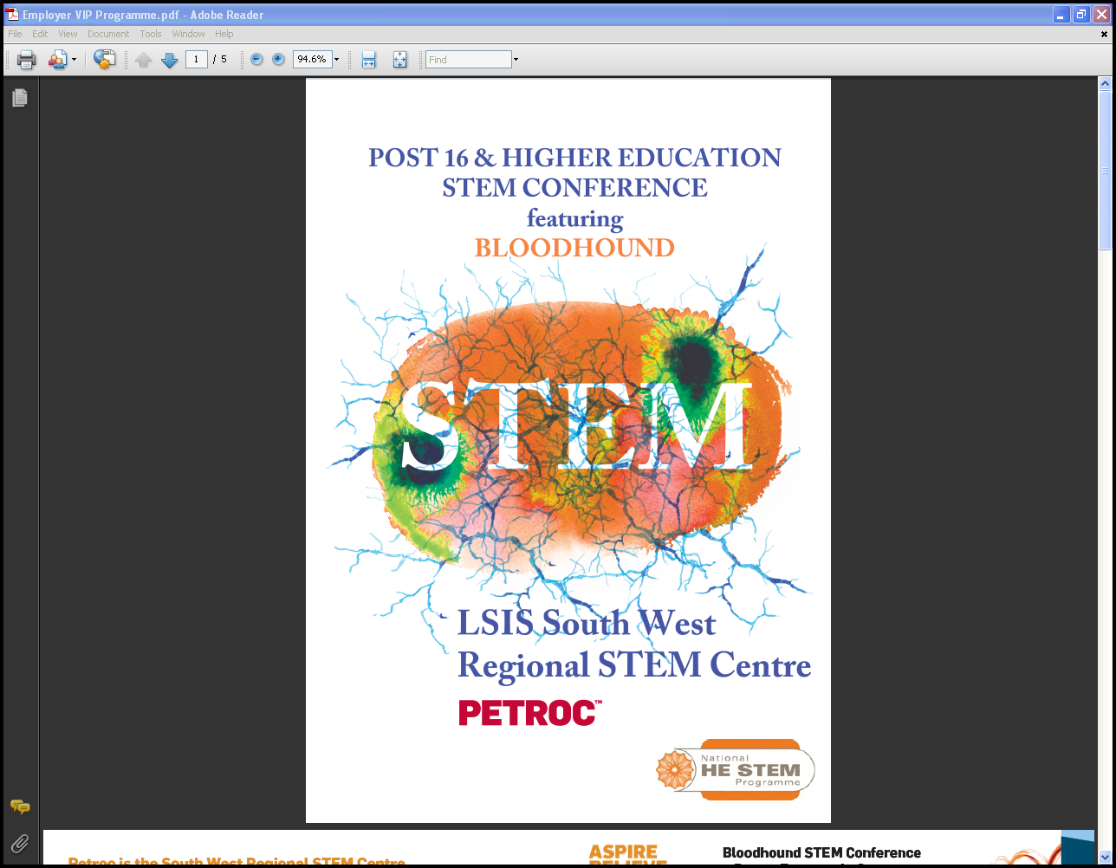
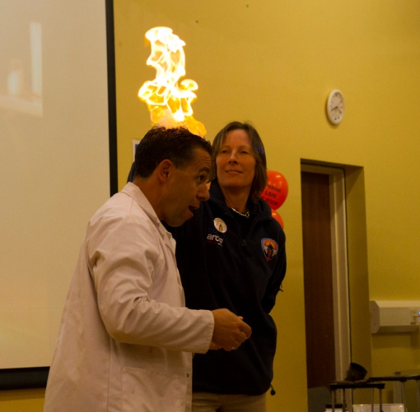
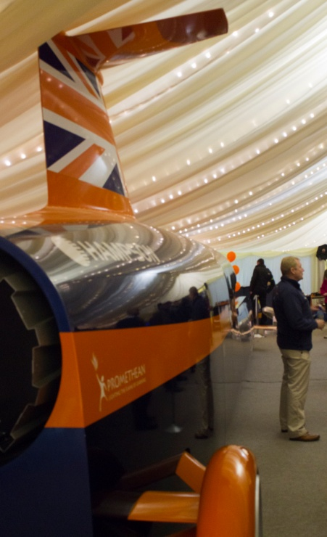
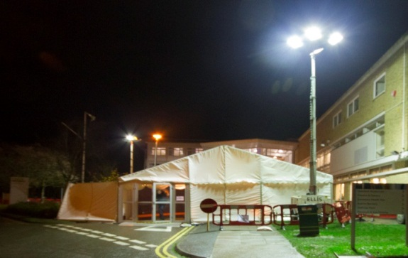
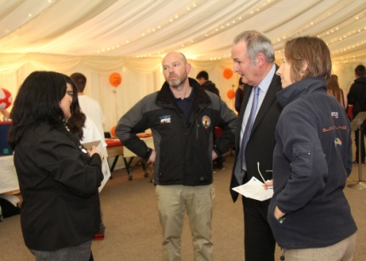

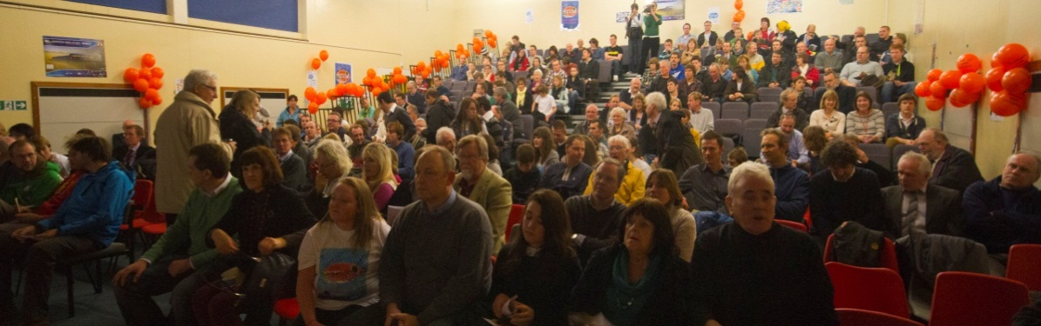

Slide 15
At Petroc we have made effective employer engagement a strategic priority. We are constantly modifying our Customer Relationship Management system to allow us to improve our effectiveness and organisational efficiency. We have been judged by Ofsted as having outstanding partnerships (March 2012)with employers and as Principal I hope to sustain and build upon our current practices, building capacity to improve by embedding throughout the organisation an innovative approach to relationship management.
David Dodd
Principal

Slide 16

Chris Evans – University of Exeter
‘People are beginning to share their perspectives
on employer engagement’

Slide 17
Customer Relationship Management Systems
Cerian Ayres, Head of Quality Petroc
LSIS South West STEM Advisor

